Slide 1
Michigan Arthroplasty Registry Collaborative Quality Initiative
Summary slide deck
3rd 2024 MARCQI Collaborative-wide meeting
September 27, 2024

Slide 2

Disclosure
MARCQI is funded via the Value Partnerships initiative by Blue Cross Blue Shield of Michigan.

Slide 3
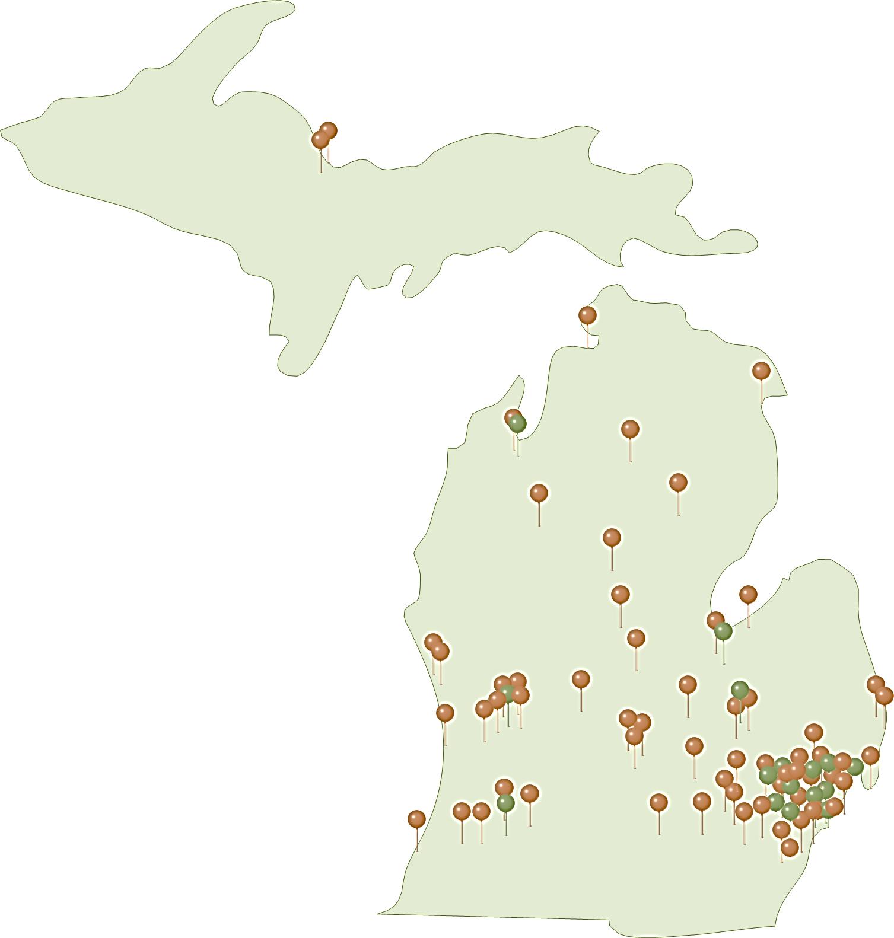
Vital statistics
MARCQI Participants
61 Hospitals
13 Affiliate hospitals
19 Outpatient surgical centers (HOPD/ASC)
360+ Orthopaedic surgeons (active)
2 Patient advocates
Data collection (August 2024)
>523,147 Hip & Knee registered cases
  ~63% Knee
49% cases with pre- & post-Op PROS

Slide 4
MARCQI goal: 90%
MARCQI average: 84%
90-Day PreOp PROs completion rate (Primary case only)
Surgery dates 03.01.2023 – 02.29.2024

Slide 5
MARCQI goal: 70%
MARCQI average: 66%
90-Day PreOp & 2-16 week PostOp PROs completion rate (Primary case only)
Surgery dates 03.01.2023 – 02.29.2024

Slide 6
MARCQI goal: 50%
MARCQI average: 29%
90-Day PreOp & 300-425 day PostOp PROs completion rate (Primary case only)
Surgery dates 06.01.2022 – 05.31.2023

Slide 7
MARCQI average: 92%
MARCQI goal: 90%
% Primary Knee Opioid
Naïve patients < 320 OME
Surgery dates 03.06.2023 – 03.05.2024

Slide 8
MARCQI average: 87%
MARCQI goal: 85%
% Primary Hip Opioid
Naïve patients < 240 OME
Surgery dates 03.06.2023 – 03.05.2024

Slide 9
MARCQI goal: 6.03%
MARCQI average: 6.37%
% of Primary Knee cases with a 30-Day ED visit
Surgery dates 03.01.2023 – 02.29.2024

Slide 10
MARCQI goal: 5.31%
MARCQI average: 5.70%
% of Primary Hip cases (Excluding conversions)
with a 30-Day ED visit
Surgery dates 03.01.2023 – 02.29.2024

Slide 11
MARCQI average: 0.82%
MARCQI goal: 1.05%
% of Primary Hip cases (Excluding conversion) with a 90-day PostOp fracture
Surgery dates 03.01.2023 – 02.29.2024

Slide 12
% of Primary Hip cases (Excluding conversion) with a 90-Day PostOp fracture
Surgery dates 03.06.2023 – 03.05.2024
% of Primary Hip cases (Excluding conversion) with a
90-Day PostOp fracture
MARCQI goal: 1.05%
MARCQI average: 0.82%
MARCQI Surgeons

Slide 13
Agenda
Optimization & appropriateness
PROs collection & clinical use
Reasons for Revisions
MARCQI: Impact
Keynote speaker takeaways
2025 Value Based Reimbursement – To do
Key takeaways & action items

Slide 14
What is optimization & appropriateness?
Optimization:
Pre-operative care aimed to improve post-operative outcomes
  Ensuring the patient is medically fit for surgery
  Anticipate & Prevent perioperative complications
  Includes Patient Education
  Contribute to the informed discussion with the patient
Appropriateness:
Who is indicated for surgery?
  Medical necessity
  Patient selection
  Evidence-based guidelines
  Ethical considerations
  Resource utilization

Slide 15
Optimization
Key areas for optimization & education:
  Smoking
  Physical activity
  Nutrition
  Alcohol use
  Cardiac disease
  DVT/VTE
  Chronic narcotic use
  Obstructive sleep apnea
  Diabetes
  Health disparities

Slide 16
Health Equity
Inequality – Unequal access to opportunities
Equality – Evenly distributed tools & assistance
Equity – Custom tools that identify & address inequalities
  Ensuring access to high quality health care for all people
  Shared decision making to ensure equitable patient-based care
Justice – Fixing the system to allow equal access to both tools & opportunities

Slide 17
Health Equity & Optimization
Identifying opportunities for optimization of all patients
Understanding barriers
  Race, ethnicity, sexual orientation, gender identity, socioeconomic status, geography, preferred language
Access to Care
  Transportation to appointments
  Access to prescriptions, medications, nutrition
  Health literacy

Slide 18
MARCQI optimization & appropriateness
Streamlining demographic collection
  Improve analysis to find disparities in care/revision rates
Improving PROs access → Single page form, language translations, email form updates
  Improved patient & CDA access for increased PROs completion
  Increased completion = improve analysis of outcomes-based PROs and patient variables (insurance, sex, diabetes, smoking, etc.)
  Understanding pre-op PROMs scores & predictors of post-op outcome scores
Reducing ED visits
  Analysis on optimization factors, education & impact on post-operative ED visits
  Collaborative quality work shared
  Multifactorial, social determinants of health may be involved

Slide 19
Common challenges + Available Resources
Limited access to social support at home
Access to clinics due to location
Standardizing pre-operative testing, education and resources while supporting patient-centered care
Encourage use of 211 (text or call) confidential service that connects people to local community social services and resources
Bundle optimization appts together (H&P, labs, EKG, SA screening, etc.) with joint education class
Surgeon workshops
  Future: work towards agreement on best practices

Slide 20
Agenda
Optimization & appropriateness
PROs collection & clinical use
Reasons for Revisions
MARCQI: Impact
Keynote speaker takeaways
2025 Value Based Reimbursement – To do
Key takeaways & action items

Slide 21
Collecting PROMs is Hard at First
Developing system takes effort
Takes time
Costs money
Once you have a system in place PROMs can be helpful and rewarding

Slide 22
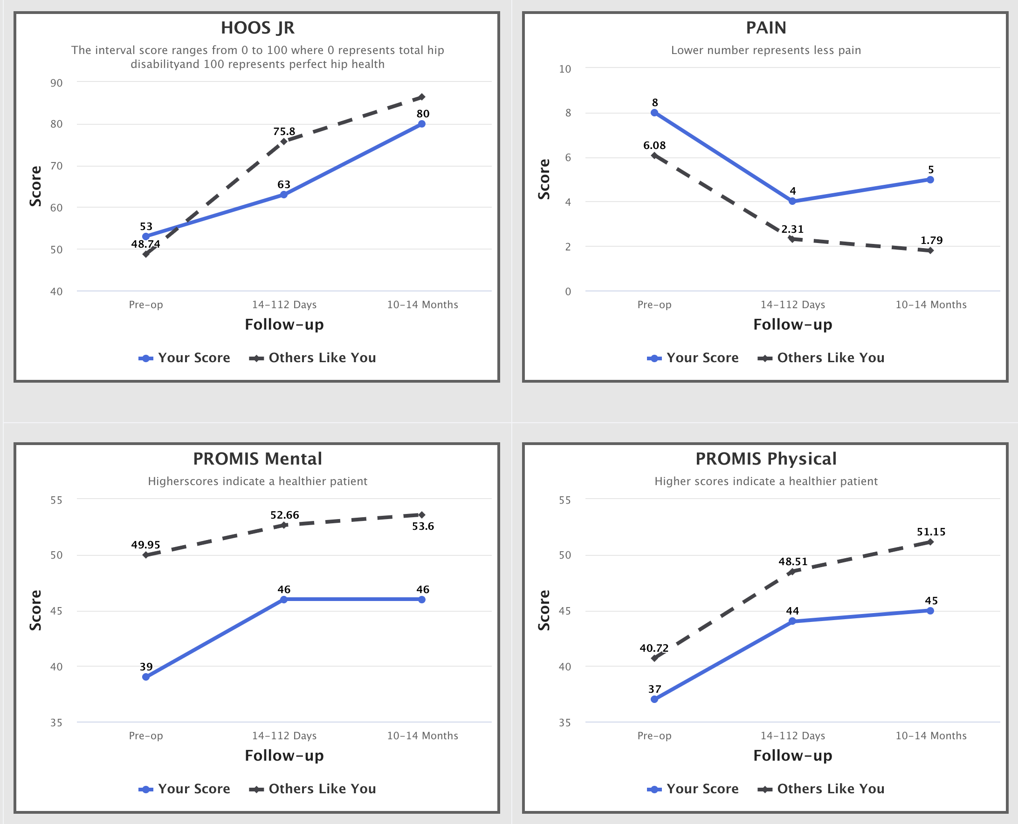
PROMs Trend Reports are now available
Shows patient progress over time
Gives comparison to patients of similar age and sex
Offer reassurance
Provide a pat on the back
See declines in function
Maybe predict revision

Slide 23
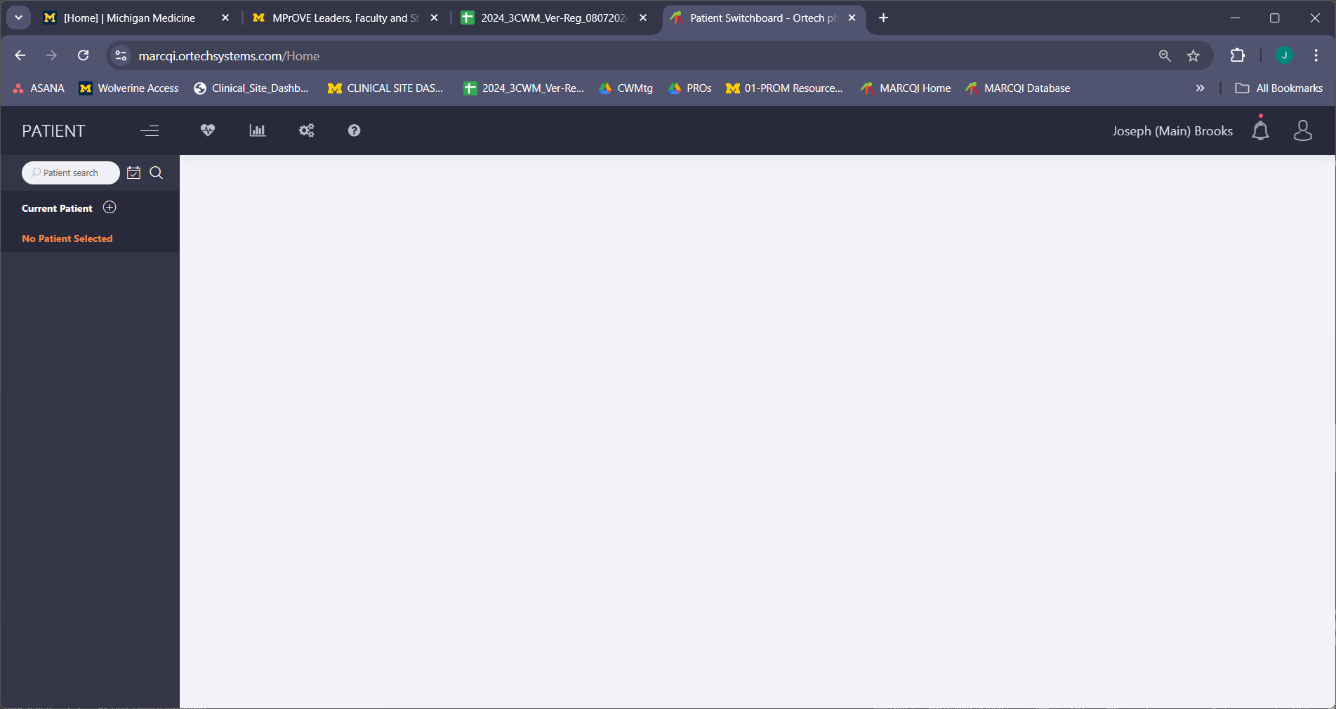
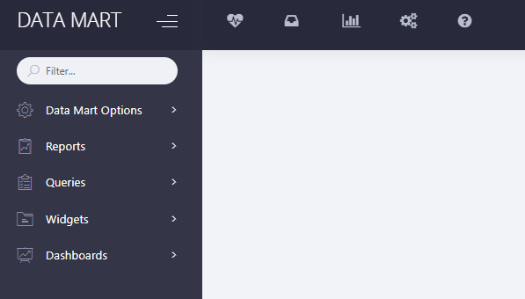

Accessing the Patient Trend Report

Slide 24
Accessing the Patient Trend Report

Slide 25

Accessing the Patient Trend Report

Slide 26
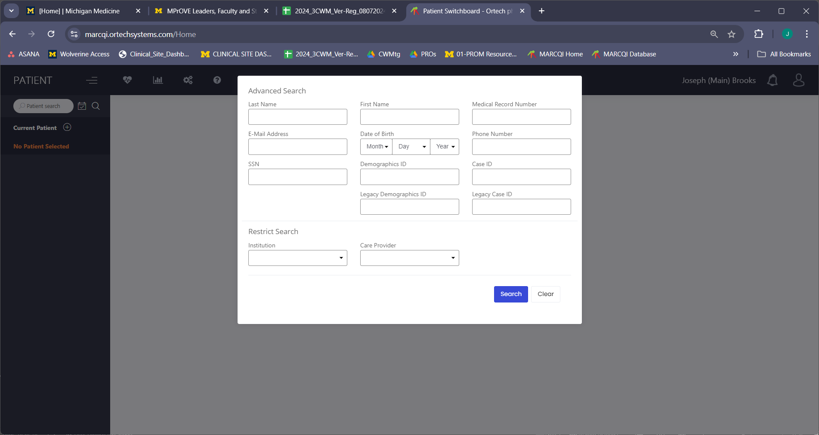
Accessing the Patient Trend Report

Slide 27
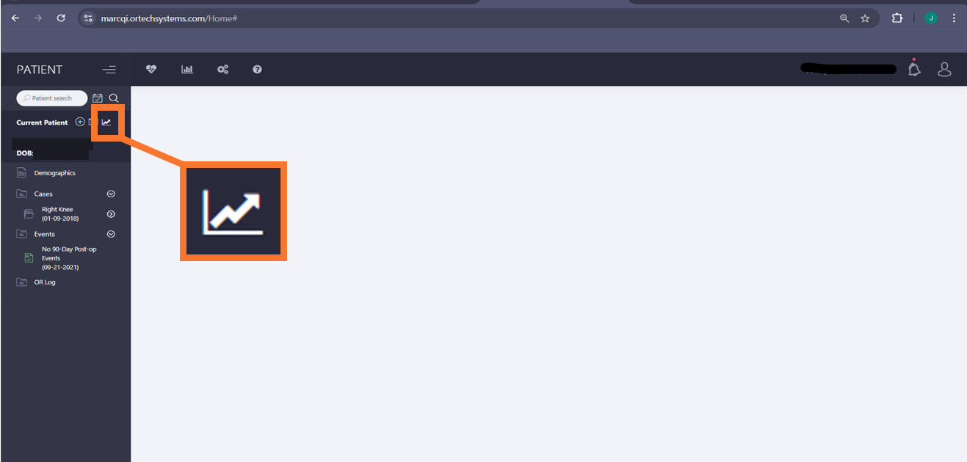
Accessing the Patient Trend Report

Slide 28
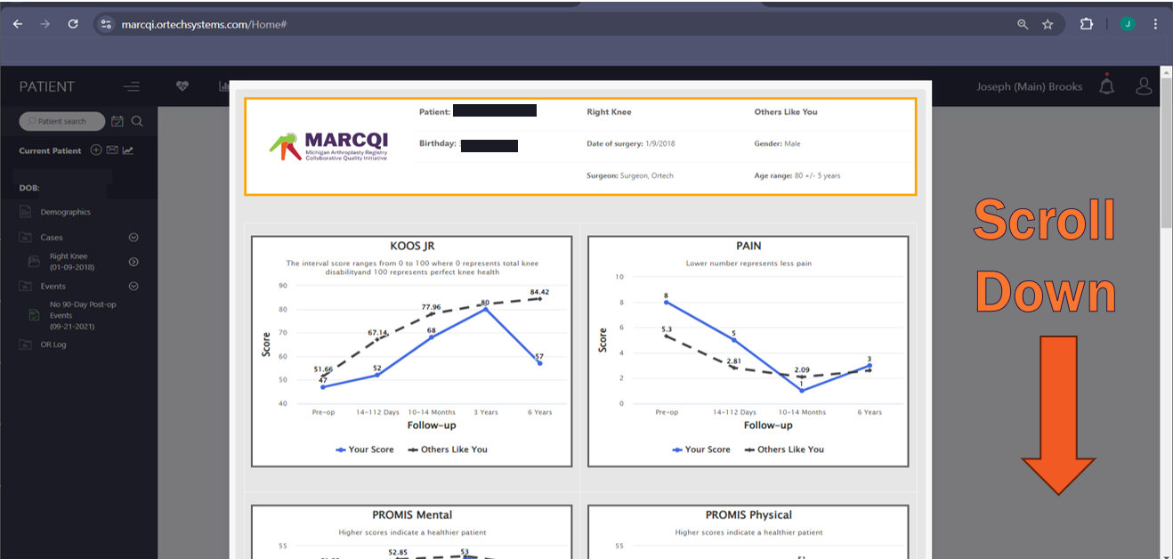
Accessing the Patient Trend Report

Slide 29
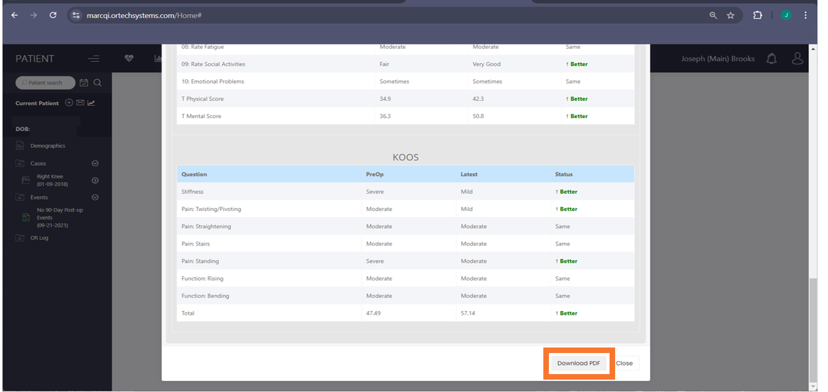
Accessing the Patient Trend Report

Slide 30
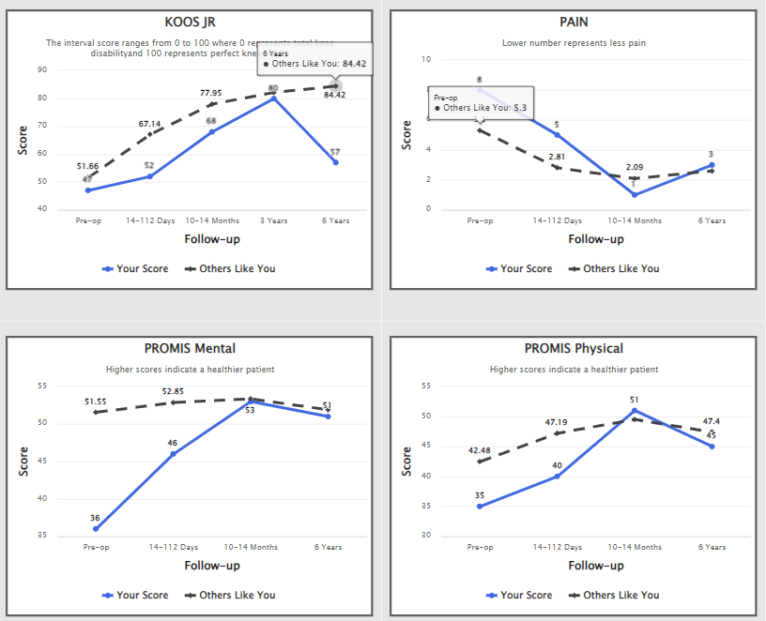
Accessing the Patient Trend Report

Slide 31
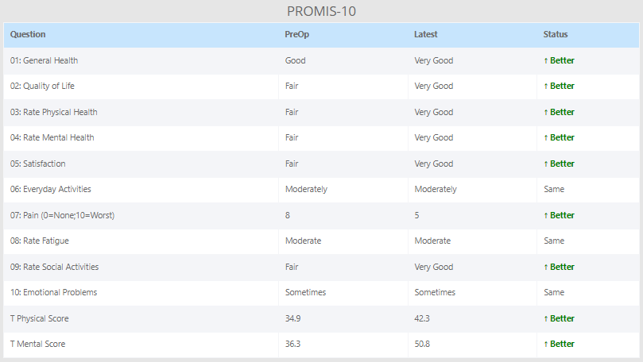
Accessing the Patient Trend Report

Slide 32
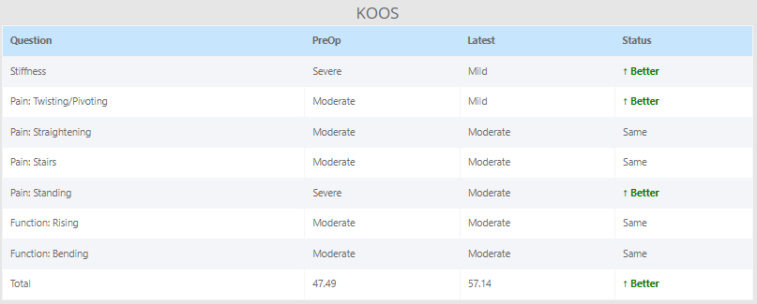
Accessing the Patient Trend Report

Slide 33
Agenda
Optimization & appropriateness
PROs collection & clinical use
Reasons for Revisions
MARCQI: Impact
Keynote speaker takeaways
2025 Value Based Reimbursement – To do
Key takeaways & action items

Slide 34
Data Background
11,845 MARCQI primary cases were revised
  86.9% revised once
  10.6% revised twice
  1.9% revised three times
  0.6% revised more than 3x
  2 cases had 9 revisions
11,845 Primaries Revised in MARCQI

Slide 35


Top 5 Reasons for Revision
Reason for Revision | Percent
Peri-prosthetic fracture - Femur | 23.7
Dislocation | 22.1
Joint Infection | 18.9
Aseptic Loosening | 18.8
Pain | 4.5
Reason for Revision | Percent
Instability | 27.8
Joint Infection | 23.7
Aseptic Loosening | 20.5
Arthrofibrosis | 7.9
Pain | 6.7

Slide 36
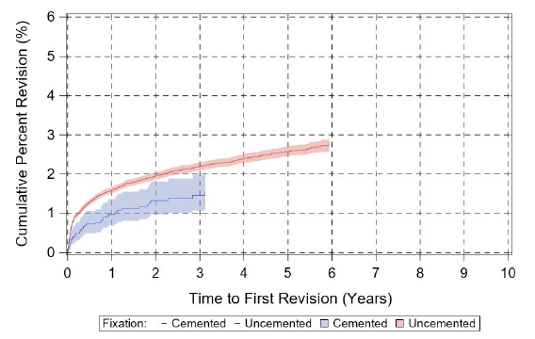
Top 5 Reasons for Hip Revision
Reason for Revision Cemented Stem | Percent | Reason for Revision Uncemented Stem | Percent
Dislocation/Instability | 34.1 | Peri-prosthetic fracture - Femur | 28.8
Joint Infection | 22.7 | Dislocation/Instability | 21.1
Aseptic Loosening | 18.2 | Joint Infection | 20.1
Peri-prosthetic fracture - Femur | 15.9 | Aseptic Loosening | 17.2
Implant Failure | 4.5 | Implant Failure | 4.1

Slide 37
Anterior
Anterolateral
Posterior
What if we could flatten the fracture curve?
How about the dislocation curve?

Slide 38
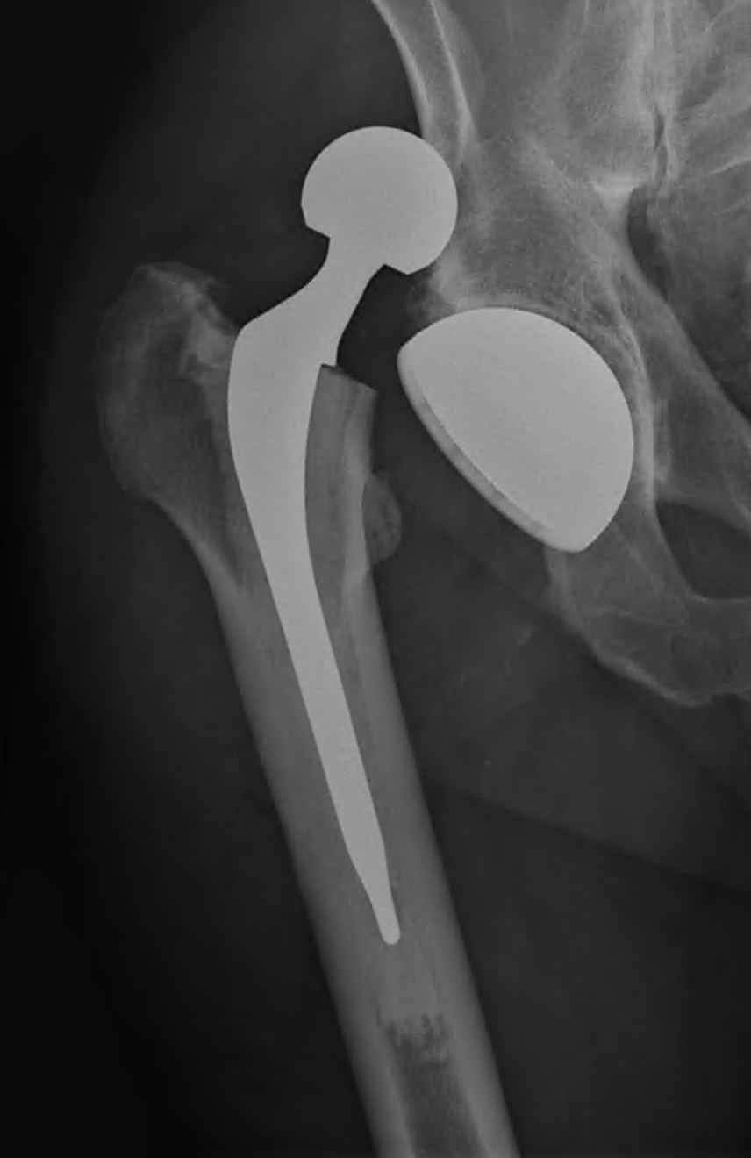
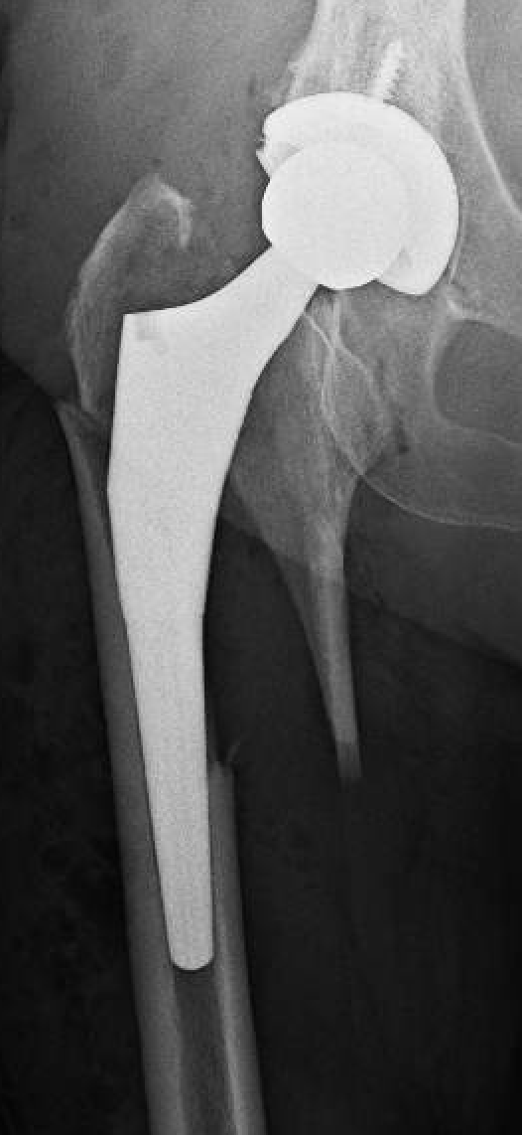
Summary and Takeaway Message
Reducing dislocation
  Approach seems to have some effect
  Some bias in patient selection
  May be trading fewer early problems for more late problems
  Dual mobility may not be the answer
  Need to investigate navigation and robotics further
Reducing fracture
  We have made some progress
  Still lots of work to do (purple curve)
  Cemented stems in older women
  Some uncemented designs look promising

Slide 39
Agenda
Optimization & appropriateness
PROs collection & clinical use
Reasons for Revisions
MARCQI: Impact
Keynote speaker takeaways
2025 Value Based Reimbursement – To do
Key takeaways & action items

Slide 40






My registry story
McLaren Greater Lansing Physician Champion:
J. Wesley Mesko, M.D.
Clinical Data Abstractors:
Faith Sunderlin, RN & Alina Vermurlen, RN
Jamie Nurenberg, RN

Slide 41
First years
Importance of keeping track of patients
Early efforts:
  Excel Spread Sheet
  Bubble Sheet with scanner
  Depuy Capture Ware
  AJRR Board
  ORTECH
“The lone ranger”

Slide 42
Starting in MARCQI
McLaren Greater Lansing (MGL) was a member of the initial collaborative
I volunteered to represent MGL and was crowned “ Champion”
I was not part of the initial leadership team
I sat in a BCBS building off HWY 96 in a room where I only knew Brian McCardle.
  I listened to Brian Hallstrom’s presentation, and thought “this is a guy I want to get to know and team up in this collaborative vision”

Slide 43
Realization
Educational programs
  Hospital wide comparisons of how quality metrics are being achieved
  System wide presentations by MI joint replacement surgeons
  National and International guest speakers – expand our horizon
  Site conversations and visits to share best practices to achieve quality goals

Slide 44
Realization
Workgroups with surgeons involving:
  Infection Prevention Workgroups
    Infection Risk Calculator
    PJI analysis
  Device Committee & Device Outlier Workgroup
    Implant specific outcomes
  Academic Quality Team (AQT)
    Multiple publications in high impact journals
  PROs
    Education & increasing collection
  Quality Metrics Workgroup
    Decrease ED visits
  Patient Education workgroup
    Pain control pathways

Slide 45
Realization
Individual surgeon reports
  Gives a yardstick of what quality is expected
  Accountability
BCBSM has gotten their investment back multiple times
Advertising with data is prohibited

Slide 46
Personal experience
Collegiality
  Getting to know colleagues (conversation, sharing data, site visits, committee work)
  Not “Me vs. You”, but how can we help each other in delivering the best quality over multiple areas of how we care for our patients
How is quality defined
  An equal if not improved pathway vs. the IRB & Meta analysis studies
Successes in quality improvement
  SAR/SNF placements
  DVT prevent with Aspirin
  Opioid prescribing patterns & decrease OME
  Decreased 90-day femur periprosthetic fractures
  Implant track records to help decision making
I believe no other part of my CME activity has prodded me in delivering improved quality of care more than MARCQI

Slide 47
Agenda
Optimization & appropriateness
PROs collection & clinical use
Reasons for Revisions
MARCQI: Impact
Keynote speaker takeaways
2025 Value Based Reimbursement – To do
Key takeaways & action items
Notes:
Review agenda

Slide 48

Health Equity Data for Quality
Improvement in Arthroplasty Care
Keynote speaker –
Renu Tipirneni, MD, MSc
Co-Director of Michigan Social Health Interventions to Eliminate Disparities (MSHIELD)

Slide 49

Routine sociodemographic data collection
= key foundation
Starting with basic stratification of the data by race/ethnicity, socioeconomic status to understand which sub-groups are experiencing work outcomes
  Markers of social experience; need to honor patients’ self-identification
Rationale for MSHIELD’s data strategy: harmonizing approach across hospitals/practices so that these data are collected and coded similarly → enables us to identify and act on disparities to continue to move the needle on quality improvement
  Identify focus patient groups for future QI efforts
MARCQI has been a leader for the CQIs in this!

Slide 50
Considering race/ethnicity data as routine part of QI
Treat race as a social marker, for example of structural racism and discrimination
So finding that patients of a particular race/ethnicity have a worse outcome on one measurement does not mean:
  That they will always have worse outcomes; or
  That this means anything inherently about individuals who identify with that race/ethnicity
Rather finding a disparity by race/ethnicity means something about their experience is systematically different/inequitable - whether their direct health care experience or their experience before or after health care episode
Considering aggregate race-stratified data can tell you about disparate experiences of access and quality that may drive down overall quality of care

Slide 51
Considering area-level disadvantage indices
Alternative modes of assessing aggregate inequities in health care experience, particularly in communities with less variation by race/ethnicity or income
Many measures available, which use composite of Census data to estimate local areas’ likelihood of social disadvantage
  Often use percentile ranking to score communities
Example: Social Deprivation Index (SDI)
  Developed to assess relationship between social disadvantage and health and health care
  Includes measures related to poverty, education, household composition, rented housing, overcrowding, access to vehicle, and unemployment

Slide 52

Applying social disadvantage indices in Health Equity Dashboards
Example strategy of building a Health Equity Dashboard:
In areas with large enough populations to stratify by individual race/ethnicity or socioeconomic status, stratify QI analyses by these individual measures
In areas with insufficient variation by individual sociodemographic measures, select an area-level social disadvantage index such as SDI and stratify by this measure
This combined approach allows identification of inequities across heterogeneous communities across the state

Slide 53
Goal 1: Emphasize self-reported race/ethnicity data collection.
Race/Ethnicity Data Collection & Submission
Recommendation:
MSHIELD recommends self-reported data collection as the primary/sole method for race/ethnicity data collection. Hospital staff should not make assumptions about patient identification to satisfy administrative requirements.

Slide 54
Goal 2: Ask race/ethnicity in a single question and update the categories based on revised federal guidance.
Race/Ethnicity Data Collection & Submission
Recommendation:
Hospitals should collect data on race/ethnicity using a single question and, at a minimum, include the following categories: American Indian or Alaska Native; Asian; Black or African American; Hispanic or Latino; Middle Eastern or North African; Native Hawaiian or Pacific Islander; White.
While the federal guidance does not require additional categories for “unknown” or “other”, MSHIELD recommends including “prefer to self-identify” (with write-in) and “prefer not to answer” as best practices in patient questionnaires and MDHHS provides similar guidance.

Slide 55
Goal 3: Hospitals should submit race/ethnicity data using the minimum categories above, but may collect more granular data on race/ethnicity.
Race/Ethnicity Data Collection & Submission
Recommendation:
While data collection practices may vary, MSHIELD recommends coding and submitting the data under the same broad categories for the combined race/ethnicity question.
MSHIELD recommends an additional “Unknown” category for data coding/submission that can include “Prefer Not to Answer” responses to the questionnaire, as well as any other reason for missing data.

Slide 56
Next Steps: Goals 1 - 3
Race/Ethnicity Data Collection & Submission
Incorporating the guidance into the HIE component of the P4P, hopefully by 2025
Hospitals should set timelines and processes for implementation of the updated federal guidance
Further dissemination of MSHIELD Best Practice Guides and related implementation toolkits should encourage self-reported race/ethnicity data collection.
Support member sites in implementing guidelines
What should the CQIs do?

Slide 57
Summary
To achieve further improvements in quality, an explicit and intentional focus on equity is needed to move the needle
Health equity data – i.e., race/ethnicity/socioeconomic data – need to be collected via harmonized approach across hospitals and practices to build foundation of QI work
Regularly reviewing QI dashboards stratified by health equity data will allow us to identify key patient populations and outcomes to focus on for future QI efforts
The national goal posts on payments & incentives are already moving to prioritize equity, so we need to get ahead of the goal posts to maintain payment and continue to improve quality of care

Slide 58



Thank you!
Contact Me:
rtipirne@med.umich.edu
Support for MSHIELD is provided by Blue Cross and Blue Shield of Michigan as part of the BCBSM Value Partnerships program. Although Blue Cross Blue Shield of Michigan and MSHIELD work collaboratively, the opinions, beliefs and viewpoints expressed by the author do not necessarily reflect the opinions, beliefs and viewpoints of BCBSM or any of its employees.

Slide 59

Keynote:
Quality improvement @ National Joint Registry
Tim Wilton, MA, FRCS
NHS consultant in Derby from 1990- 2021, specializing in lower limb arthroplasty and knee revision surgery
Helped to develop the National Joint Registry (NJR)
NJR Medical Director and Board Vice Chair; Chair, Medical Advisory Committee
Member and past president of British Assoc for Surgery of the Knee (BASK), and the British Orthopaedic Association (BOA)
Member of the MHRA Medical Devices Committee improving safety of medical devices
Instrumental in ODEP rating system for knees
Led the Beyond Compliance system to help surgeons and patients make more rational decisions for the use of hip and knee implants
Board of the International Society for Arthroplasty Registries (ISAR)
Involved in the development of knee implants and instruments
Focused on improving the safety, consistency and functional benefits of joint replacement patients
Editorial Board of the Bone and Joint Journal for almost 2 decades

Slide 60
National Joint Registry
Whole of UK except Scotland – population 63 million
Started 2003 – initially slowly (95%+ of all cases since 2008)
Now contains over 4 million records – all joints in NHS and Private units
1.6 million primary knees
  1.4+ million primary TKA
  C 200k UKA

Slide 61
National Joint Registry
Purpose is to monitor different types and brands of joint replacement
Aim to improve patient care and outcomes
Main outcome measure Revision of operation
Accessory outcomes include PROMs, additional operations, Infection and other specific reasons for revision
Surgeon and Unit monitoring are an accessory function

Slide 62
How do we function?
Some basic data about the patients is entered by pre-op clinic staff and consent for submitting data to NJR is taken
Without this consent we can do very little with the data
Surgeon then enters operative details (usually on paper form)
Theatre staff enter or scan implant details (preferably by bar-code scan)
If paper form used an audit clerk enters the details on line to NJR

Slide 63
Other data sources
Registration of deaths is performed nationally so we obtain those data through NHS sources
Every patient has a unique NHS number so that is used to link data sets and revision data
If revision occurs anywhere in the country (except Scotland) another set of data are entered
Hospital activity data are obtained from them to allow cross-checking and auditing of the data to avoid missing cases

Slide 64
PROMs
Since 2010 PROMs have been collected for Hip and Knee replacement by a national program for all NHS patients
NJR has been able to access these until COVID (and hopefully will again!)
These PROMs can be linked to the revision data to enhance the reporting
Oxford Hip (or Knee or Shoulder) scores plus EQ-5D plus EQ-VAS have been obtained by this process, but the compliance is not brilliant (approx. 50%)

Slide 65
Reports to surgeons, Units and Manufacturers
These data are cleaned, audited, analysed and then formed into reports
Annual Report – 365 pages last year with enormous amount of information
On-line reports available to above stake-holders
Consultants detailed annual reports on their practice and outcomes
Unit reports including individual surgeon data about ‘whole practice’

Slide 66
Revision rates and implant choice are often made based on ‘Brand’
This is definitely NOT adequate
Some brands contain hundreds of potential variants which may have very different outcomes

Slide 67
Have implants improved?
Implant revision rates HAVE improved
Is this due to implant design and manufacture?
We don’t have proof of that BUT
Implants have been removed from the market due to poor performance
Implants have been discontinued due to ‘Commercial reasons’
Surgeons may have been getting better OR making better decisions

Slide 68
How has the NJR affected practice
Mortality after arthroplasty has halved
Revision rate has halved
These changes followed every year after the year in which surgeons first received their own results in comparison to other surgeons
Many hip and knee implants withdrawn from market
Beware Revision rates quoted by ‘BRAND’
These may hide large variations ‘WITHIN BRAND’ and the NJR annual reports can assist with this interpretation

Slide 69
Is this all related to or observed by the NJR?
Very likely such changes are multi-factorial
Improved Anaesthetics
Improved understanding of the benefits of rapid mobilisation
Improved multimodal VTE prophylaxis
BUT NJR data allows clear demonstration of this progress and highlights areas where improvement does and does not occur

Slide 70
Thank You
Tim Wilton MA FRCS NJR Medical Director
timothy.wilton@njr.org.uk

Slide 71
Agenda
Optimization & appropriateness
PROs collection & clinical use
Reasons for Revisions
MARCQI: Impact
Keynote speaker takeaways
2025 Value Based Reimbursement – To do
Key takeaways & action items
Notes:
Review agenda

Slide 72
Upcoming VBR deliverable deadlines
10.16.2024 – Last day to request a MARCQI surgeon database account to download 2024 MARCQI Individual Surgeon Report
11.01.2024 – Last day to download 2024 MARCQI Individual Surgeon Report from MARCQI database to qualify for MARCQI 2025 VBR
11.15.2024 – All VBR Metrics must be submitted/met by 11:59PM ET on Friday, November 15, 2024
  Conduct and submit documentation for 3rd 2024 site based quality meeting via MARCQI database (in-person, virtual or hybrid)
  Submit peer review for reviewing a 2024 MARCQI Individual Surgeon Report
  Submit surgical site attestation
  Identify a quality improvement opportunity from 2024 MARCQI Individual Surgeon Report
  Submit C-suite letter for MARCQI site

Slide 73
Agenda
Optimization & appropriateness
PROs collection & clinical use
Reasons for Revisions
MARCQI: Impact
Keynote speaker takeaways
2025 Value Based Reimbursement – To do
Key takeaways & action items
Notes:
Review agenda

Slide 74
Key takeaways
Health equity in MARCQI data collection & analysis is an ongoing initiative we continue to prioritize
Efforts in optimization of appropriate patients ties in with health equity – ensuring all have access/opportunities to pre-op optimization care
  All providers can play a role in providing equitable education & optimization
Joint Registries at an international level continue to show value in improve arthroplasties in multiple spaces
PROs collection is the first step towards clinical use
  Clinical use and trend reports reviewed
  Trend reports help shared decision making & discussion with patient & provider

Slide 75
Action items:
Upcoming P4P/PI deliverable deadlines
10.1.2024 – Data entry deadline: All cases performed on or before May 4, 2024 abstracted completely by 11:59PM ET
10.5.2025 – Data clean up dead: Impacts 2024 October Quarterly Reports
11.01.2024 – All Case Inclusion reviews must be complete by 4:00PM
11.15.2024 – 3rd 2024 Site based quality meeting documentation due by 11:59PM (in-person, virtual or hybrid)
11.30.2024 – Quality Administrator (QA) submission of the FTE/Data abstraction effort attestation by 11:59PM ET

Slide 76
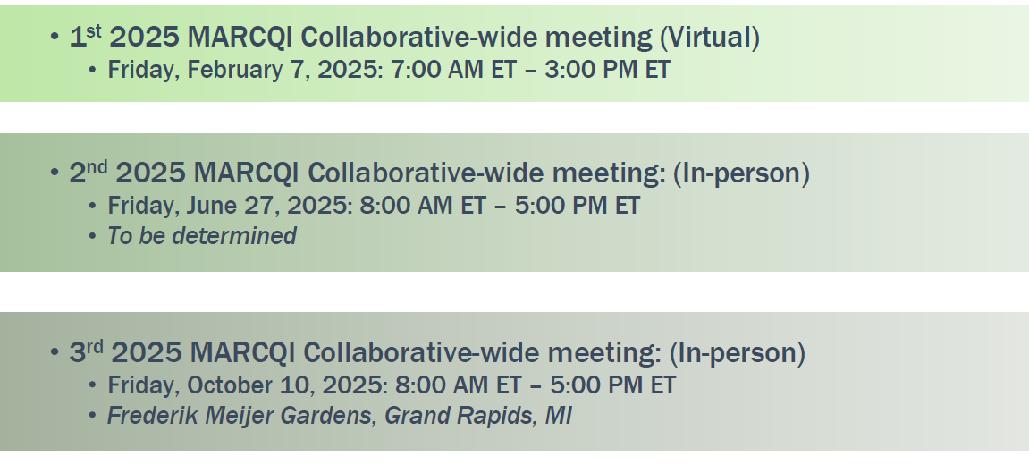
2025 Collaborative-wide meeting dates

