Slide 1
2022 ANNUAL REPORT SUMMARY
Making Michigan the best place in the world to have a joint replacement

Slide 2

MARCQI ANNUAL REPORT
This deck summarizes only what is new in this year’s report
Data on many more implants are available in the full report that can be accessed using this QR code:

Slide 3
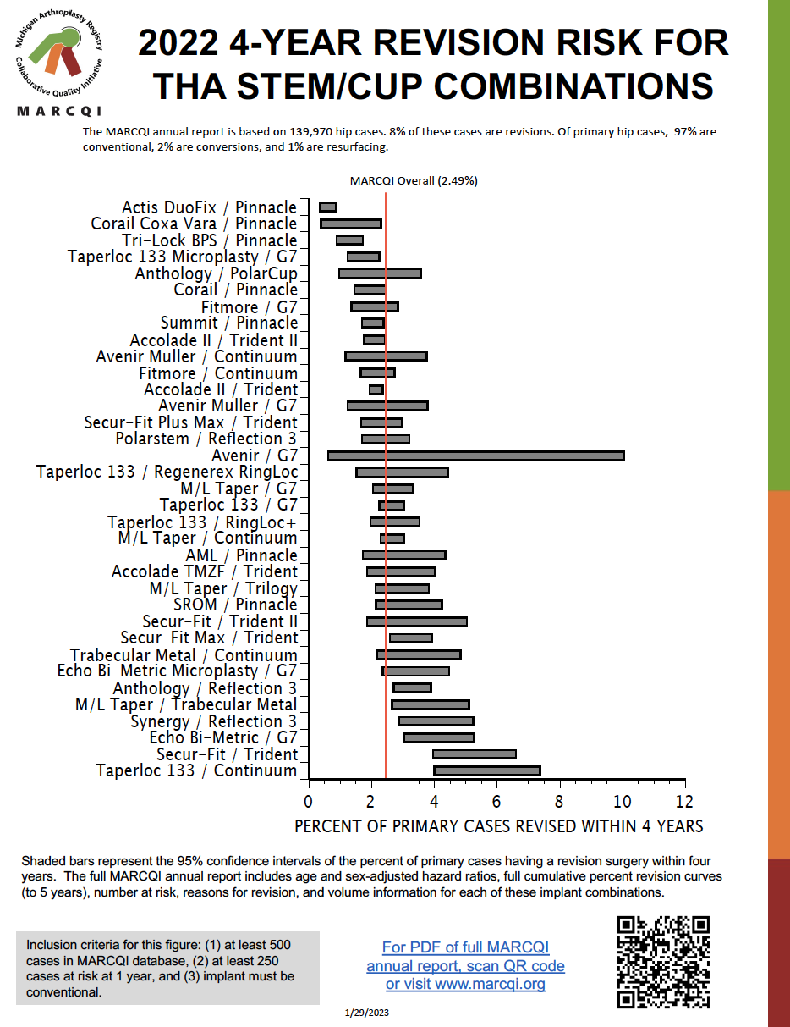
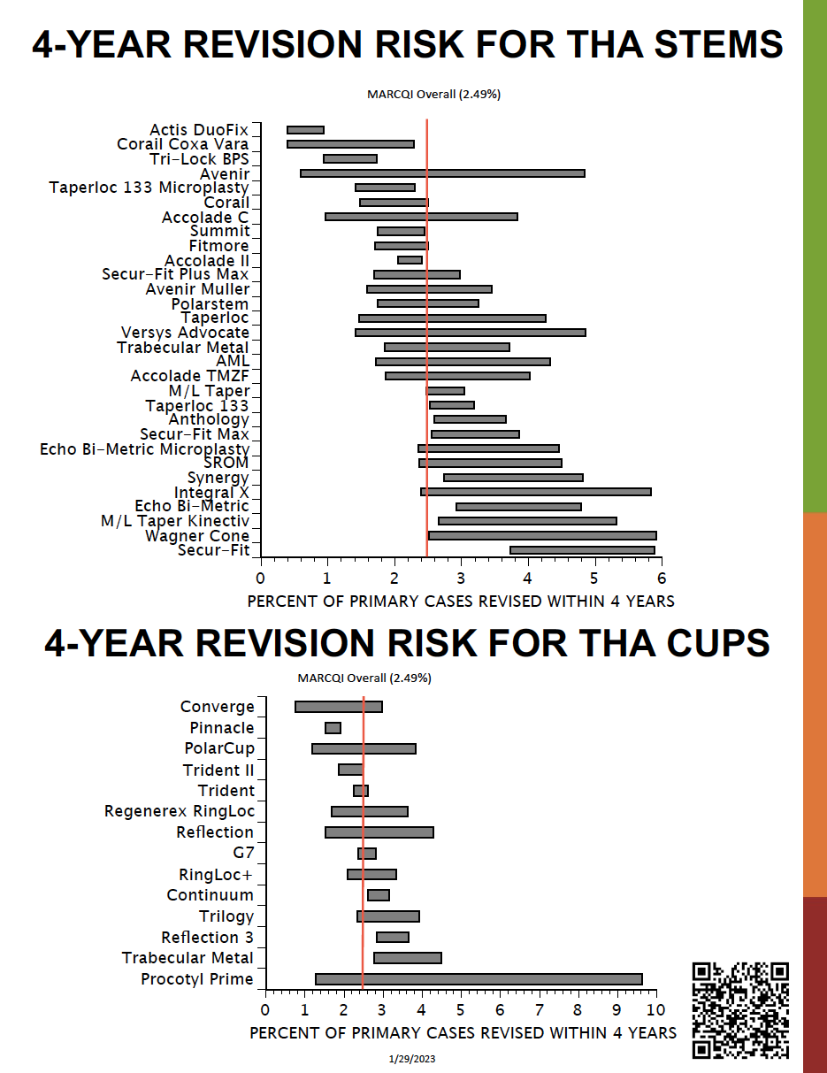
HIP 2-PAGE SUMMARY

Slide 4
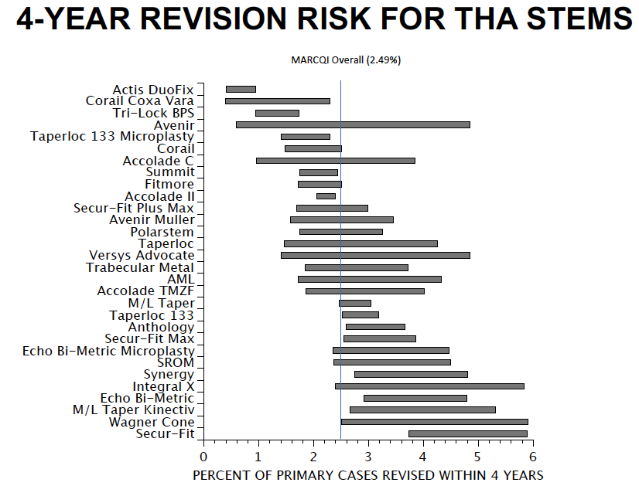
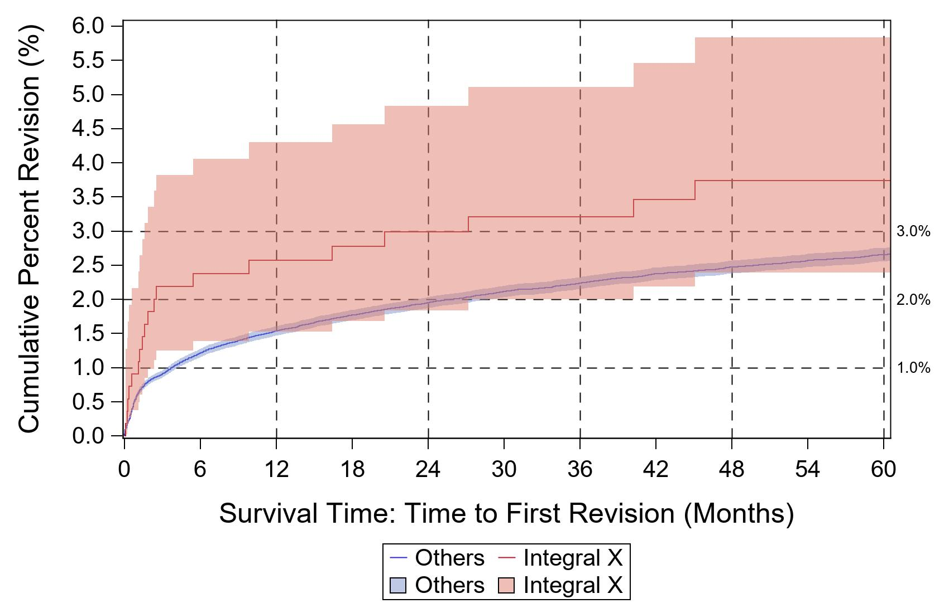
MEANING OF GRAY BARS

Slide 5
NEW THA IMPLANT COMBINATIONS THIS YEAR
Anthology/PolarCup
Avenir Muller/G7
Avenir/G7

Slide 6
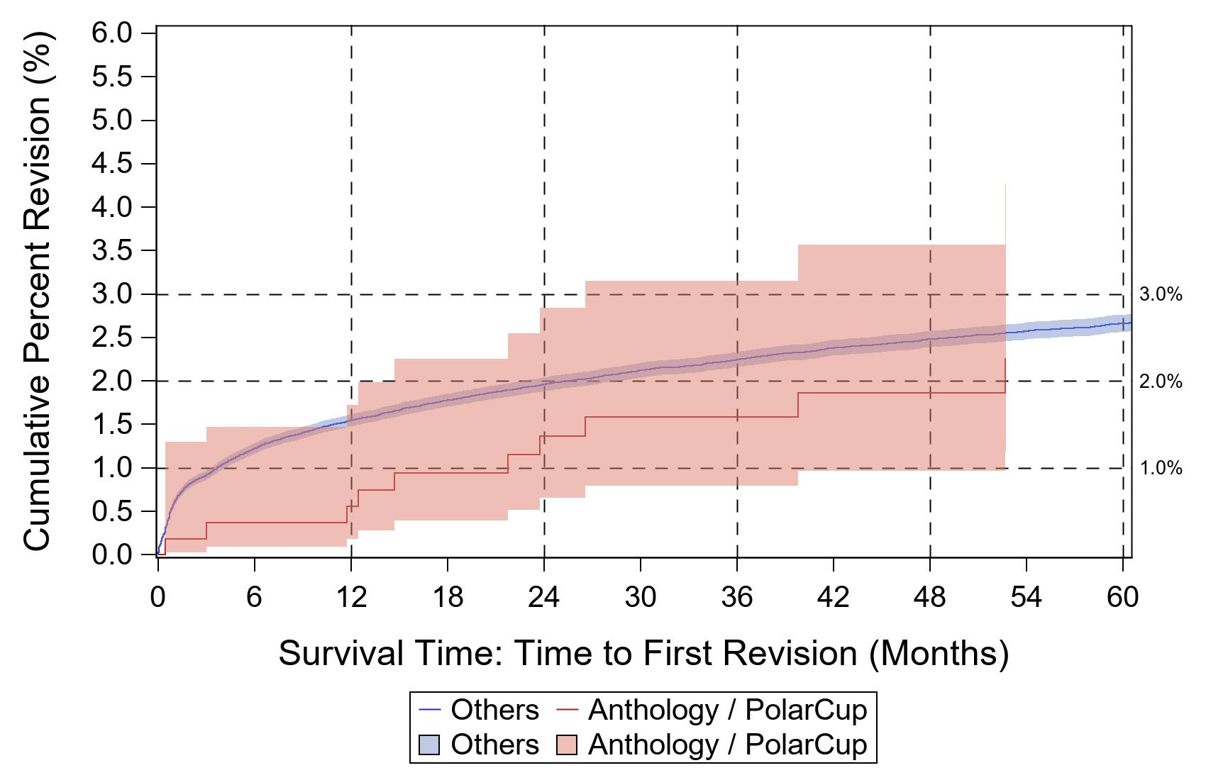
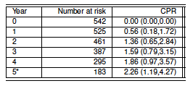
ANTHOLOGY/POLARCUP
Adjusting for age and sex in a Cox model,
the hazard ratio for implant effect
is not statistically significant.
2023 MARCQI ANNUAL REPORT p. 34

Slide 7
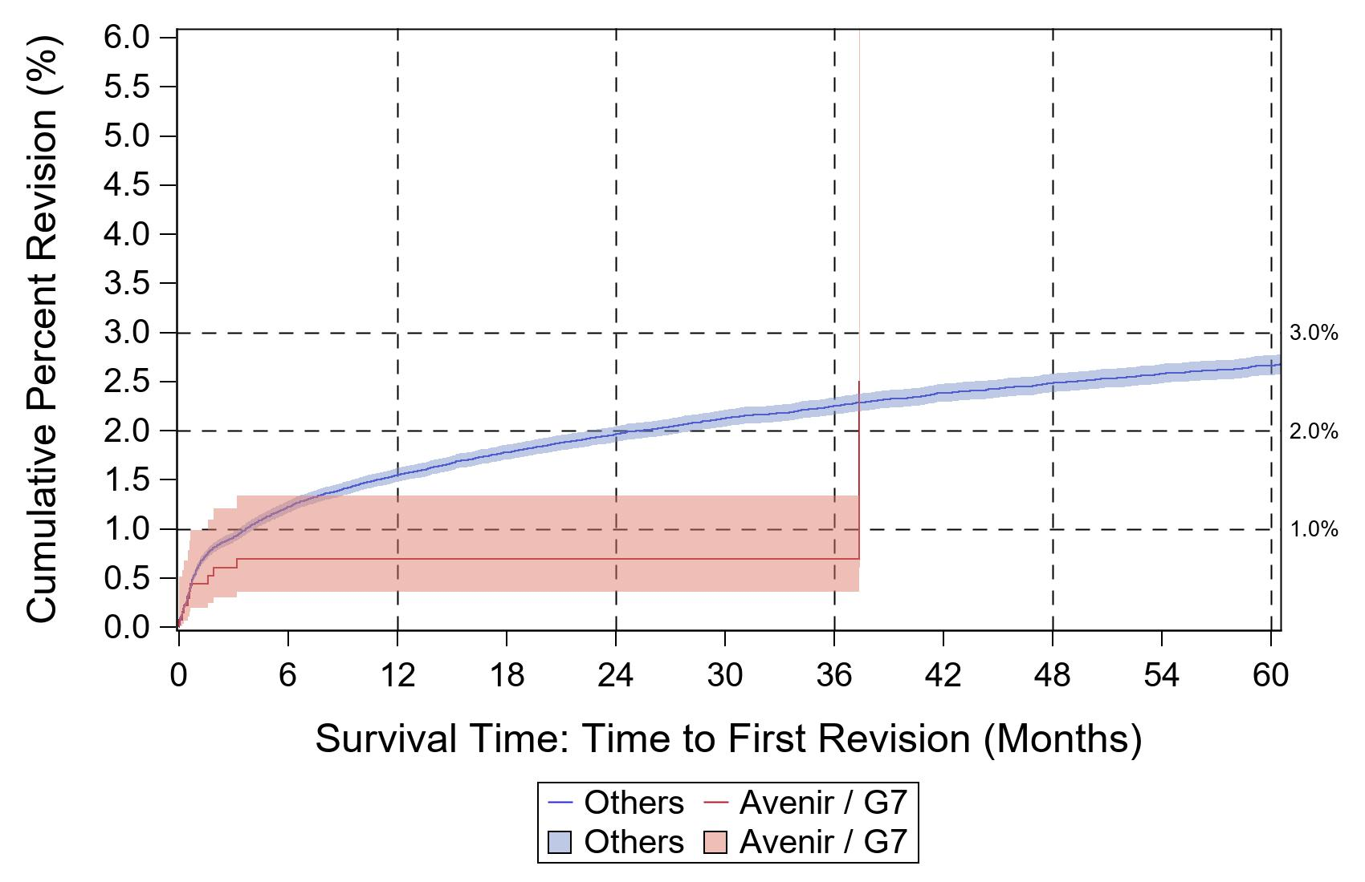
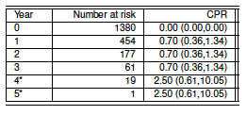
AVENIR/G7
Adjusting for age and sex in a Cox model,
the hazard ratio for implant effect
is not statistically significant.
2023 MARCQI ANNUAL REPORT p. 38

Slide 8
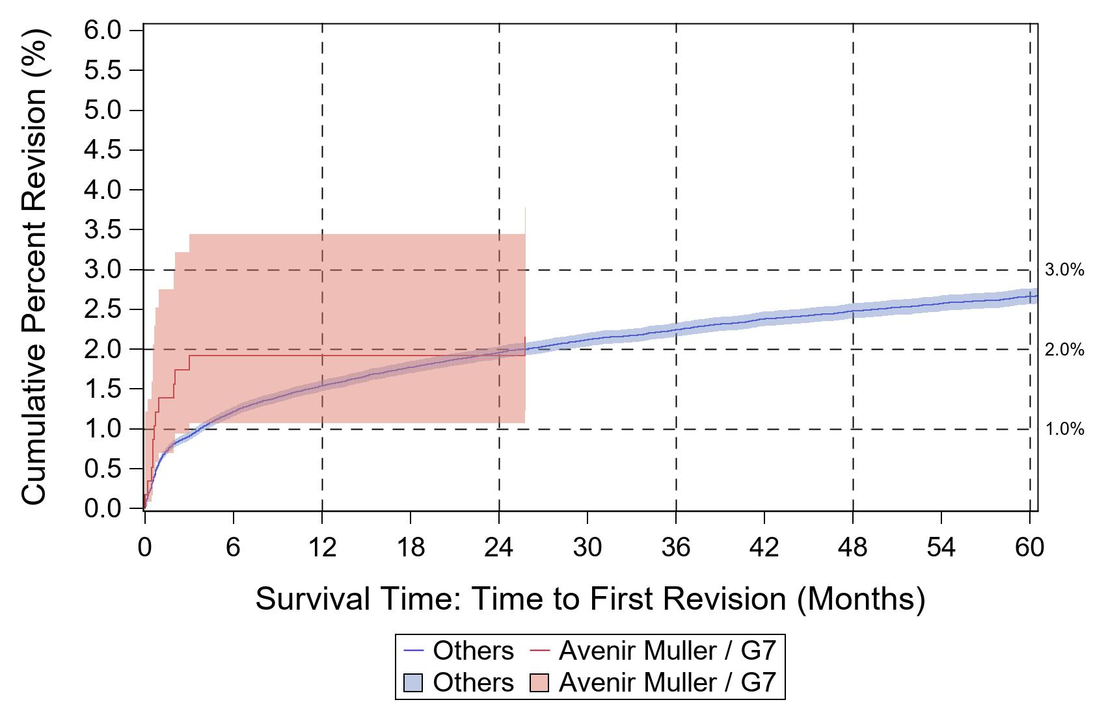
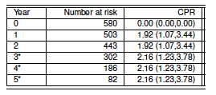
AVENIR MULLER/G7
Cannot compute hazard ratio because
data do not meet assumptions of method.
2023 MARCQI ANNUAL REPORT p. 42

Slide 9
STEM/CUP COMBINATNONS – CPR ABOVE OR BELOW OVERALL?

Slide 10
THA COMBINATIONS WITH 95% CI BELOW MARCQI OVERALL (2.49%)
MARCQI Overall (2.49%)

Slide 11
THA COMBINATIONS WITH 95% CI ABOVE MARCQI OVERALL (2.49%)
MARCQI Overall (2.49%)

Slide 12
NEW THA STEMS THIS YEAR
Avenir
Accolade C
Versys Advocate
Integral X
Wagner Cone

Slide 13
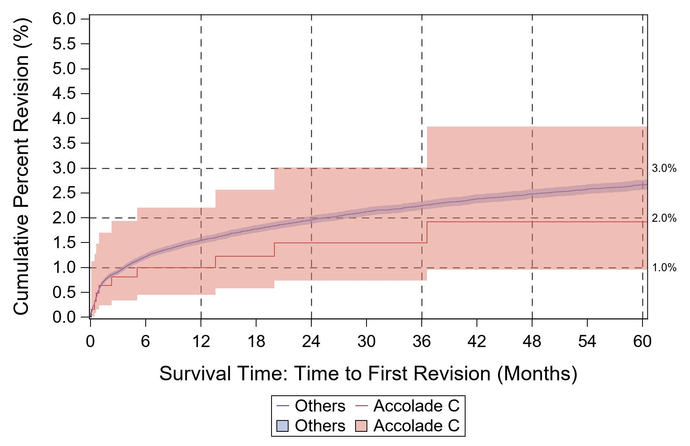
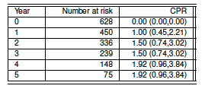
ACCOLADE C
Adjusting for age and sex in a Cox model,
the hazard ratio for implant effect
is not statistically significant.
2023 MARCQI ANNUAL REPORT p. 96

Slide 14
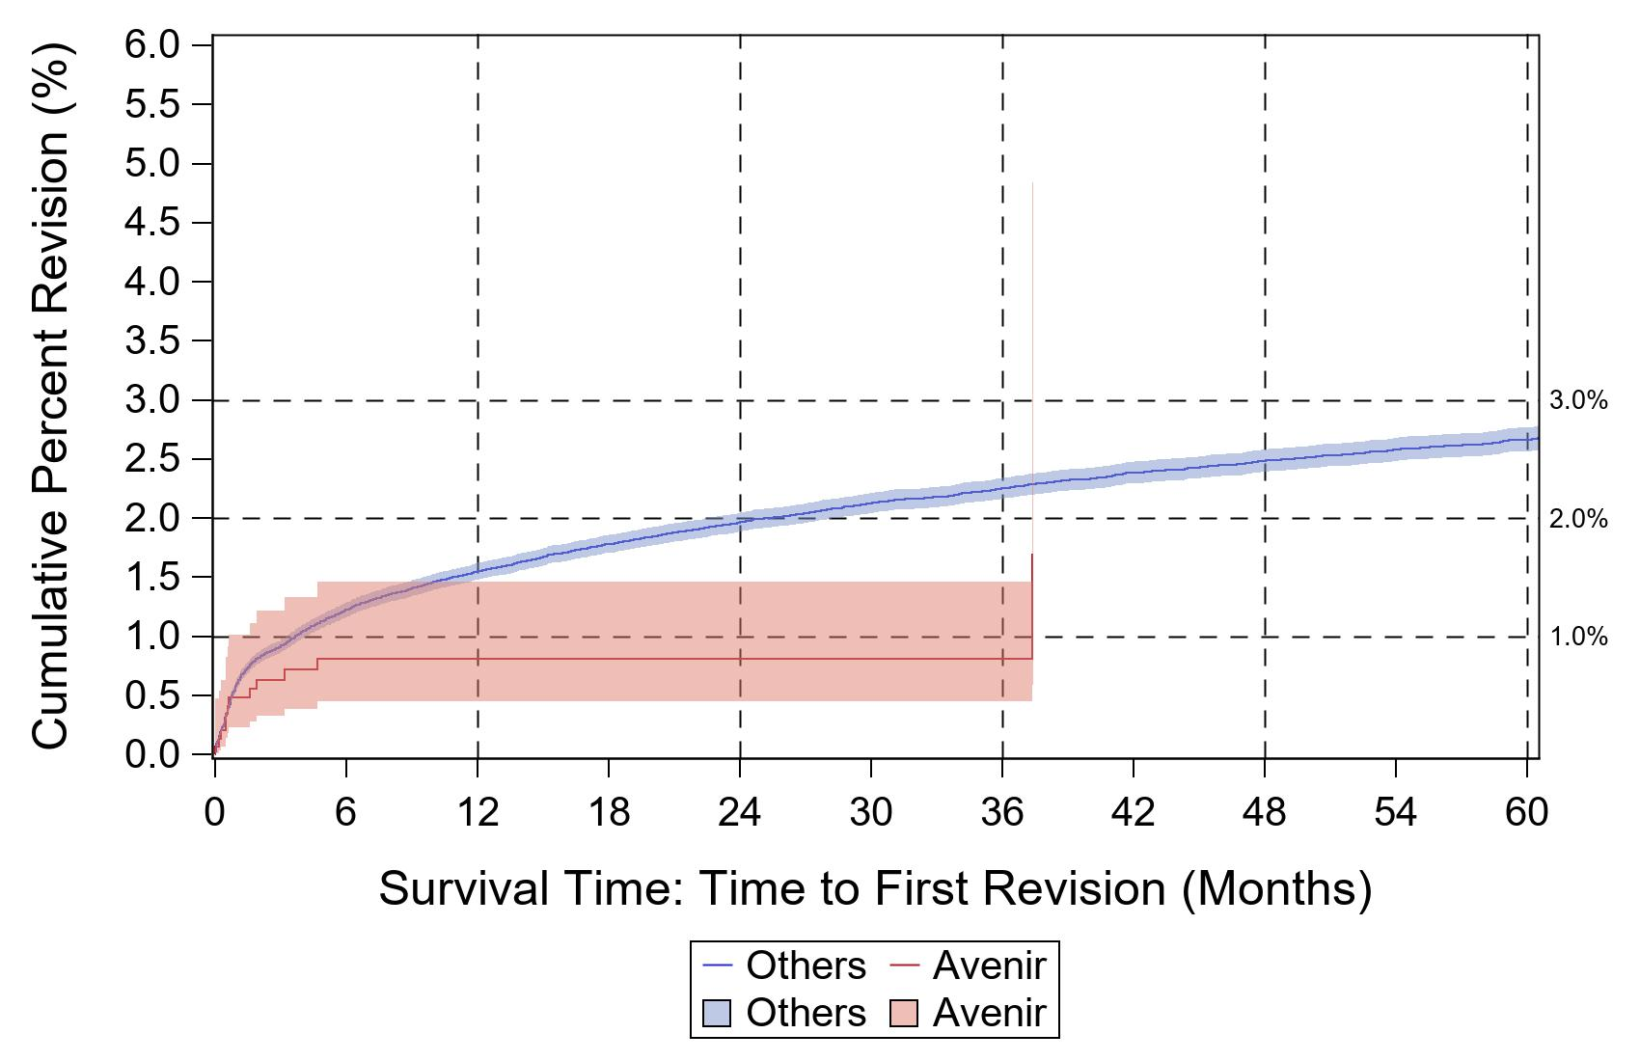
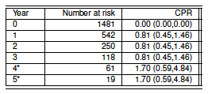
AVENIR
Adjusting for age and sex in a Cox model,
the hazard ratio for implant effect
is statistically significantly lower than 1.0.
2023 MARCQI ANNUAL REPORT p. 108

Slide 15
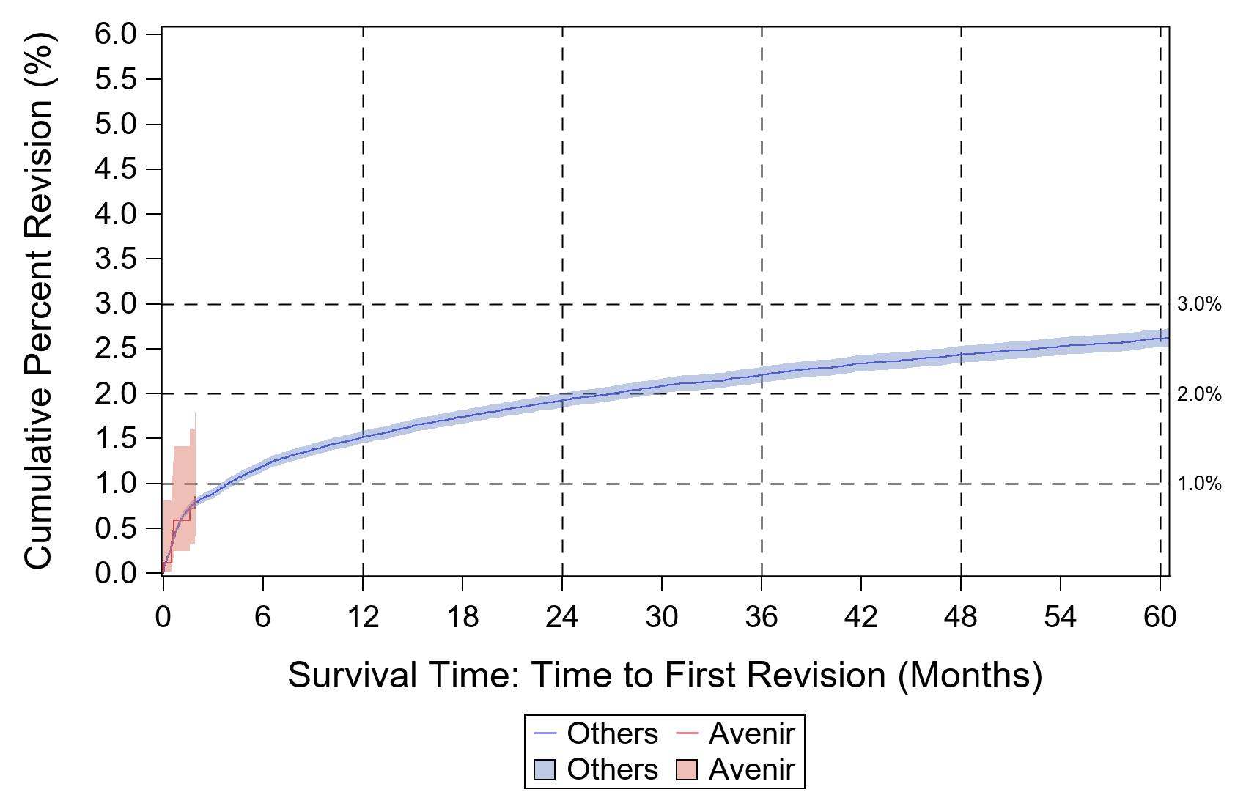
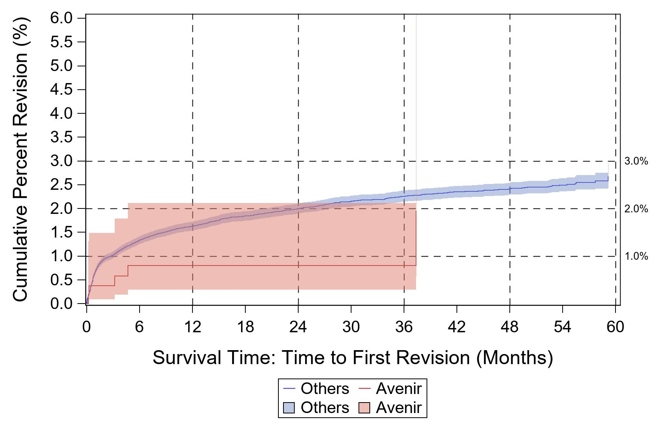
AVENIR
UNCEMENTED
CEMENTED
2023 MARCQI ANNUAL REPORT - NOT INCLUDED

Slide 16
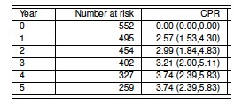
INTEGRAL X
Adjusting for age and sex in a Cox model,
the hazard ratio for implant effect
is not statistically significant.
2023 MARCQI ANNUAL REPORT p. 122

Slide 17
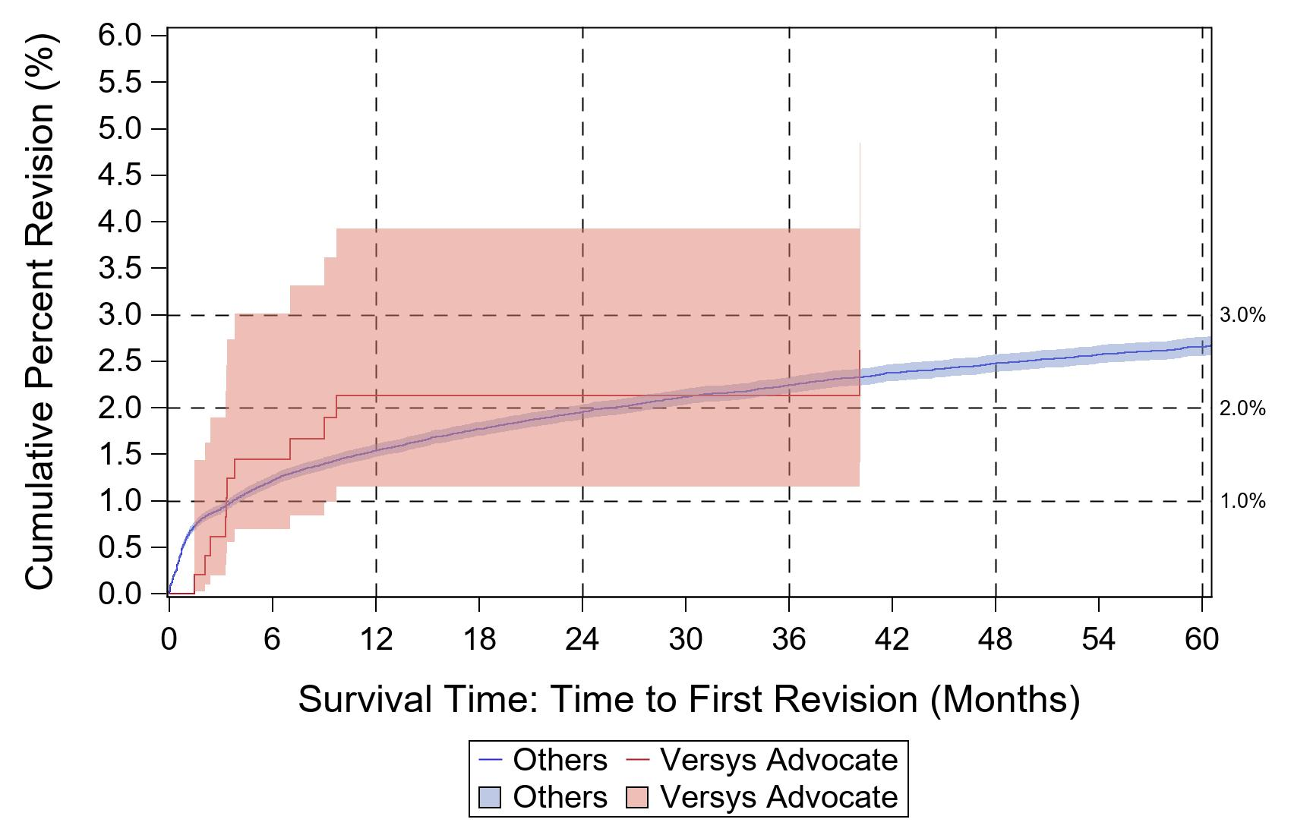
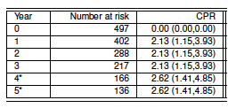
VERSYS ADVOCATE
Adjusting for age and sex in a Cox model,
the hazard ratio for implant effect
is not statistically significant.
2023 MARCQI ANNUAL REPORT p. 152

Slide 18
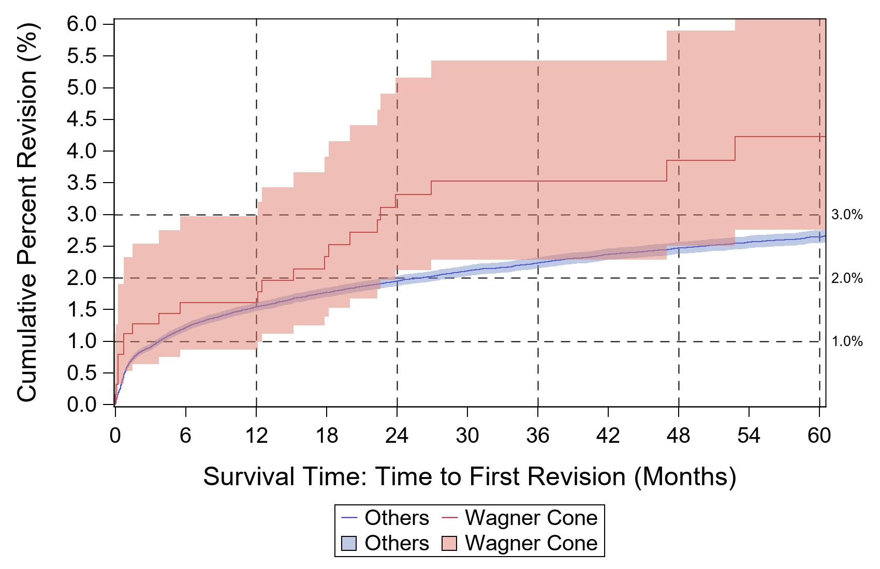
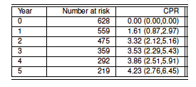
WAGNER CONE
Adjusting for age and sex in a Cox model,
the hazard ratio for implant effect
is statistically significantly higher than 1.0.
2023 MARCQI ANNUAL REPORT p. 154

Slide 19
STEMS – CPR ABOVE OR BELOW OVERALL?

Slide 20
THA STEMS WITH 95% CI BELOW MARCQI OVERALL (2.49%)
MARCQI Overall (2.49%)

Slide 21
THA STEMS WITH 95% CI ABOVE MARCQI OVERALL (2.49%)
MARCQI Overall (2.49%)

Slide 22
NEW THA CUPS THIS YEAR
PolarCup
Procotyl Prime

Slide 23
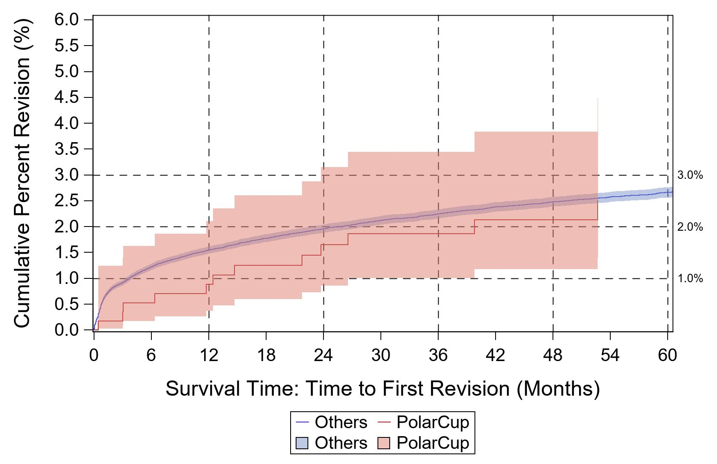
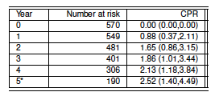
POLARCUP
Adjusting for age and sex in a Cox model,
the hazard ratio for implant effect
is not statistically significant.
2023 MARCQI ANNUAL REPORT p. 165

Slide 24
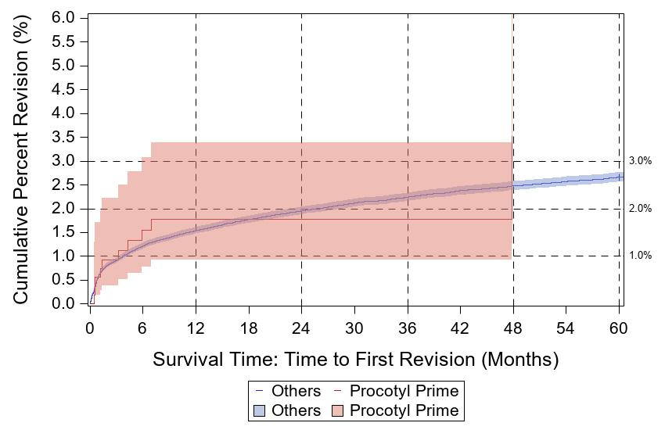
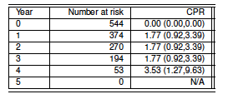
PROCOTYL PRIME
Adjusting for age and sex in a Cox model,
the hazard ratio for implant effect
is not statistically significant.
2023 MARCQI ANNUAL REPORT p. 167

Slide 25
CUPS – CPR ABOVE OR BELOW OVERALL?

Slide 26
THA CUPS WITH 95% CI BELOW MARCQI OVERALL (2.49%)
MARCQI Overall (2.49%)
Upper 95% confidence interval is 2.49%, right at
MARCQI overall

Slide 27
THA CUPS WITH 95% CI ABOVE MARCQI OVERALL (2.49%)
MARCQI Overall (2.49%)

Slide 28
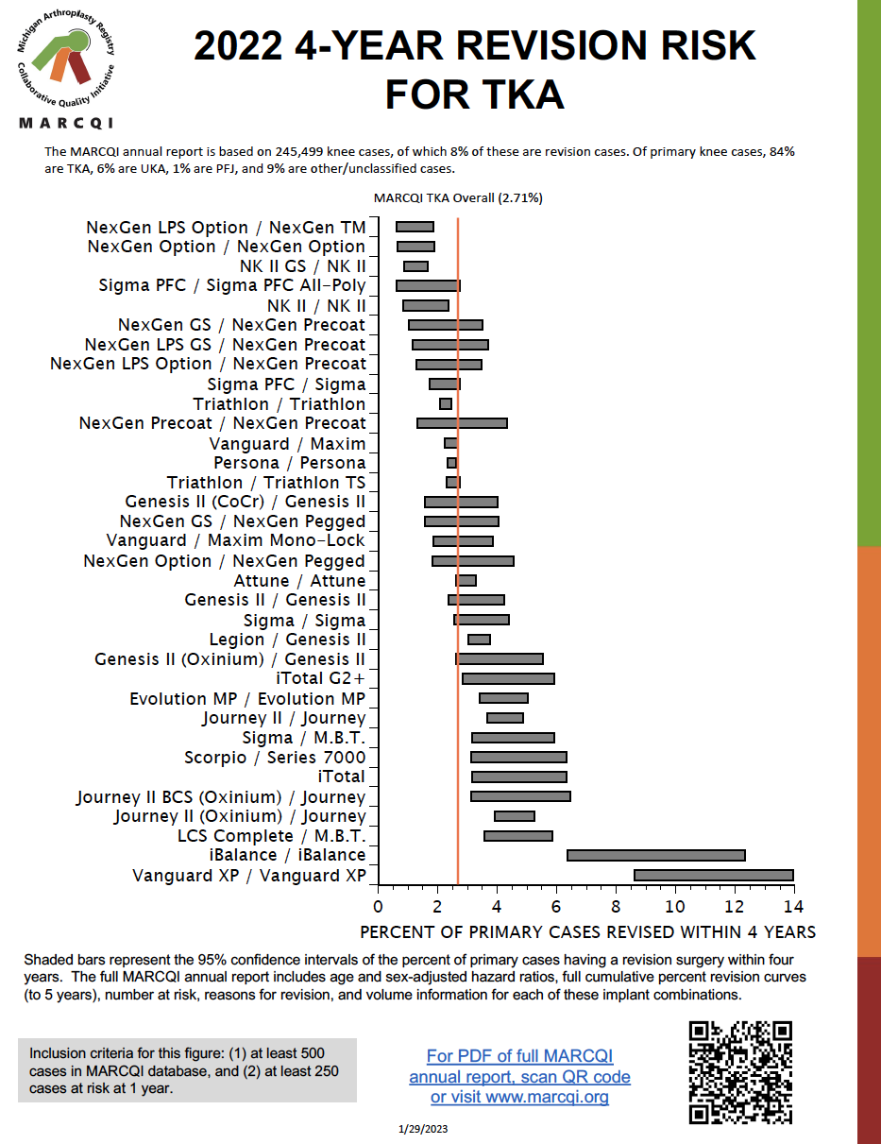
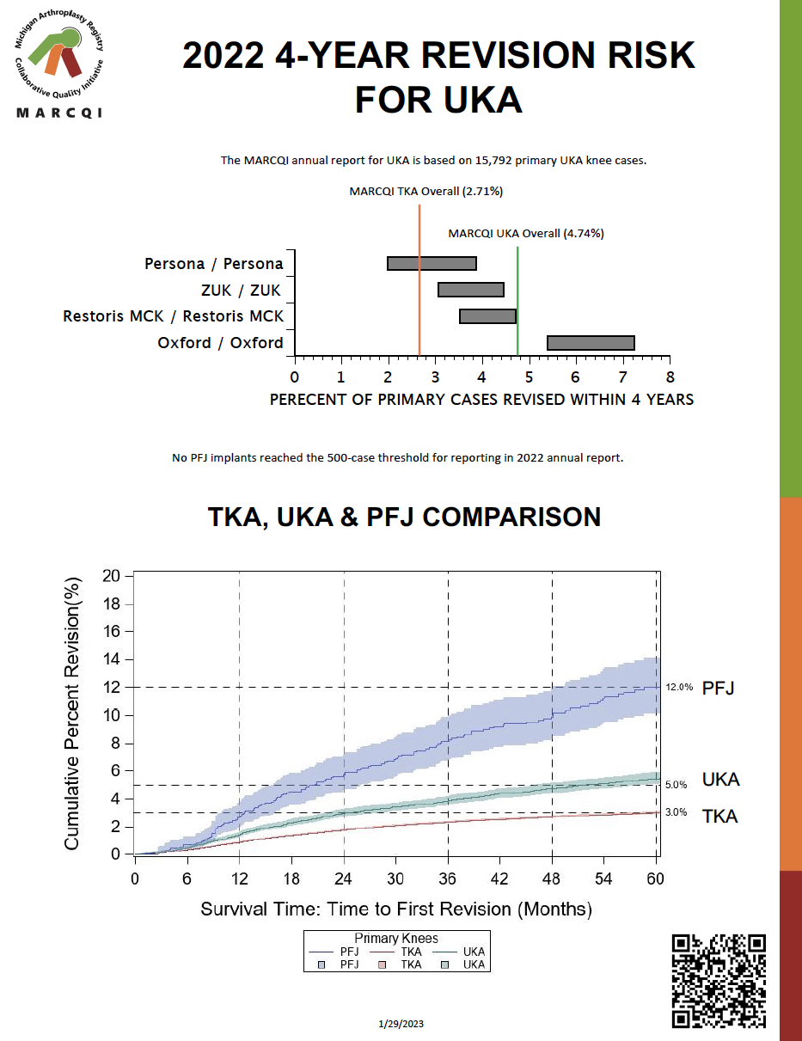
KNEE 2-PAGE SUMMARY

Slide 29
NEW TKA SYSTEMS THIS YEAR
NexGen Precoat/NexGen Precoat
iBalance/iBalance

Slide 30
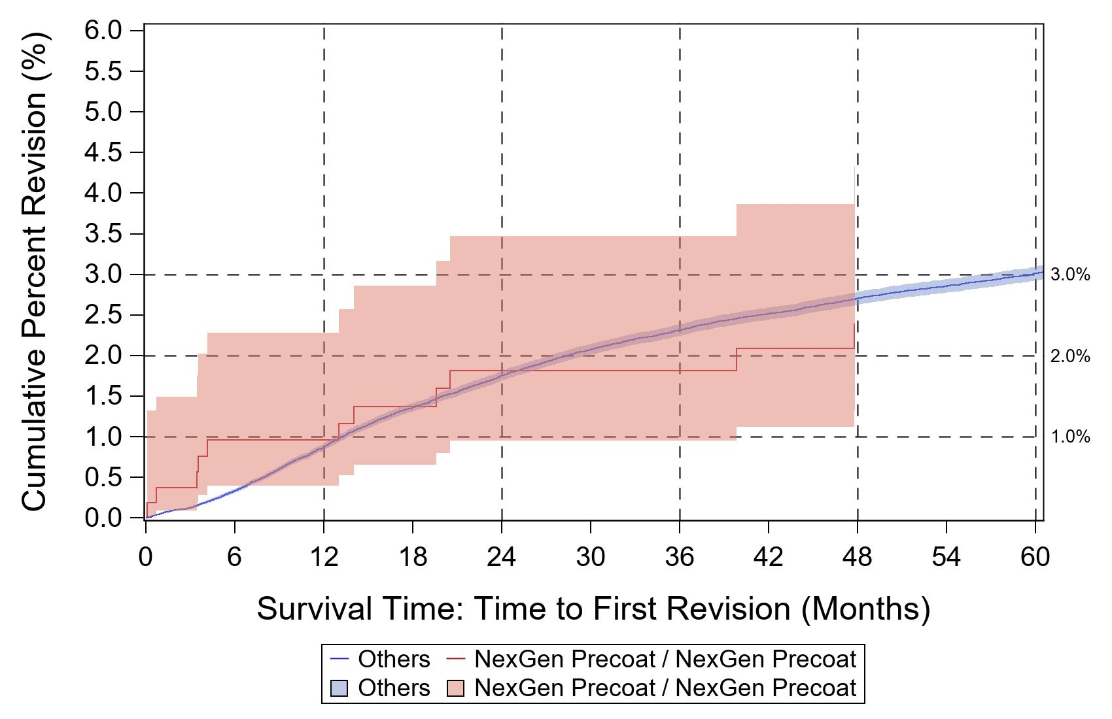
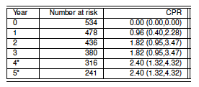
NEXGEN PRECOAT/NEXGEN PRECOAT
Adjusting for age and sex in a Cox model,
the hazard ratio for implant effect
is statistically significantly lower than 1.0.
2023 MARCQI ANNUAL REPORT p. 240

Slide 31
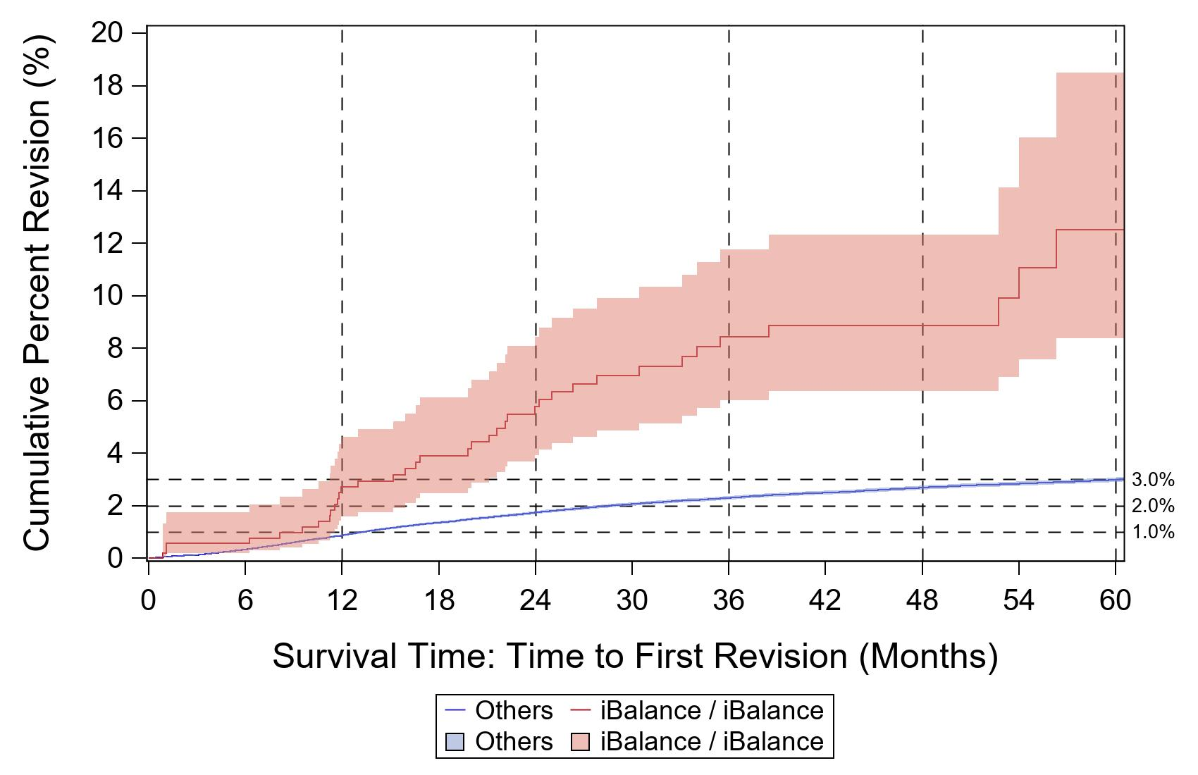
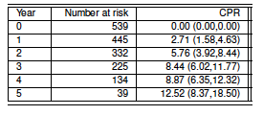
iBALANCE/iBALANCE
Caution: Median number of cases per surgeon is 2
Adjusting for age and sex in a Cox model,
the hazard ratio for implant effect
is statistically significantly higher than 1.0.
2023 MARCQI ANNUAL REPORT p. 213

Slide 32
THA CPR ABOVE OR BELOW OVERALL?

Slide 33
TKA COMBINATIONS WITH 95% CI BELOW MARCQI (2.71%)
MARCQI Overall (2.71%)

Slide 34
TKA COMBINATIONS WITH 95% CI ABOVE MARCQI (2.71%)
MARCQI Overall (2.71%)

Slide 35
UKA PAGE OF 2-PAGE KNEE SUMMARY
No new implants
added this year

Slide 36
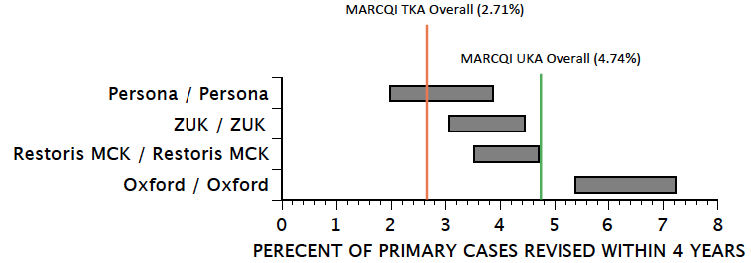
UKA COMBINATIONS WITH 95% CI BELOW MARCQI OVERALL
Below MARCQI TKA
overall (2.71%)
None
Below MARCQI UKA
overall (4.74%)
Persona/Persona
Restoris MCK/Restoris MCK
ZUK/ZUK

Slide 37
UKA COMBINATIONS WITH 95% CI ABOVE MARCQI OVERALL
Above MARCQI TKA
overall (2.71%)
ZUK/ZUK
Restoris MCK/Restoris MCK
Oxford/Oxford
Above MARCQI UKA
overall (4.74%)
Oxford/Oxford

