Slide 1
MARCQI 2018 ANNUAL REPORT
Reports on the first six years of MARCQI
Released November, 2018
This slide deck provides selected slides
For full report, see PDF available http://marcqi.org/marcqi-registry-reports-marcqi-annual-reports/

Slide 2

Michigan Arthroplasty Registry Collaborative Quality Initiative (MARCQI)

Slide 3
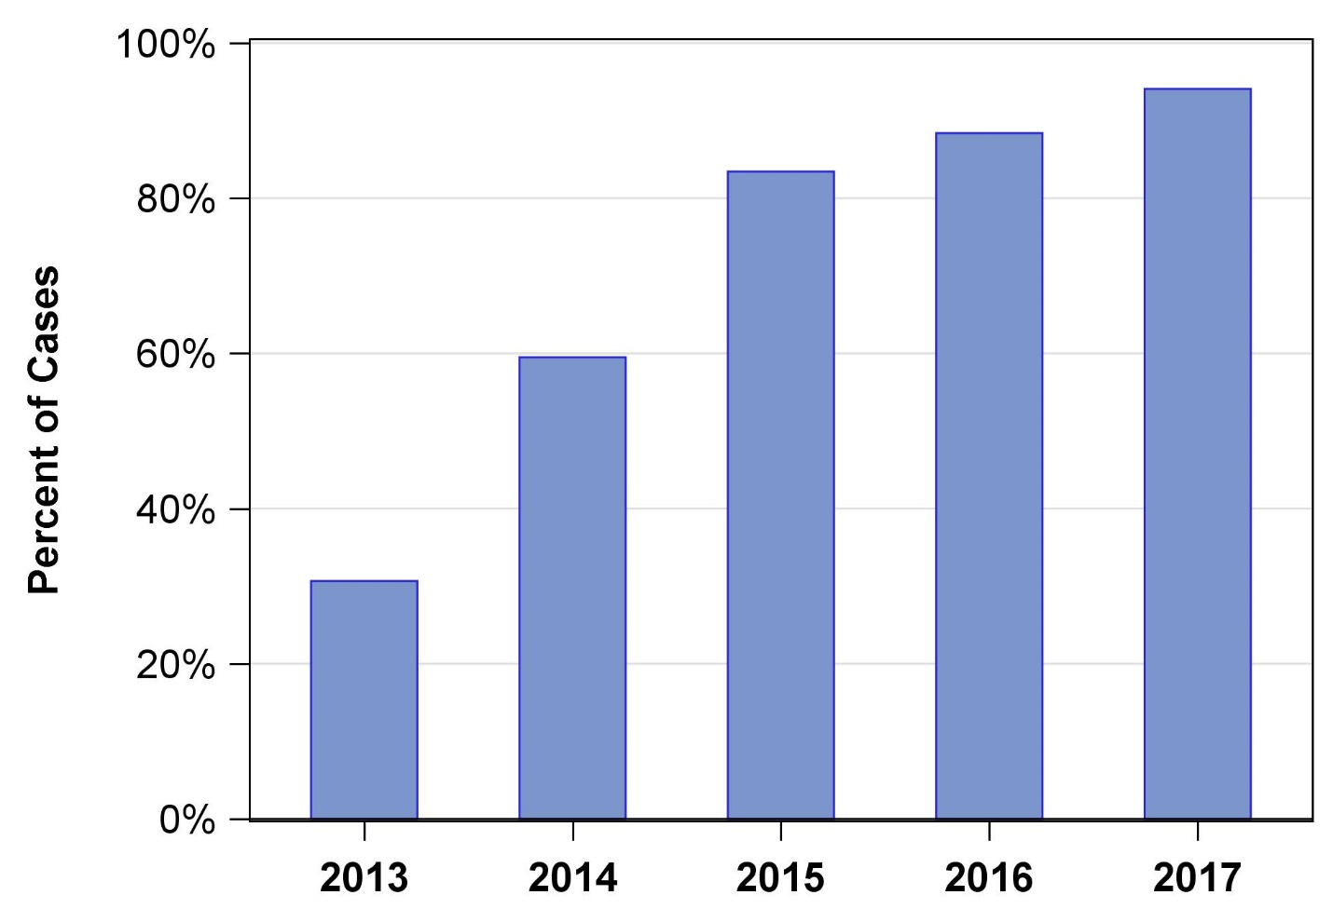
Figure 1: Frequency of using tranexamic acid in MARCQI.

Slide 4
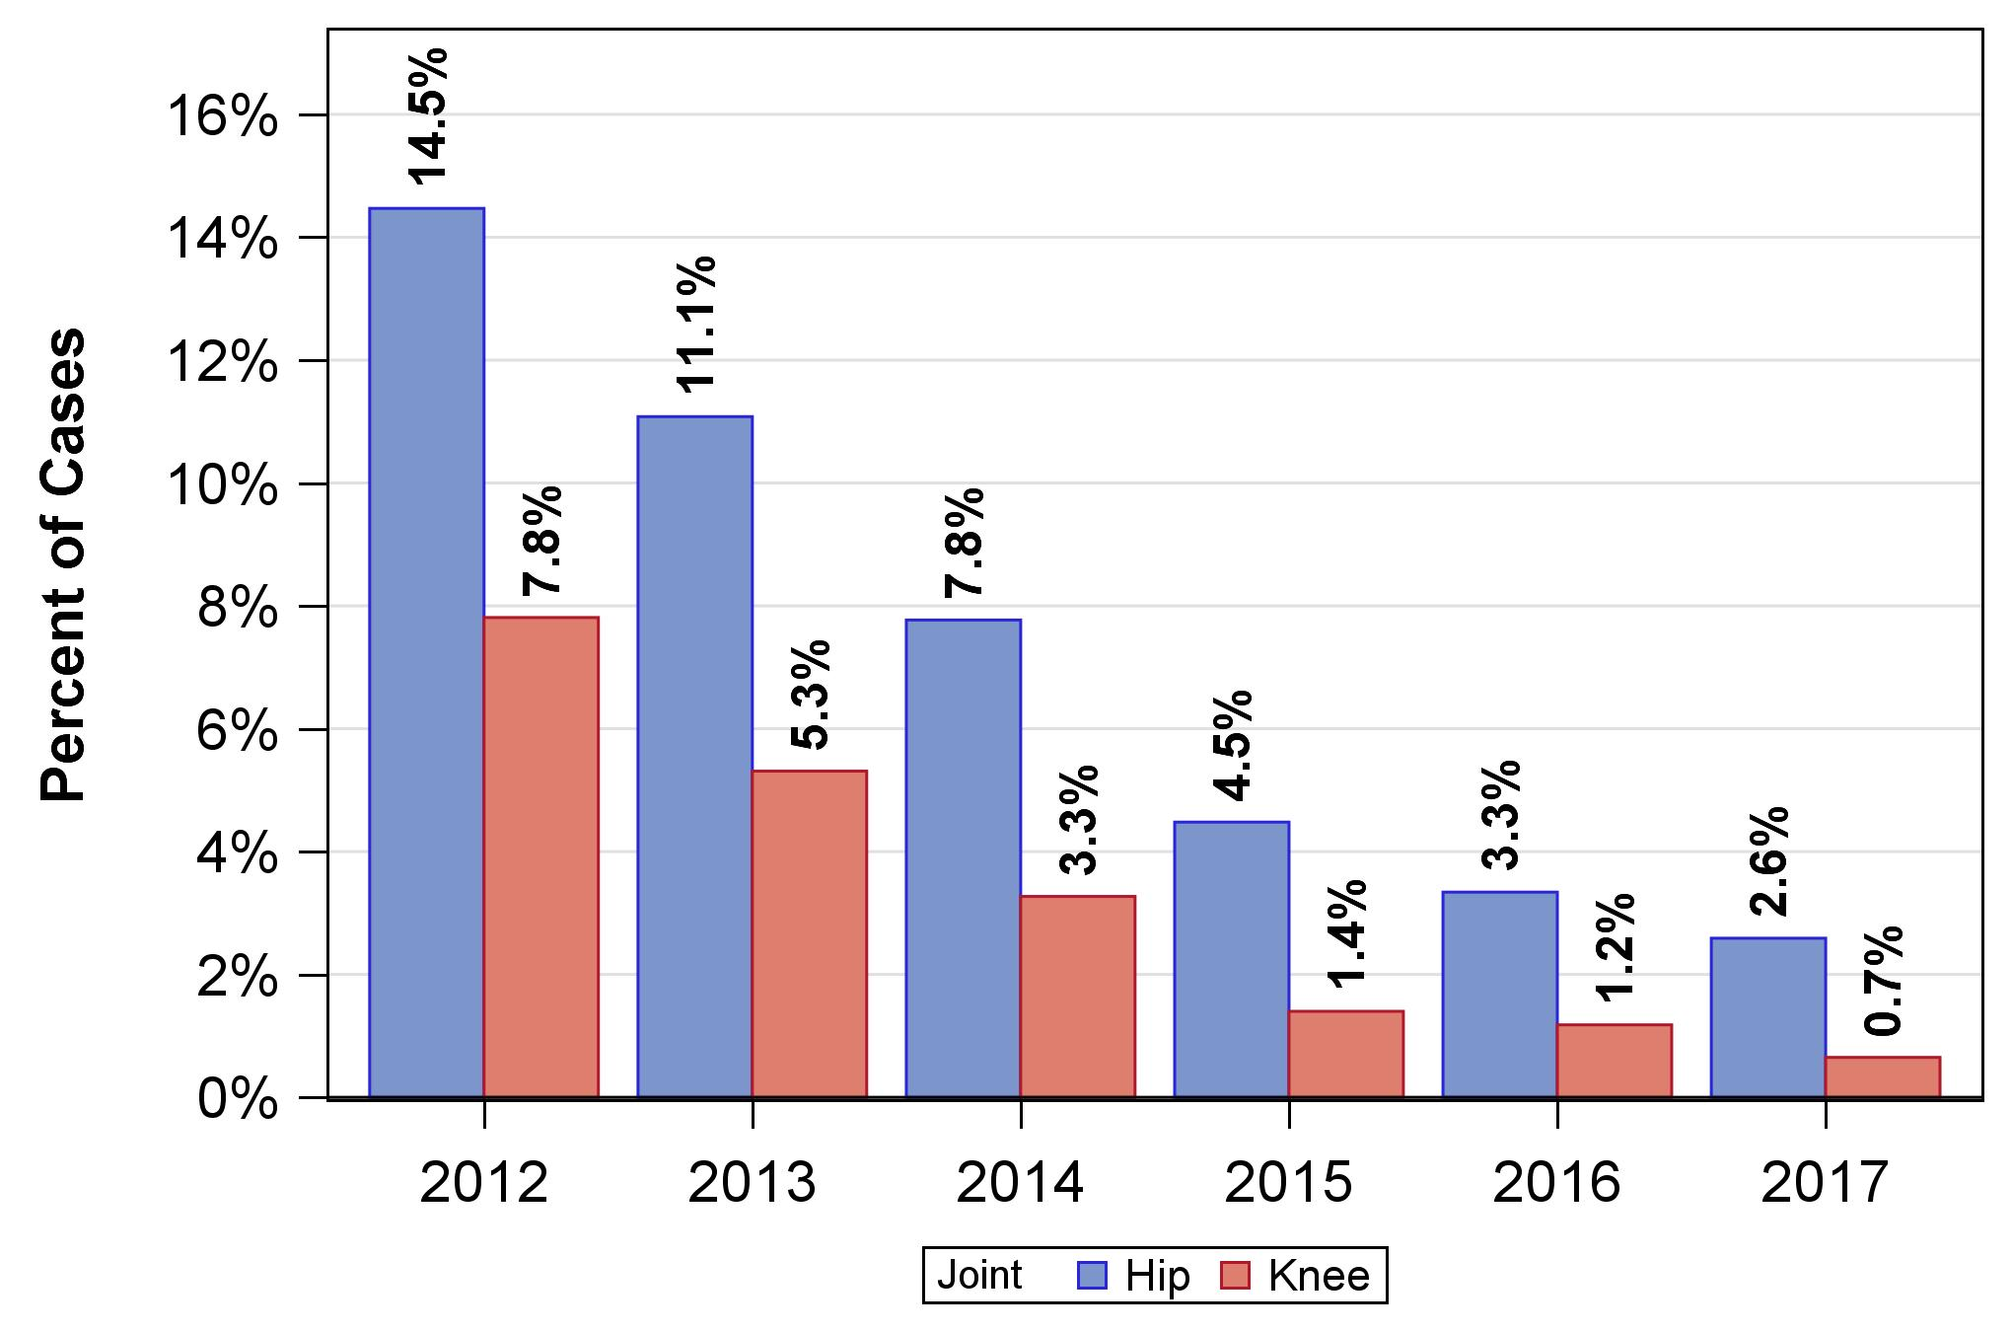
Figure 2: Frequency of transfusions after primary hip and knee arthroplasty in MARCQI.

Slide 5
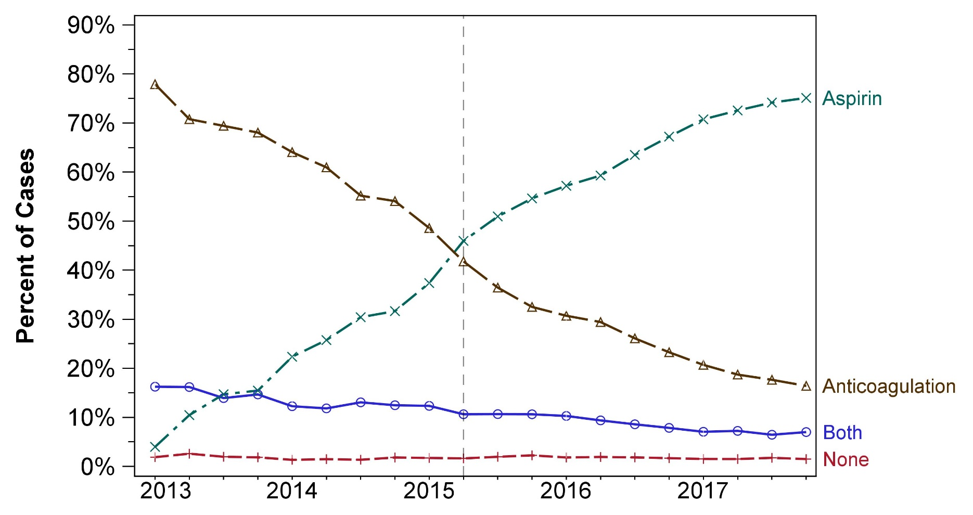
Figure 3: Frequency of VTE prophylaxis usage for venous thromboembolism over time in MARCQI.

Slide 6
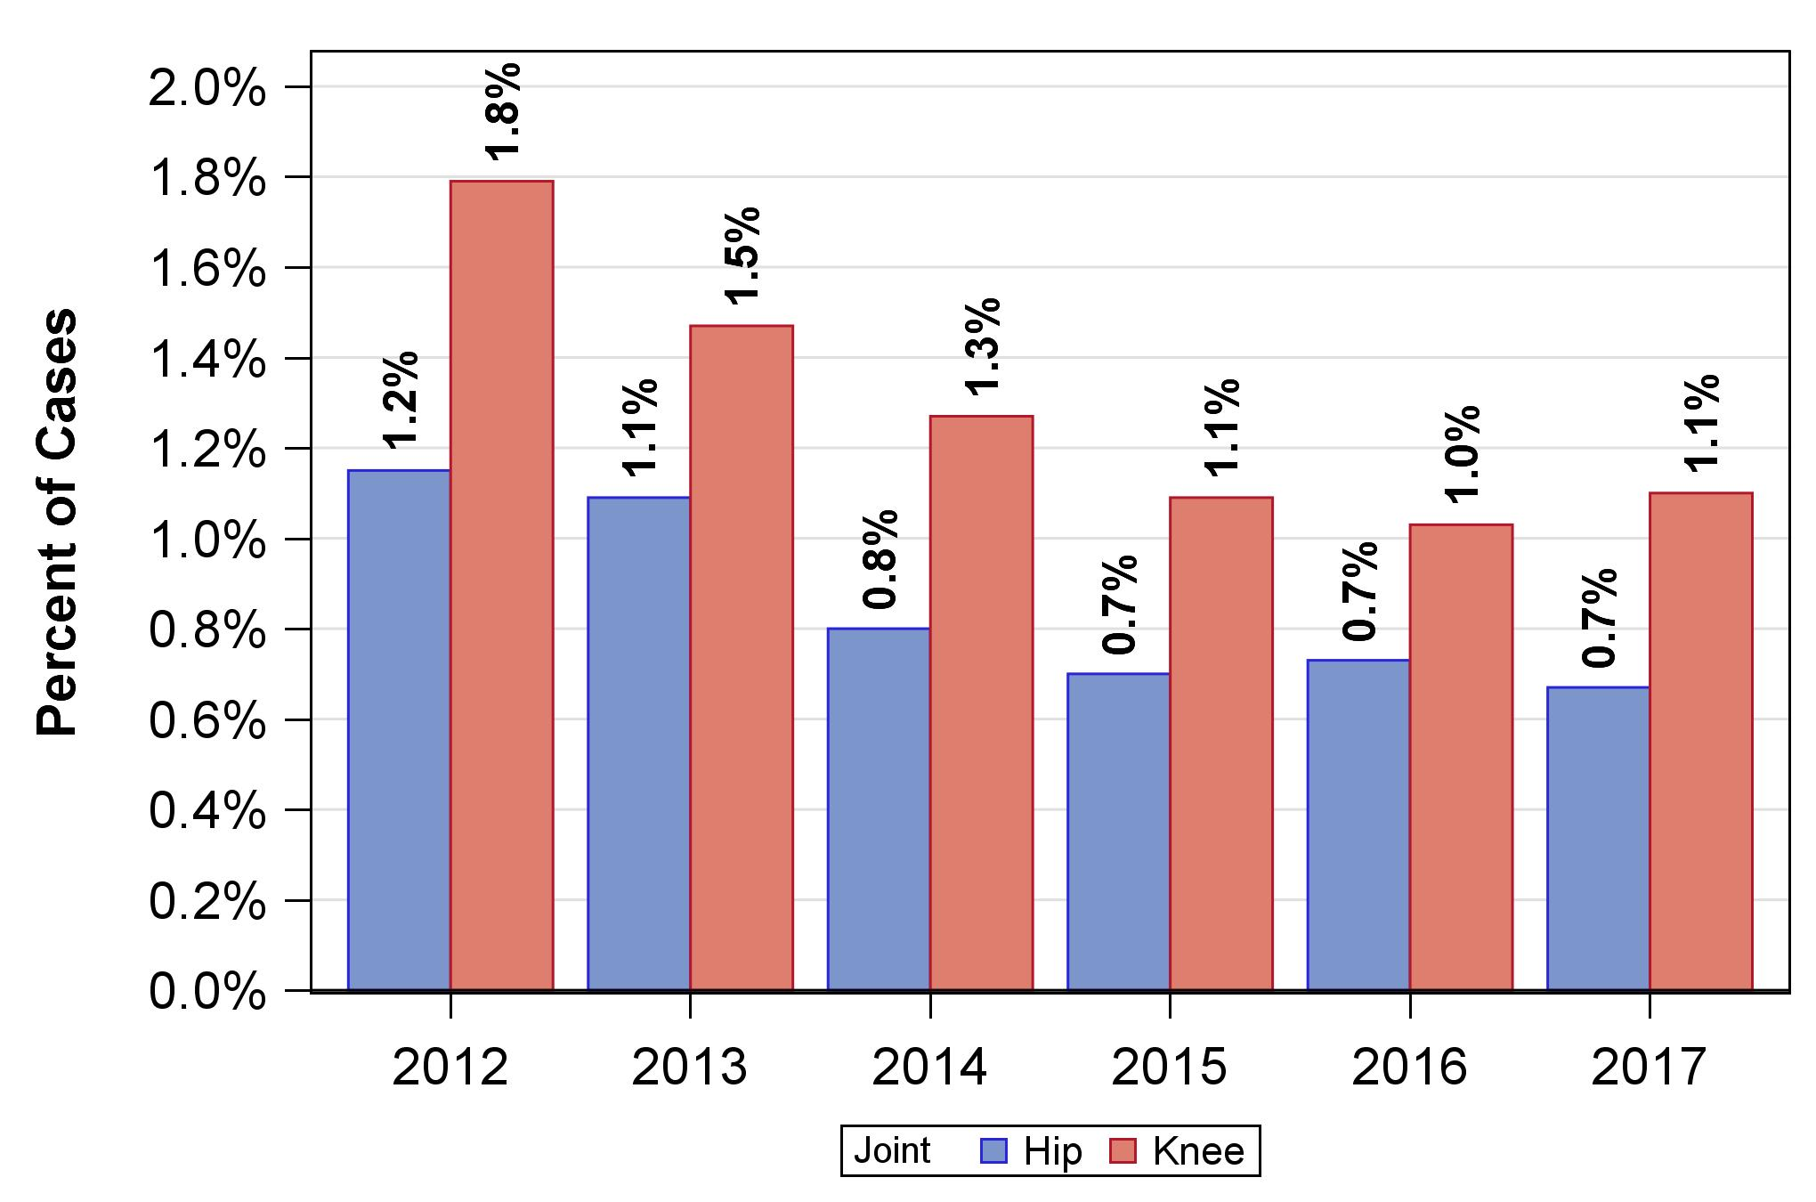
Figure 4: Frequency of VTE events (DVT and PE) after primary total hip and knee arthroplasty in MARCQI.

Slide 7
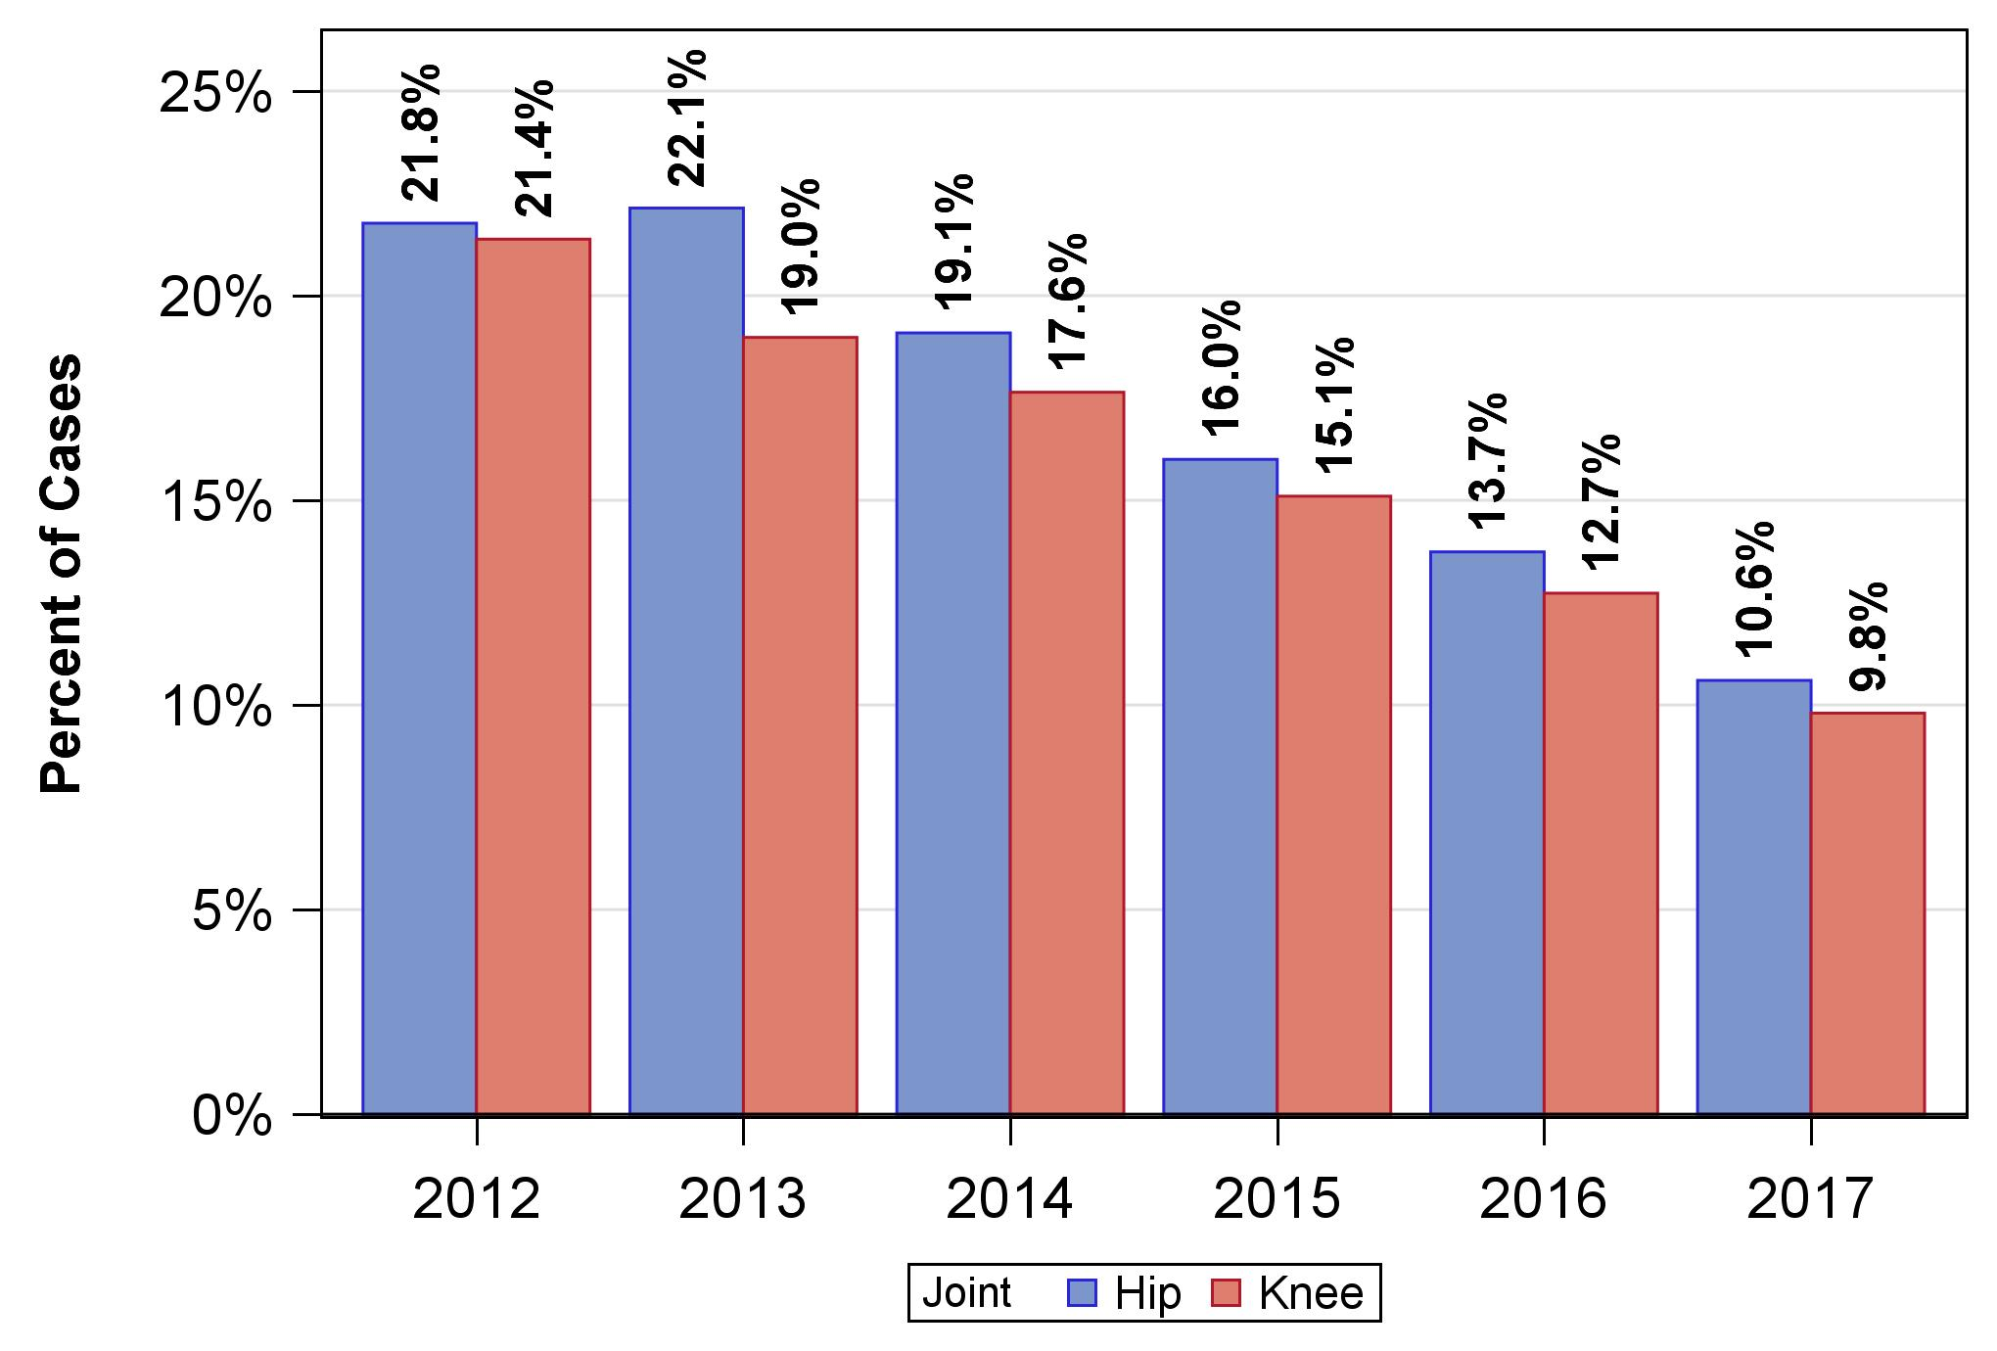
Figure 5: Frequency of discharge to nursing home after primary total hip and knee arthroplasty in MARCQI.

Slide 8
HIP CHAPTER

Slide 9
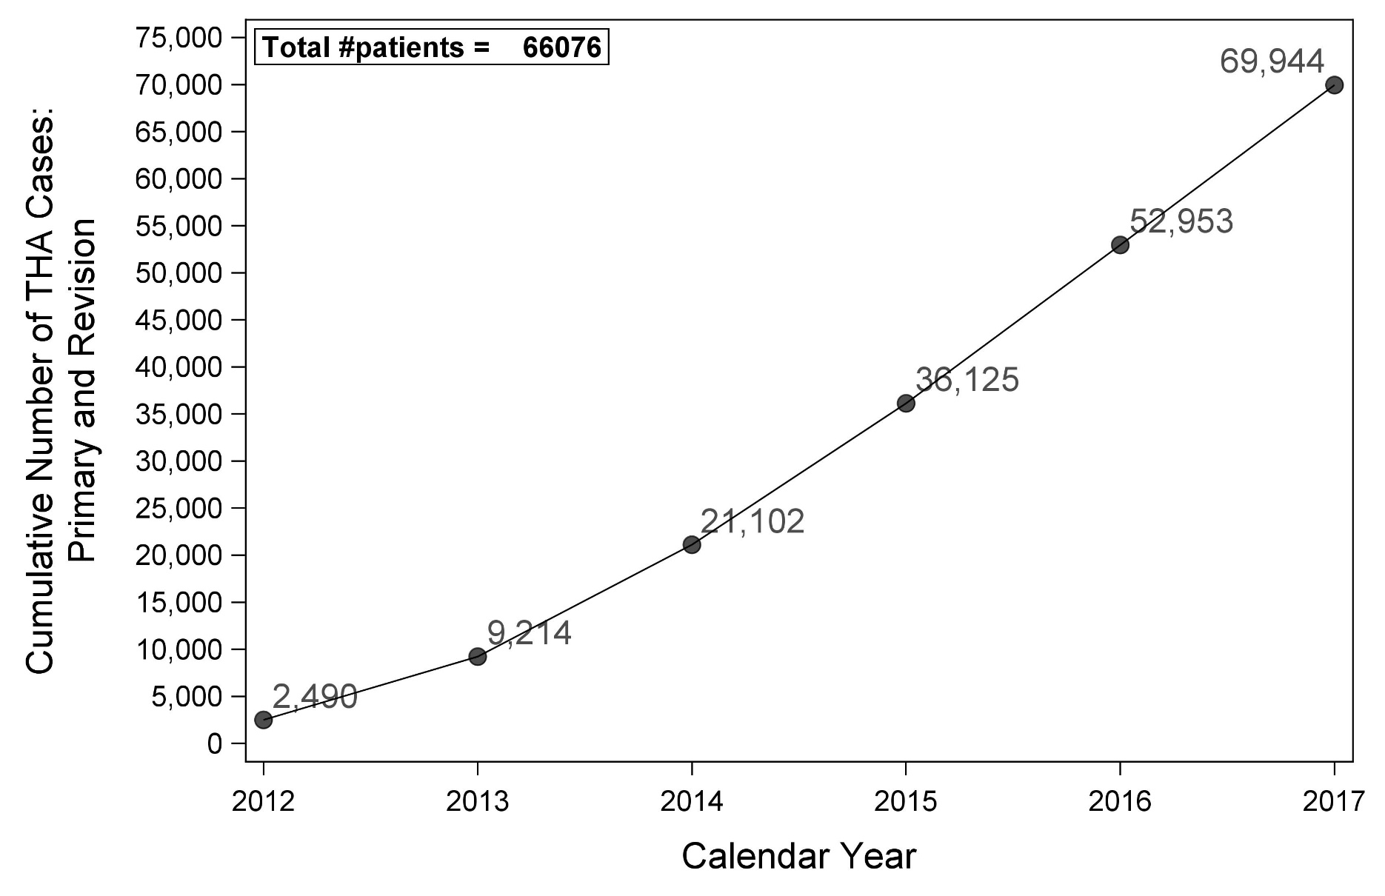
Figure 6: THA cases over time.

Slide 10
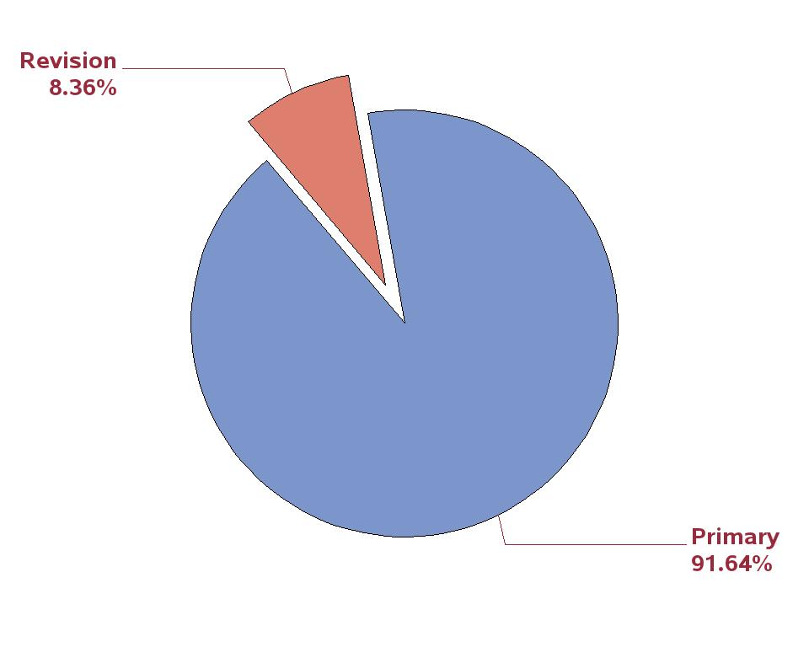
Figure 7: Percent of THA arthroplasty cases by primary or revision.

Slide 11
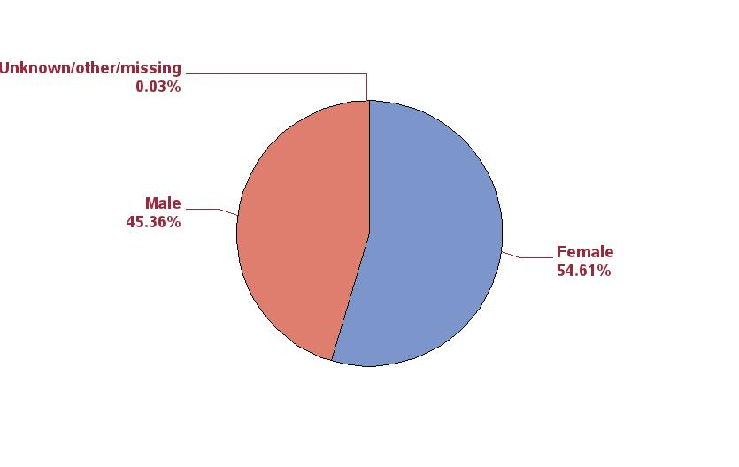
Figure 8: Percent of primary THA cases by sex.

Slide 12
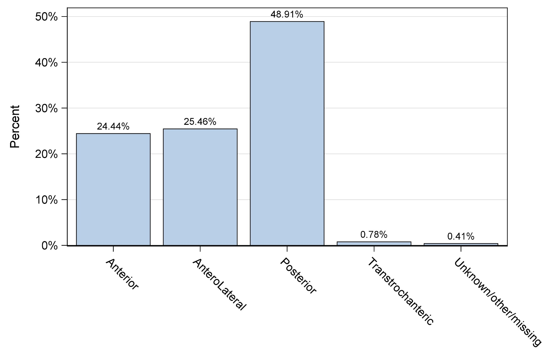
Figure 10: Percent of primary THA cases by approach.

Slide 13
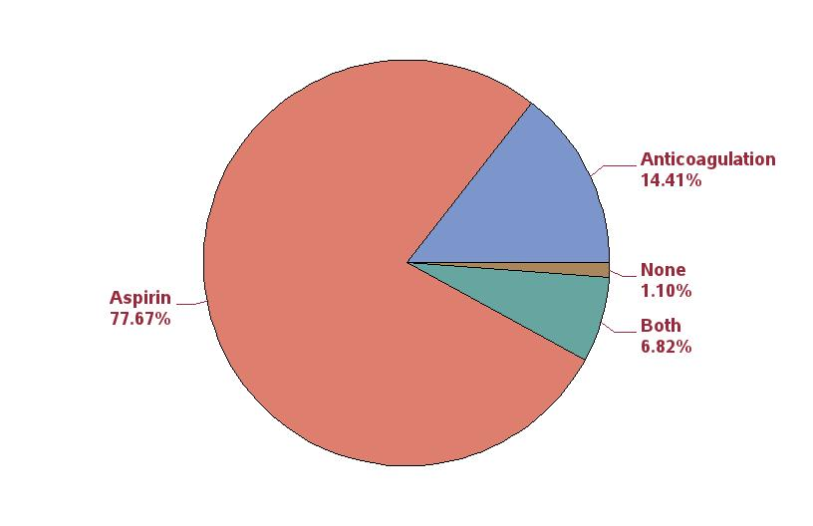
Figure 13: Percent of primary THA patients (first case) by thrombosis prophylaxis between 10/1/2017 and 12/31/2017).

Slide 14
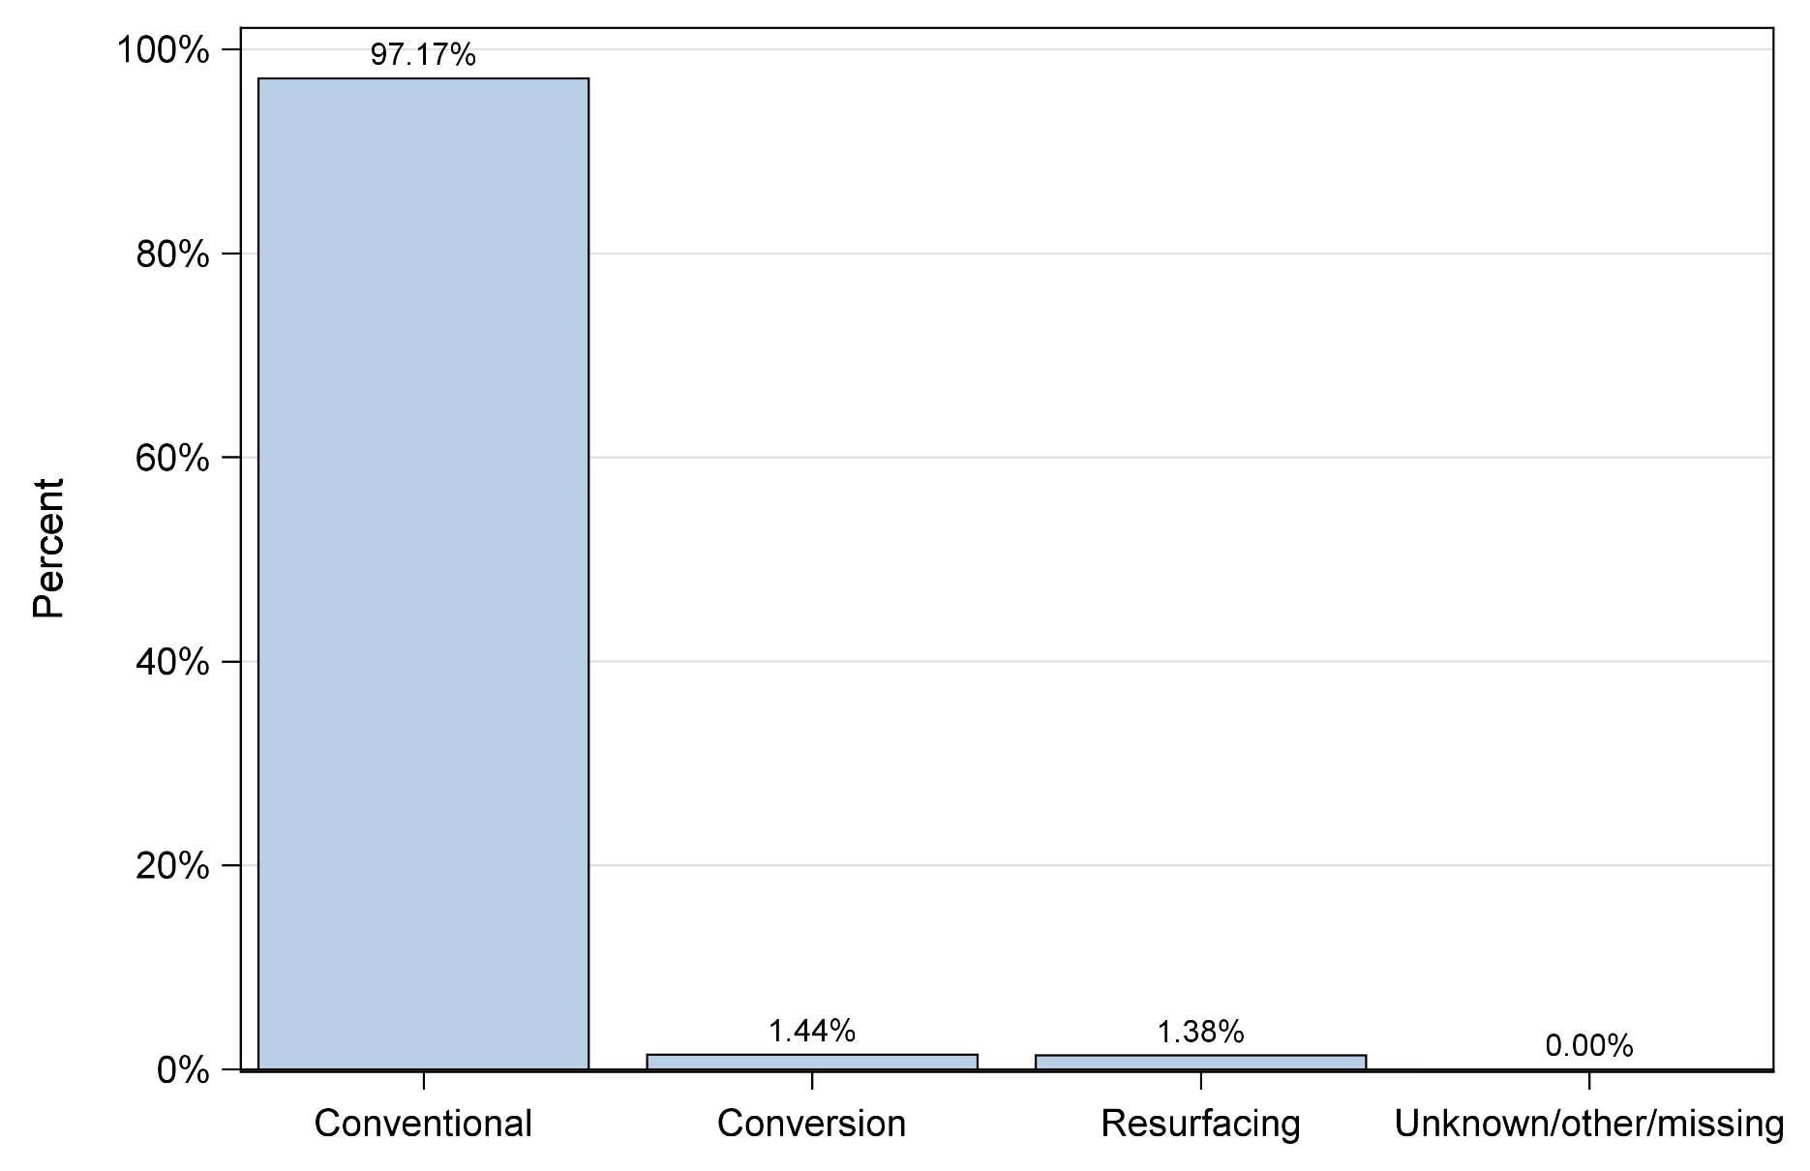
Figure 14: Percent of primary THA cases by procedure.

Slide 15
Table 4: Ten most commonly used femoral/acetabular component combinations used in primary total conventional THA.
Rank | Stem/cup combination | N | Percent
1 | Accolade II / Trident | 14230 | 22.5
2 | M/L Taper / Continuum | 5685 | 9.0
3 | Summit / Pinnacle | 4636 | 7.3
4 | Taperloc 133 / G7 | 3344 | 5.3
5 | Fitmore / Continuum | 2401 | 3.8
6 | Secur-Fit Max / Trident | 1988 | 3.1
7 | Secur-Fit Plus Max / Trident | 1909 | 3.0
8 | Anthology / Reflection 3 | 1875 | 3.0
9 | Corail / Pinnacle | 1799 | 2.9
10 | Tri-Lock BPS / Pinnacle | 1623 | 2.6
11 | Others | 23720 | 37.2

Slide 16
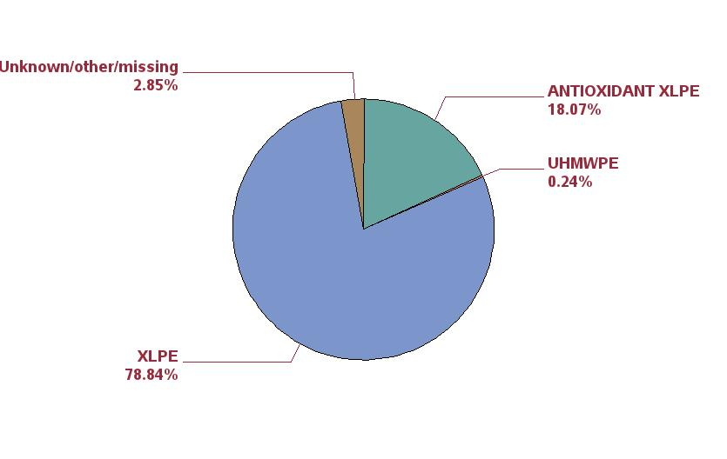
Figure 15: Percentage of polyethylene liners by type of polyethylene for primary conventional
THA.

Slide 17
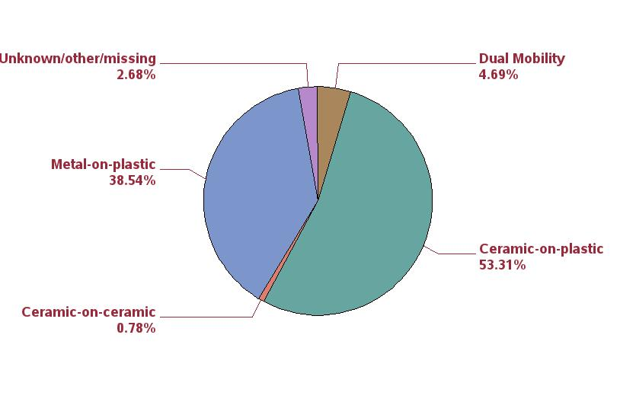
Figure 16: Percentage by bearing surface couple for primary conventional
THA.

Slide 18
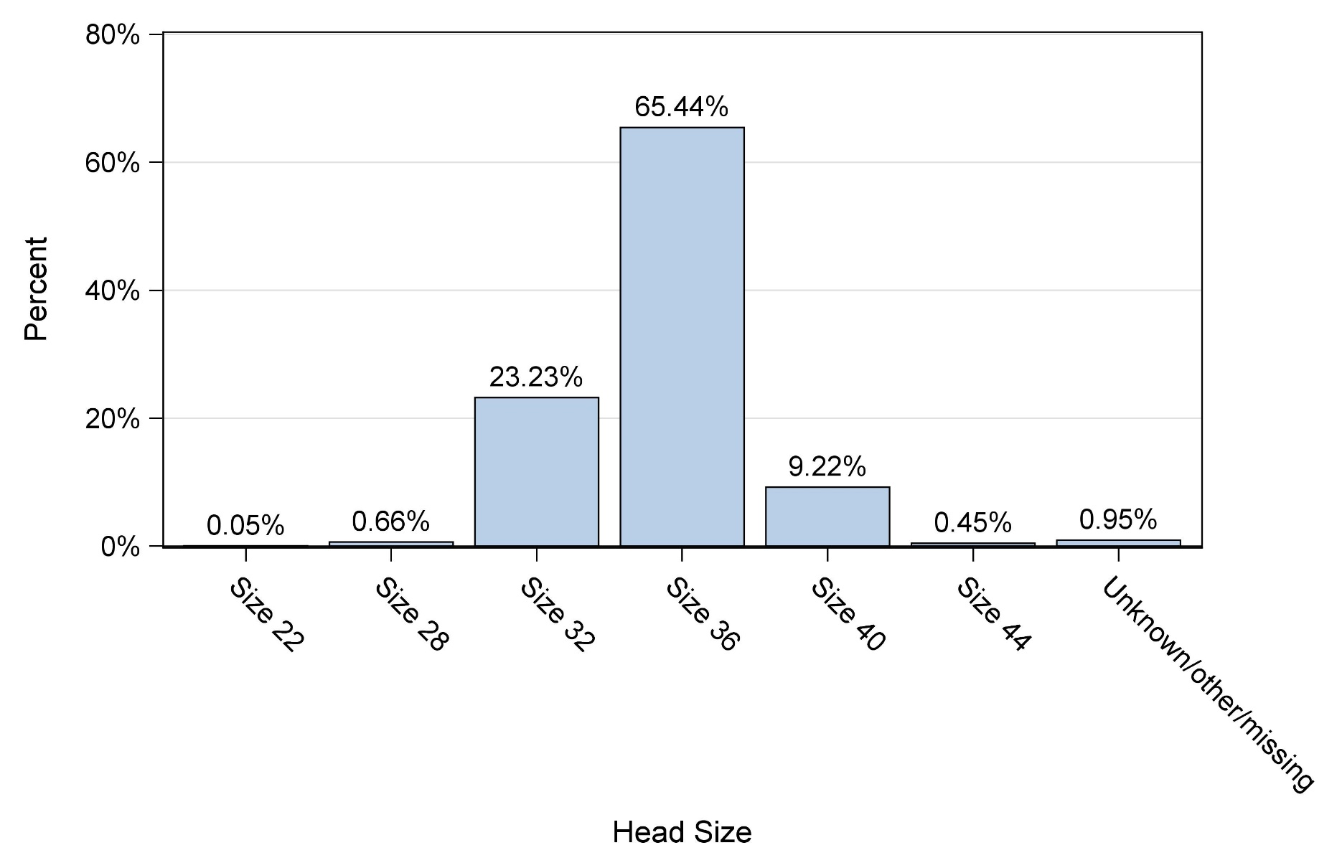
Figure 17: Distribution of head sizes for primary conventional THA, excluding dual mobility cases.

Slide 19
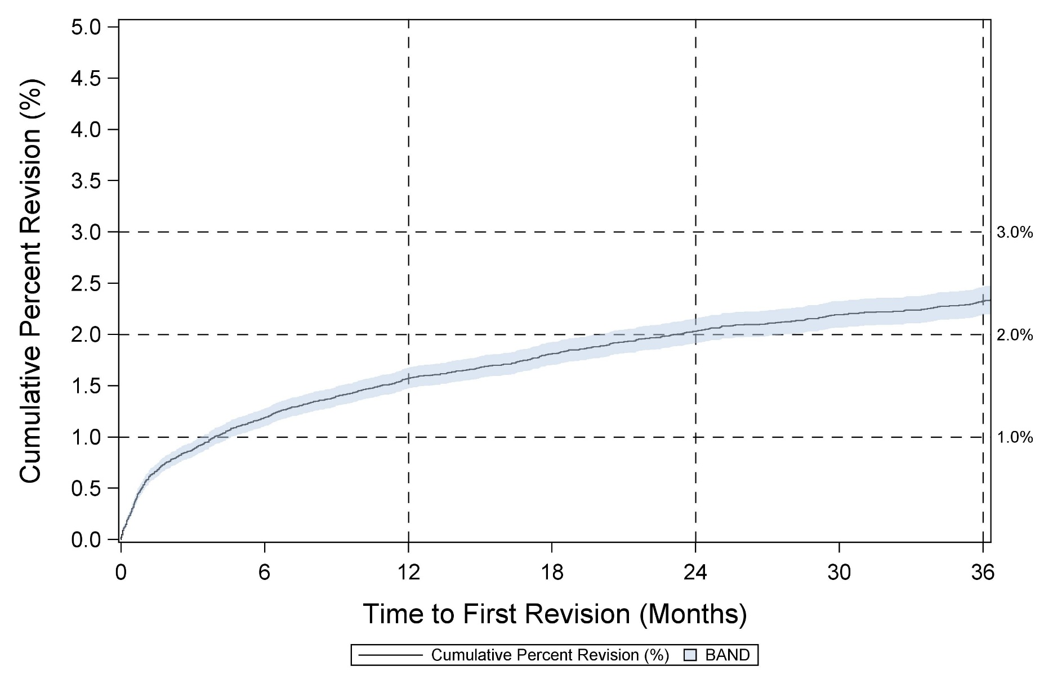
Figure 19: Cumulative percent revision for primary conventional THA.

Slide 20
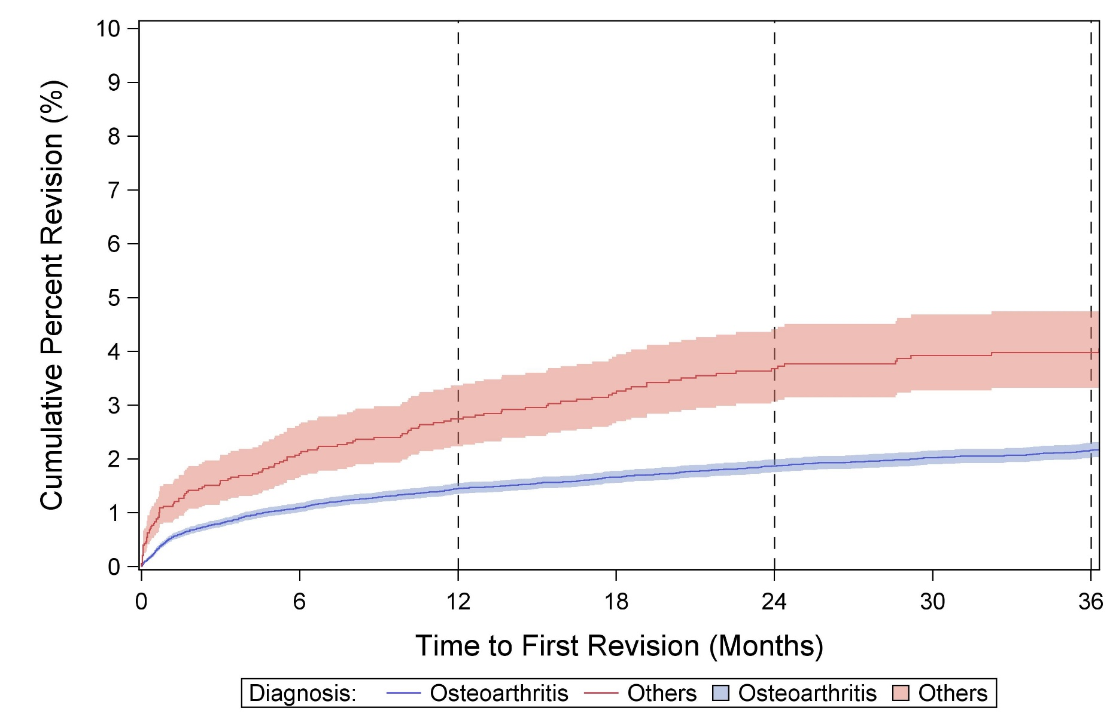
Figure 20: Cumulative percent revision for primary conventional THA by diagnosis.

Slide 21
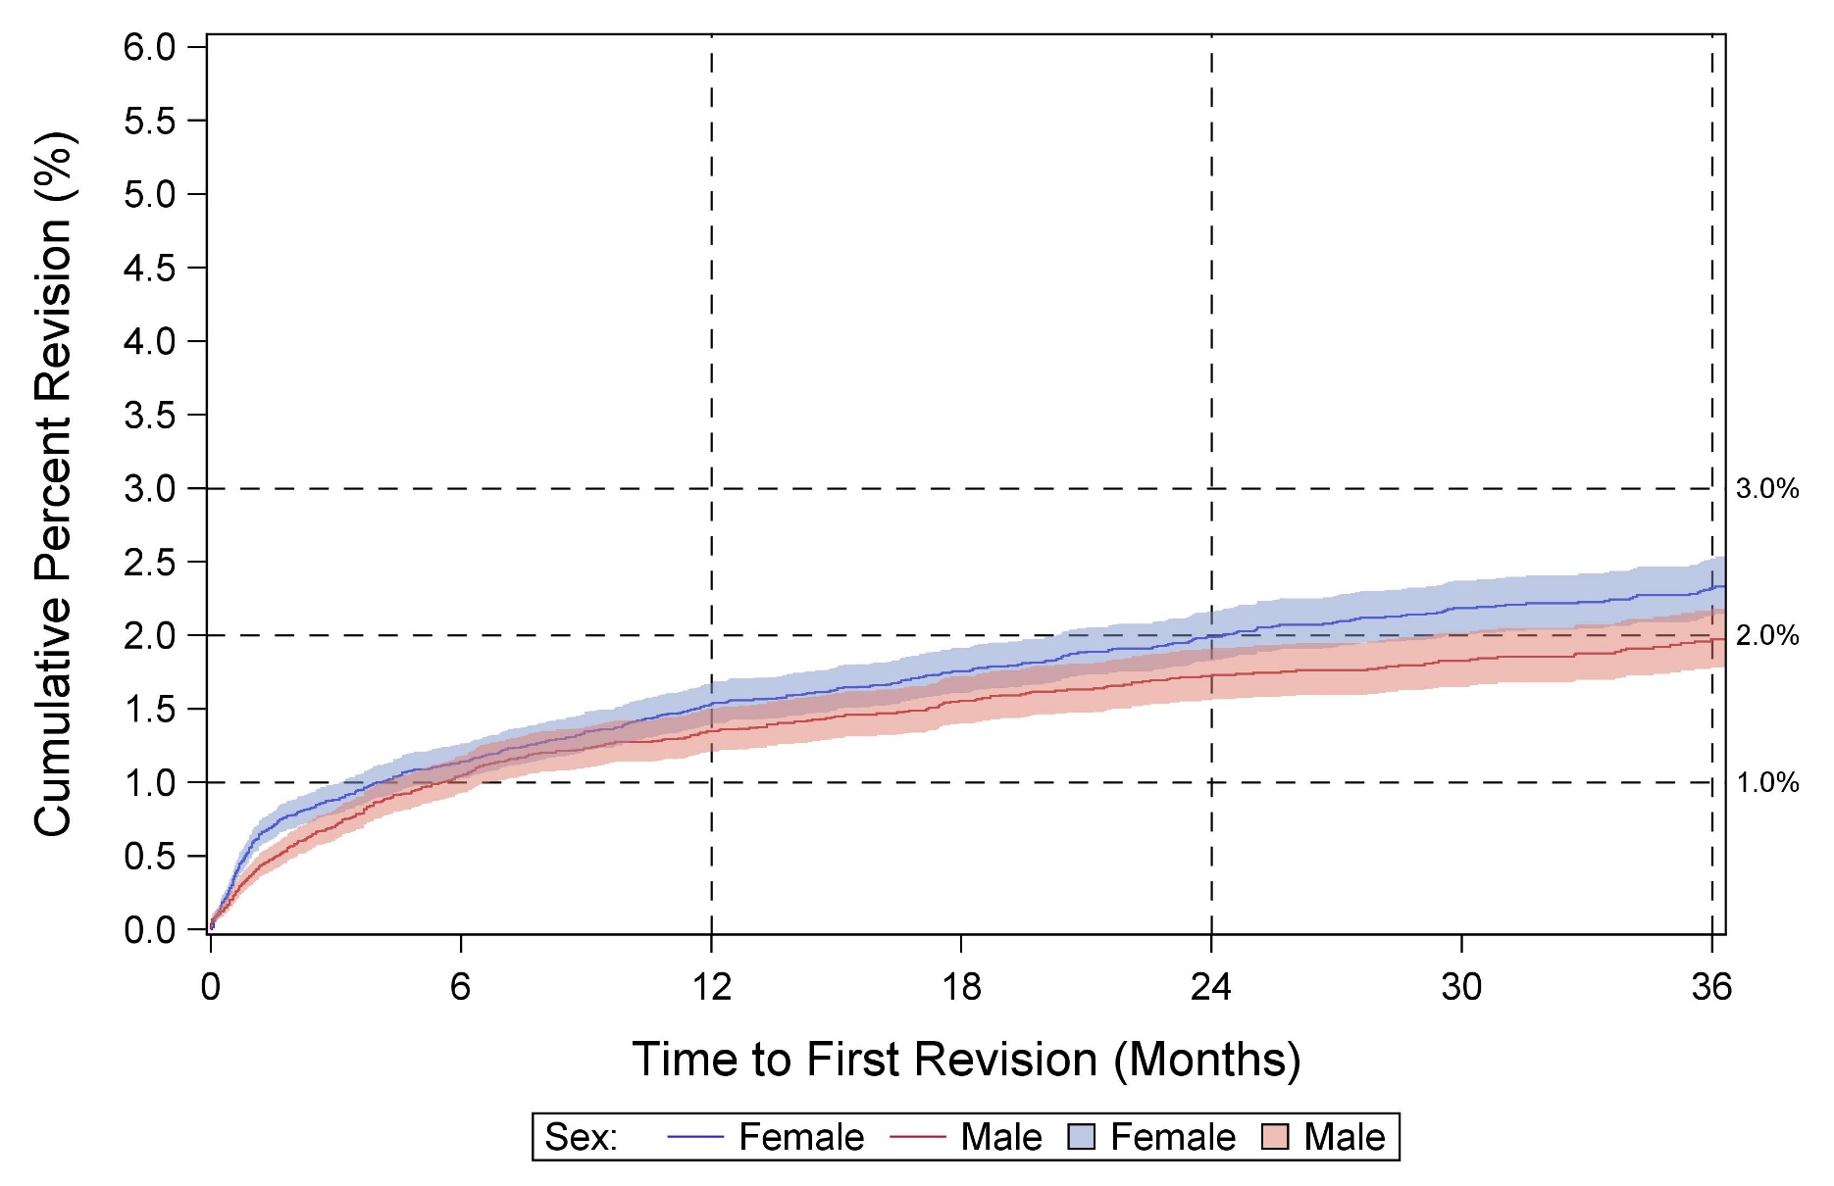
Figure 21: Cumulative percent revision for primary conventional THA by sex for osteoarthritis diagnosis.

Slide 22
CPR AT 1 YEAR FOR THA, SORTED BY CPR
** M/L Taper does not include M/L Taper Kinectiv

Slide 23
Table 6: Reasons for revision following primary conventional THA in first year post-operatively (top 10).
Rank | Reason for revision | N | Percent
1 | Peri-prosthetic fracture (Femur) | 235 | 32.1
2 | Instability/Dislocation | 187 | 25.6
3 | Joint Infection | 127 | 17.4
4 | Aseptic loosening | 70 | 9.6
5 | Pain | 46 | 6.3
6 | Component fracture/failure | 30 | 4.1
7 | Peri-prosthetic fracture (Acetabulum) | 18 | 2.5
8 | Malalignment | 15 | 2.0
9 | Poly liner wear | 1 | 0.1
10 | Unknown/other/missing | 2 | 0.3

Slide 24
CPR AT 3 YEARS FOR THA, SORTED BY CPR
** M/L Taper does not include M/L Taper Kinectiv

Slide 25
Table 5: Reasons for revision following primary conventional THA (top 10).
Rank | Reason for revision | N | Percent
1 | Peri-prosthetic fracture (Femur) | 255 | 24.9
2 | Instability/Dislocation | 248 | 24.2
3 | Joint Infection | 174 | 17.0
4 | Aseptic loosening | 159 | 15.5
5 | Pain | 93 | 9.1
6 | Component fracture/failure | 38 | 3.7
7 | Peri-prosthetic fracture (Acetabulum) | 24 | 2.3
8 | Malalignment | 22 | 2.1
9 | Metal reaction/Metallosis | 8 | 0.8
10 | Poly liner wear | 1 | 0.1

Slide 26
KNEE CHAPTER

Slide 27
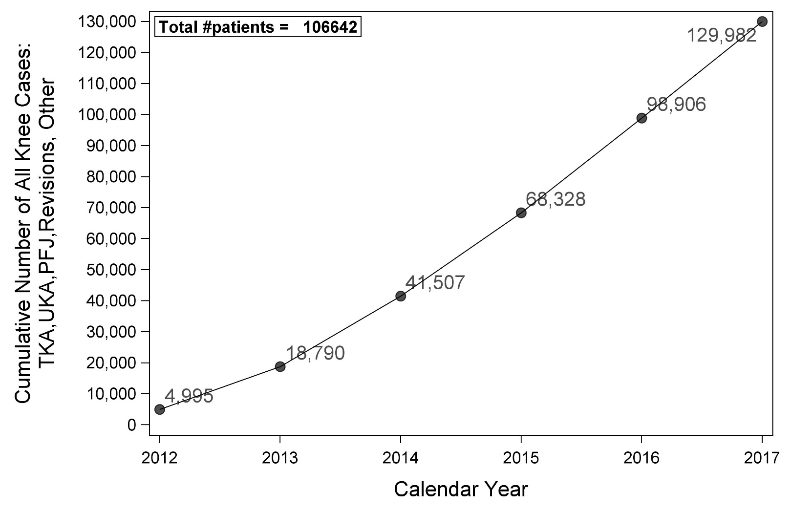
Figure 44: All knee cases over time.

Slide 28

Figure 45: Percent of knee arthroplasty cases by primary or revision.

Slide 29
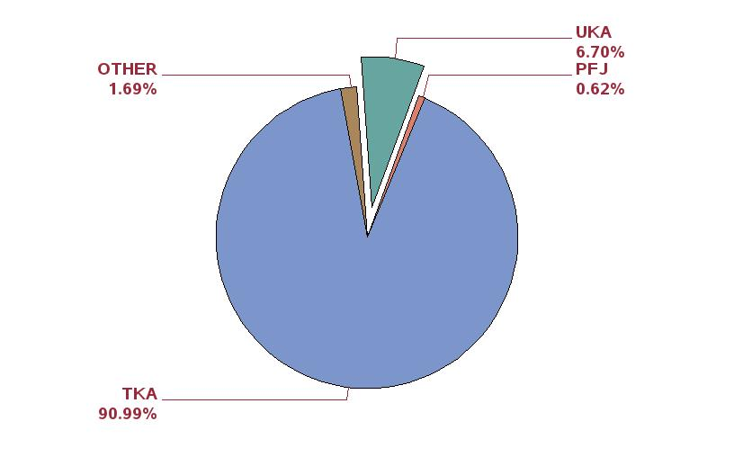
Figure 46: Percent of primary TKA cases performed as TKA, UKA, and PFJ.

Slide 30
TKA

Slide 31
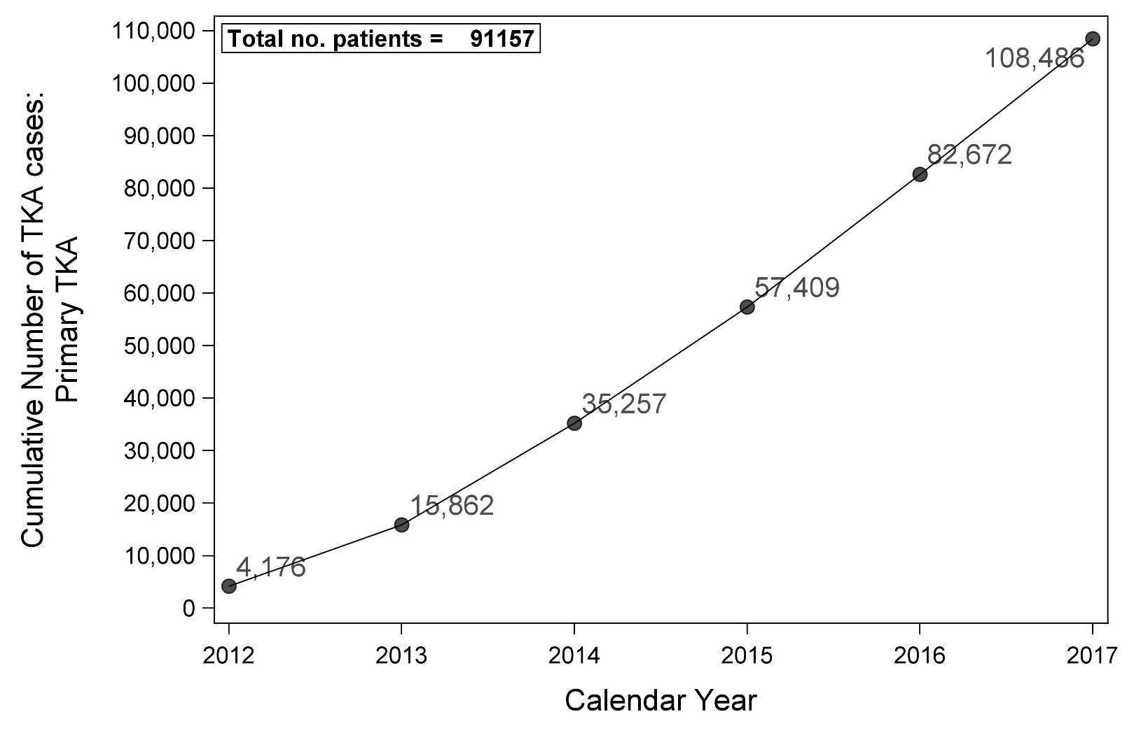
Figure 47: Primary TKA cases over time.

Slide 32
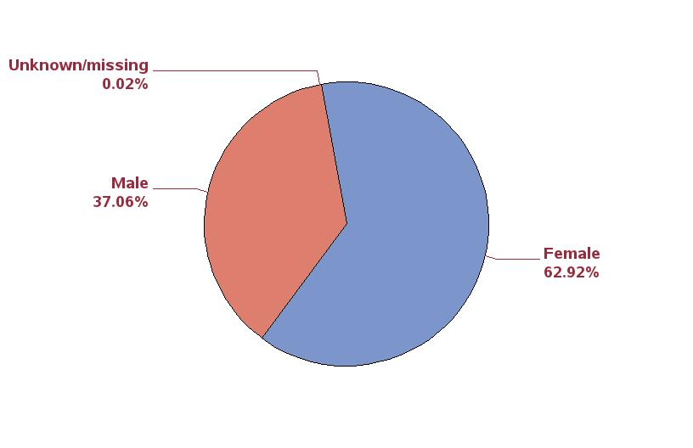
Figure 48: Percent of primary TKA cases by sex.

Slide 33
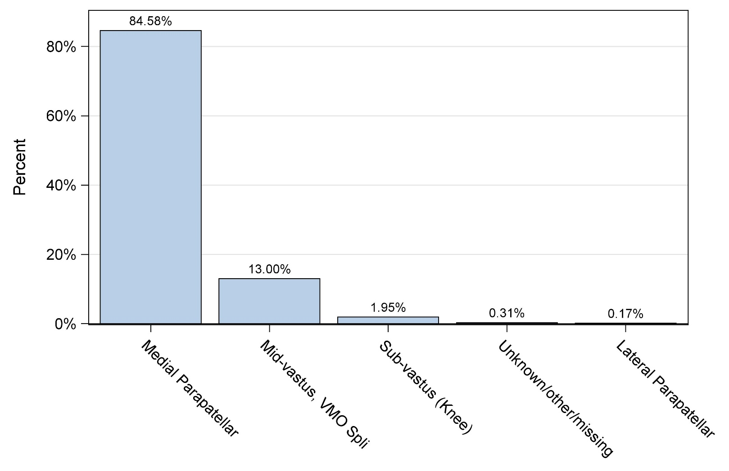
Figure 50: Percent of primary TKA cases by approach.

Slide 34
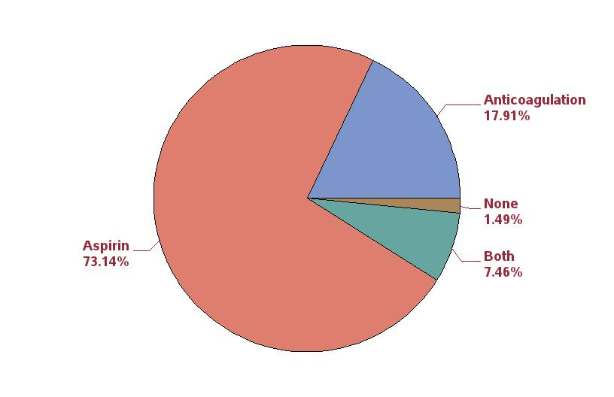
Figure 53: Percent of primary TKA patients (first case) by thrombosis pharmacoprophylaxis between 10/1/2017 and 12/31/2017.

Slide 35
Table 192: Ten most commonly used femoral/tibial component combinations in primary
TKA.
Rank | Femora/tibial component combination | N | Percent
1 | Persona / Persona | 25251 | 23.3
2 | Vanguard / Maxim | 15195 | 14.0
3 | Triathlon / Triathlon | 14829 | 13.7
4 | Triathlon / Triathlon TS | 13667 | 12.6
5 | Attune / Attune | 6363 | 5.9
6 | Genesis II / Genesis II | 6356 | 5.9
7 | Sigma PFC / Sigma | 2734 | 2.5
8 | Journey II / Journey | 2507 | 2.3
9 | NK II GS / NK II | 2071 | 1.9
10 | Sigma / Sigma | 1366 | 1.3
11 | Others | 18147 | 16.6

Slide 36
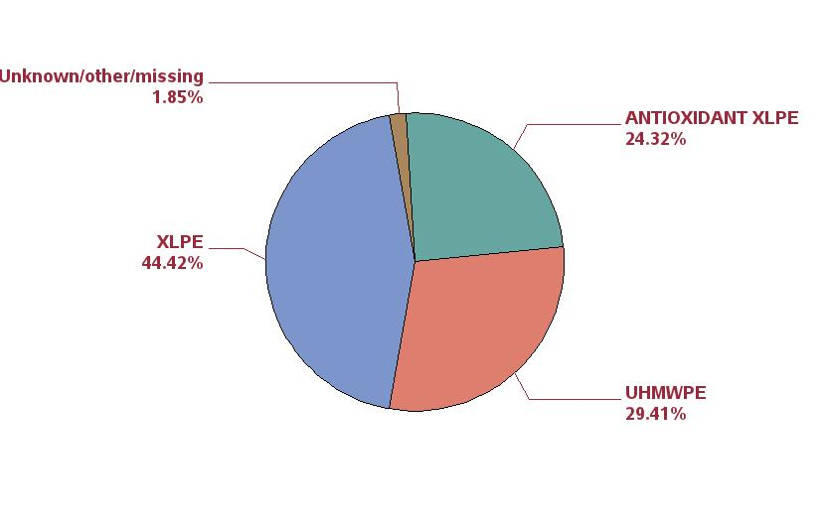
Figure 54: Percent of polyethylene inserts by type of polyethylene in primary
TKA.

Slide 37
Table 193: Reasons for first revision following
TKA (top 10).
Rank | Reason for revision | N | Percent
1 | Instability/Dislocation | 446 | 28.0
2 | Joint Infection | 363 | 22.8
3 | Pain | 254 | 16.0
4 | Aseptic loosening | 242 | 15.2
5 | Arthrofibrosis | 110 | 6.9
6 | Component fracture/failure | 57 | 3.6
7 | Malalignment | 30 | 1.9
8 | Peri-prosthetic fracture (Femur) | 28 | 1.8
9 | Metal reaction/Metallosis | 18 | 1.1
10 | Extensor mechanism failure | 14 | 0.9

Slide 38
Table 194: Reasons for first revision following primary TKA in first year post-operatively (top 10).
Rank | Reason for revision | N | Percent
1 | Joint Infection | 182 | 27.8
2 | Instability/Dislocation | 175 | 26.8
3 | Pain | 94 | 14.4
4 | Arthrofibrosis | 66 | 10.1
5 | Aseptic loosening | 47 | 7.2
6 | Peri-prosthetic fracture (Femur) | 22 | 3.4
7 | Component fracture/failure | 19 | 2.9
8 | Malalignment | 17 | 2.6
9 | Extensor mechanism failure | 10 | 1.5
10 | Peri-prosthetic fracture (Tibia) | 8 | 1.2

Slide 39
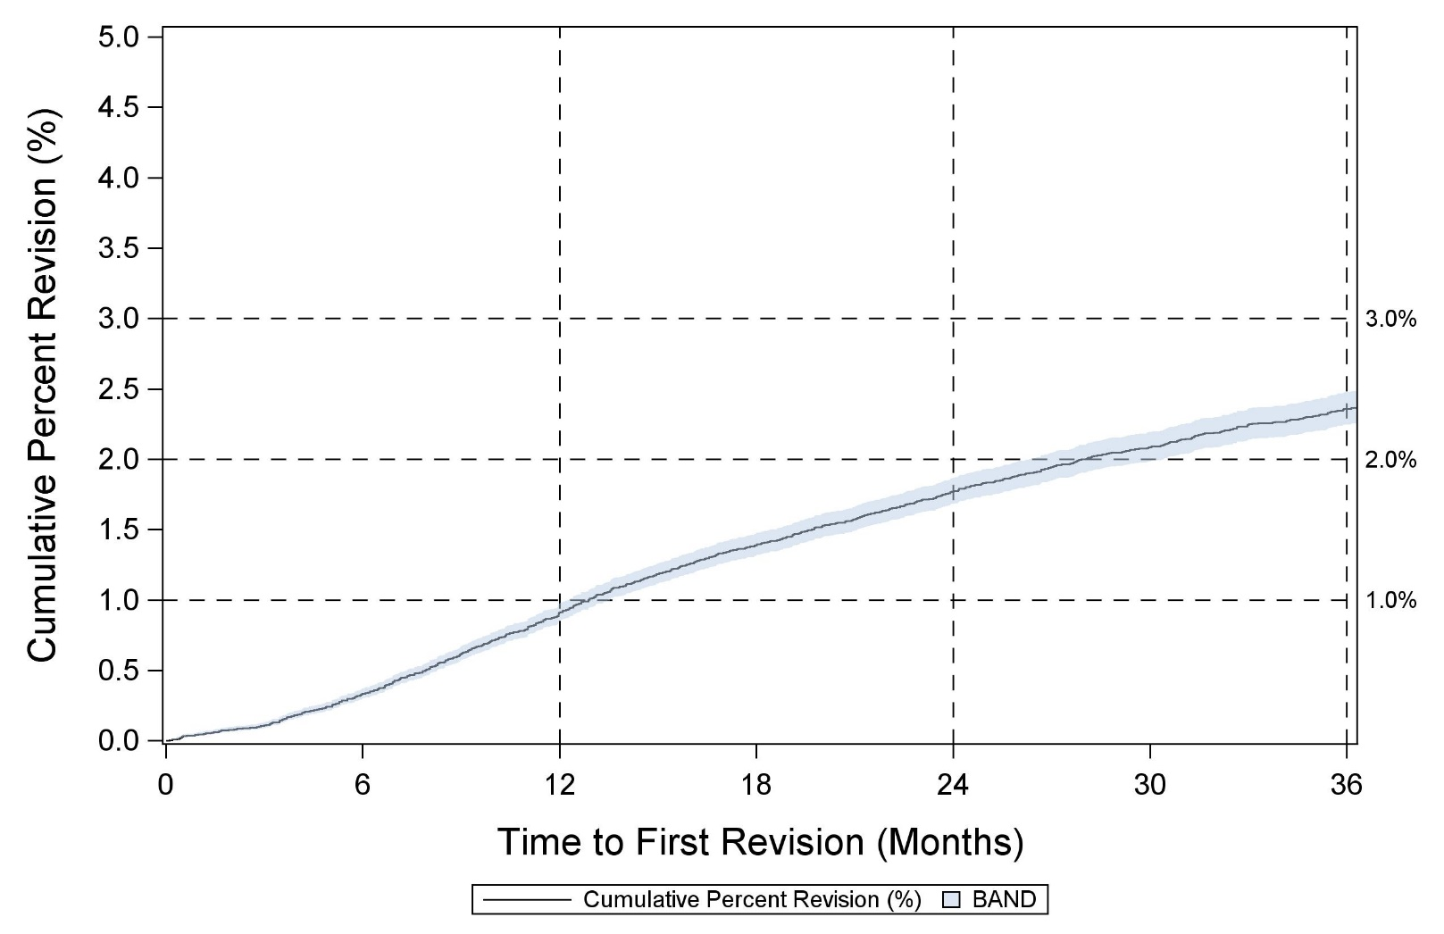
Figure 56: Cumulative percent revision for primary TKA.

Slide 40
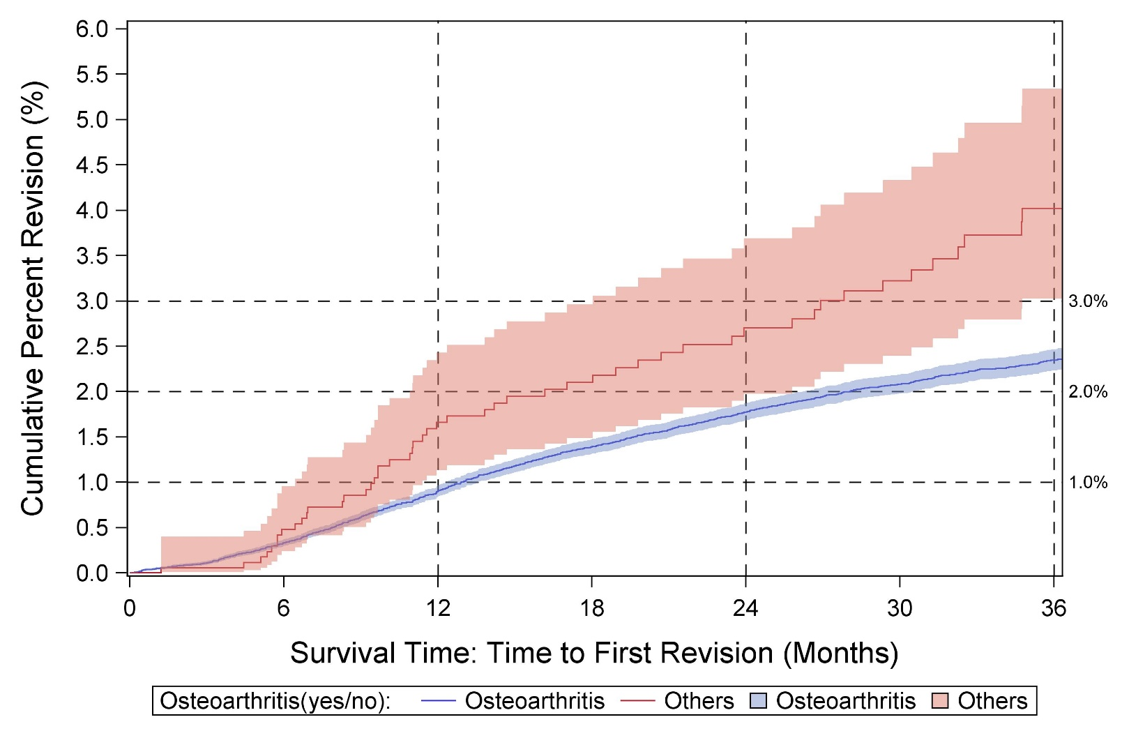
Figure 57: Cumulative percent revision for primary TKA by diagnosis.

Slide 41
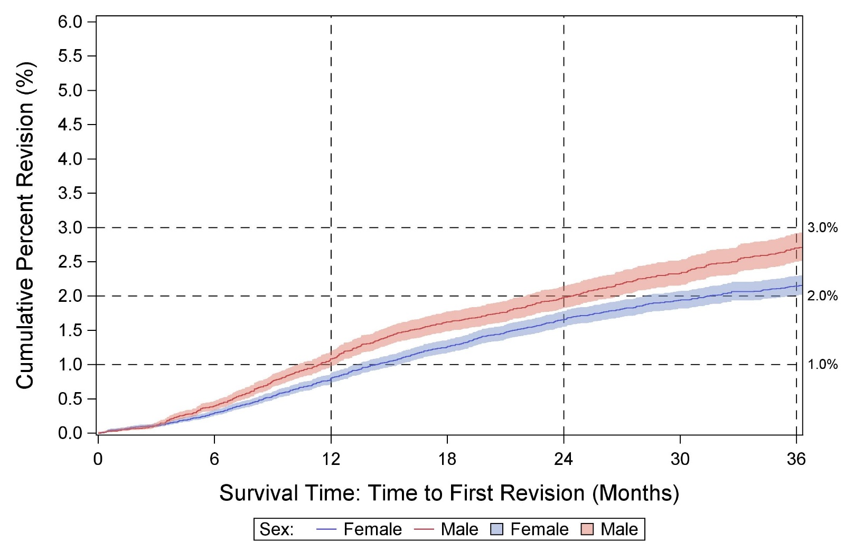
Figure 58: Cumulative percent revision for primary TKA by sex for osteoarthritis diagnosis.

Slide 42
CPR AT 3 YEARS FOR TKA, SORTED BY CPR

Slide 43
UKA

Slide 44
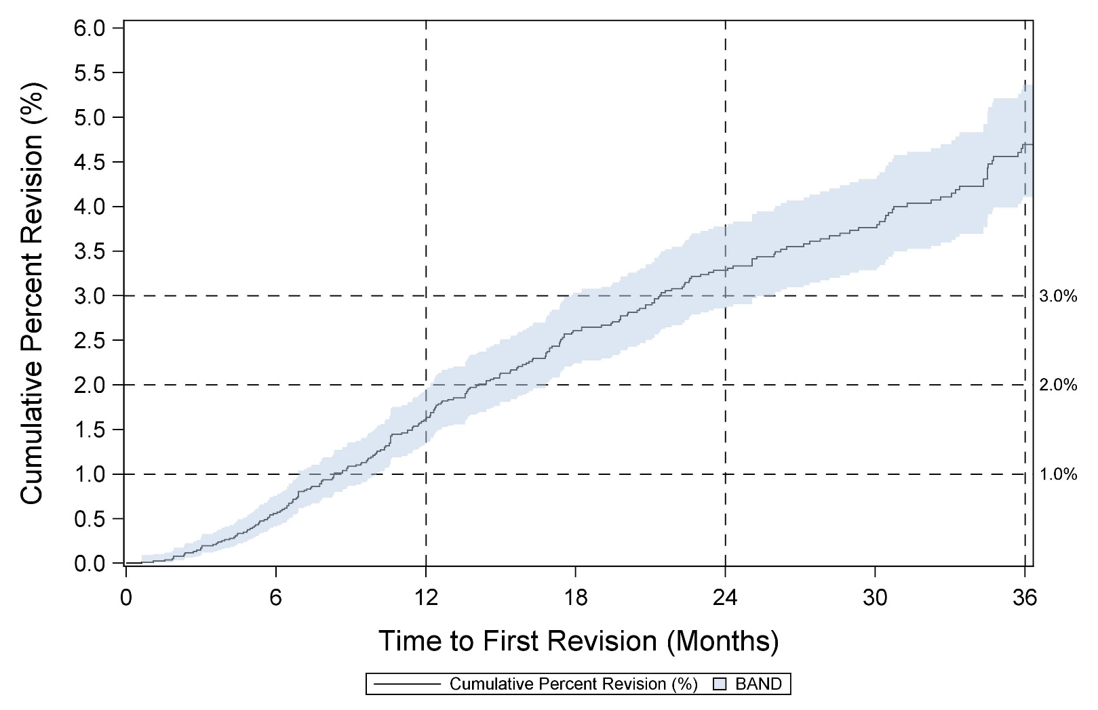
Figure 85: Primary UKA cases over time.

Slide 45
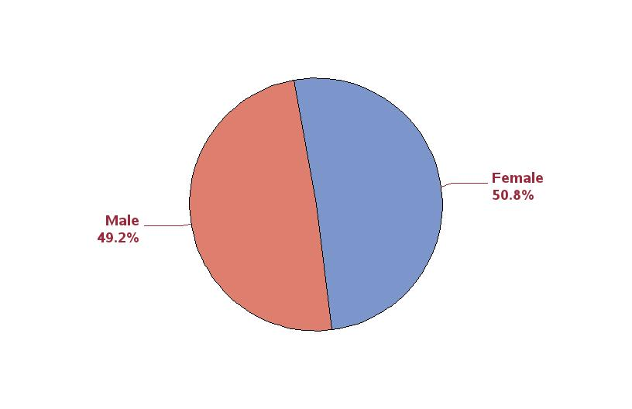
Figure 86: Percent of primary UKA cases by sex.

Slide 46
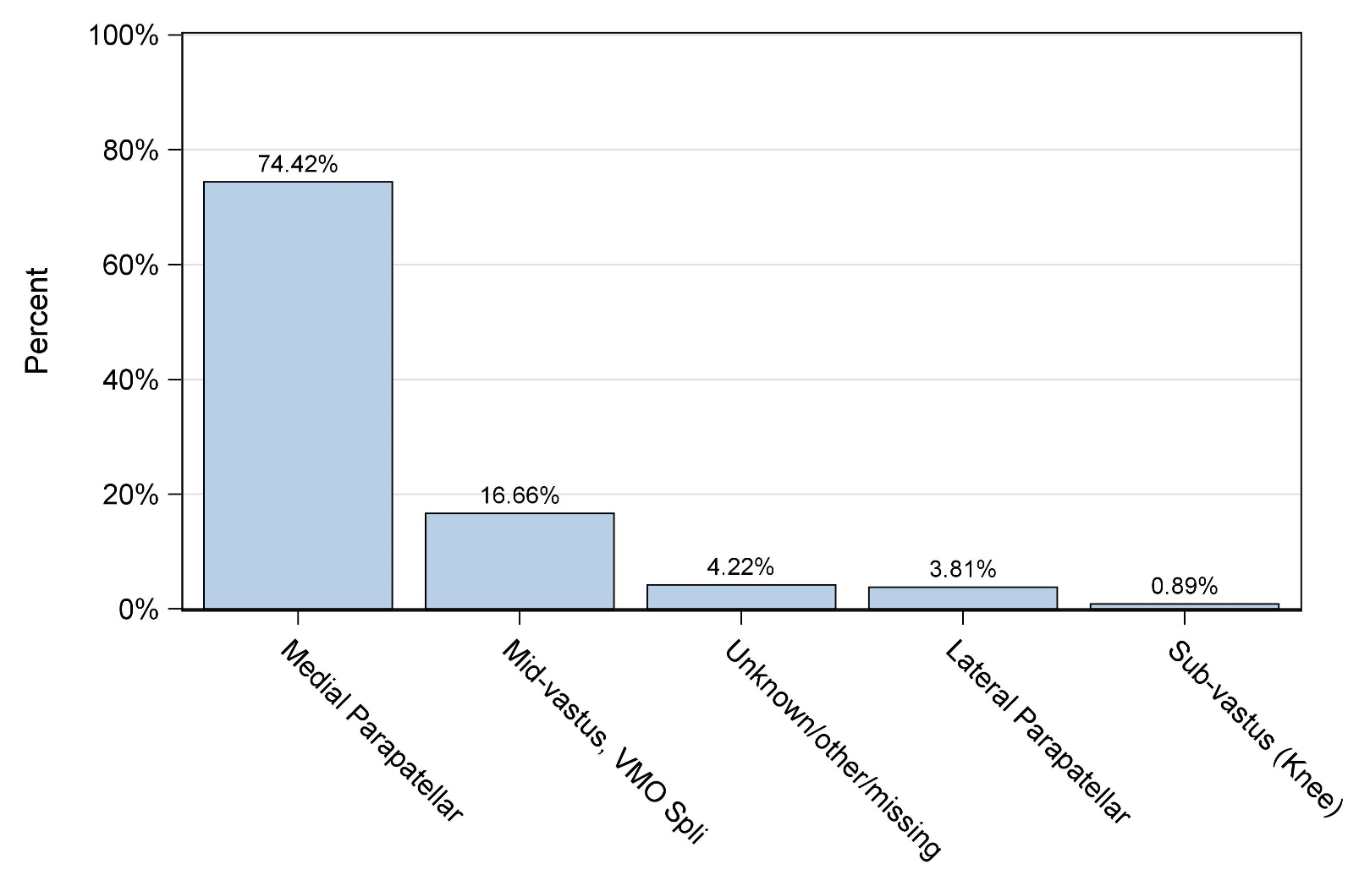
Figure 88: Percent of primary UKA cases by approach.

Slide 47
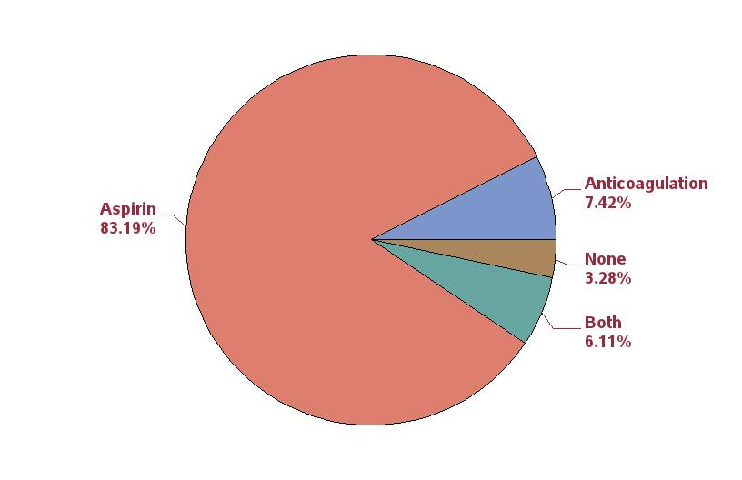
Figure 91: Percent of primary UKA patients (first case) by thrombosis pharmacoprophylaxis between 10/1/2017 and 12/31/2017.

Slide 48
Table 360: Ten most commonly used femoral/tibial component combinations in primary UKA.
Rank | Femoral/tibial component combination | N | Percent
1 | Restoris MCK / Restoris MCK | 2498 | 31.3
2 | ZUK/ZUK* | 2313 | 29.0
3 | Oxford / Oxford | 2040 | 25.5
4 | Triathlon PKR / Triathlon PKR | 266 | 3.3
5 | iBalance / iBalance | 167 | 2.1
6 | Sigma HP / Sigma HP | 141 | 1.8
7 | Persona / Persona | 106 | 1.3
8 | Journey / Journey | 103 | 1.3
9 | Journey / Zimmer High Flex | 89 | 1.1
10 | Stride / Stride | 89 | 1.1
11 | Others | 175 | 2.2
* ZUK (Zimmer Unicondylar Knee) was formerly known as the Zimmer High Flex Knee.

Slide 49
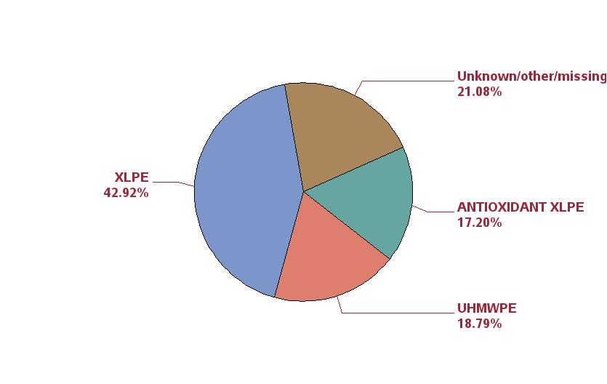
Figure 92: Percentage of polyethylene inserts by type of polyethylene in primary
UKA.

Slide 50
Table 361. Reasons for first revision following primary UKA.
Rank | Reason for revision | N | Percent
1 | Conversion of UKA | 66 | 29.3
2 | Aseptic loosening | 47 | 20.9
3 | Pain | 45 | 20.0
4 | Instability/Dislocation | 17 | 7.6
5 | Joint Infection | 14 | 6.2
6 | Component fracture/failure | 12 | 5.3
7 | Peri-prosthetic fracture (Tibia) | 8 | 3.6
8 | Extensor mechanism failure | 4 | 1.8
9 | Osteolysis | 3 | 1.3
10 | Metal reaction/Metallosis | 2 | 0.9

Slide 51
Table 362. Reasons for first revision following primary UKA in first year post-operatively.
Rank | Reason for revision | N | Percent
1 | Conversion of UKA | 16 | 18.0
2 | Pain | 15 | 16.9
3 | Aseptic loosening | 14 | 15.7
4 | Joint Infection | 11 | 12.4
5 | Instability/Dislocation | 8 | 9.0
6 | Peri-prosthetic fracture (Tibia) | 8 | 9.0
7 | Component fracture/failure | 4 | 4.5
8 | Extensor mechanism failure | 4 | 4.5
9 | Osteolysis | 2 | 2.2
10 | Metal reaction/Metallosis | 2 | 2.2

Slide 52
Figure 94: Cumulative percent revision for primary UKA.

Slide 53
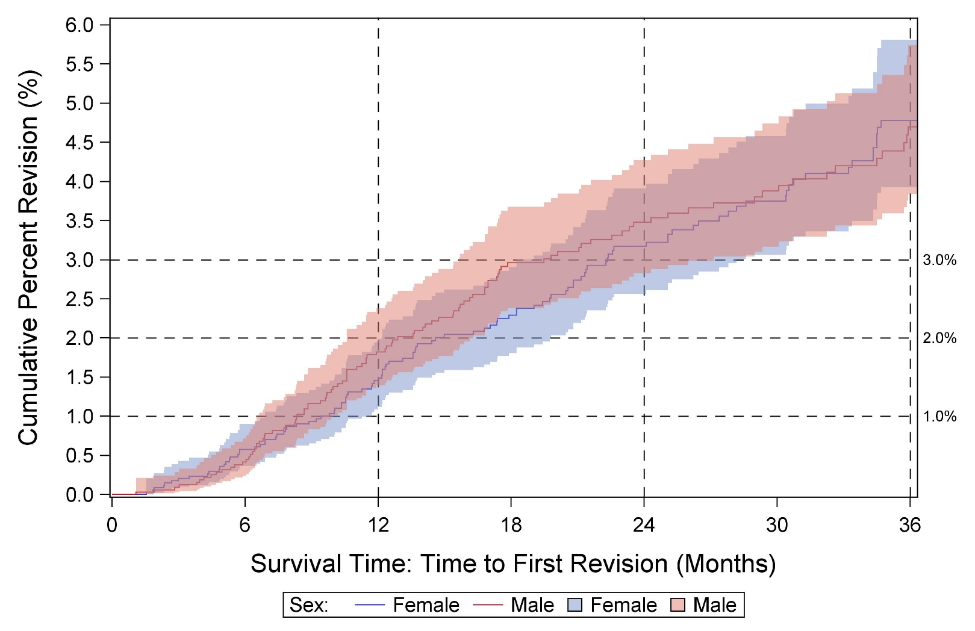
Figure 95: Cumulative percent revision for primary UKA by sex for osteoarthritis diagnosis.

Slide 54
CPR AT 3 YEARS FOR UKA, SORTED BY CPR
** Formerly known as Zimmer High Flex knee

