Slide 1

Michigan Arthroplasty Registry Collaborative Quality Initiative (MARCQI)

Slide 2
MARCQI REPORT
Reports on the first five years of MARCQI
Released November, 2017
This slide deck provides selected slides
For full report, see PDF available online

Slide 3
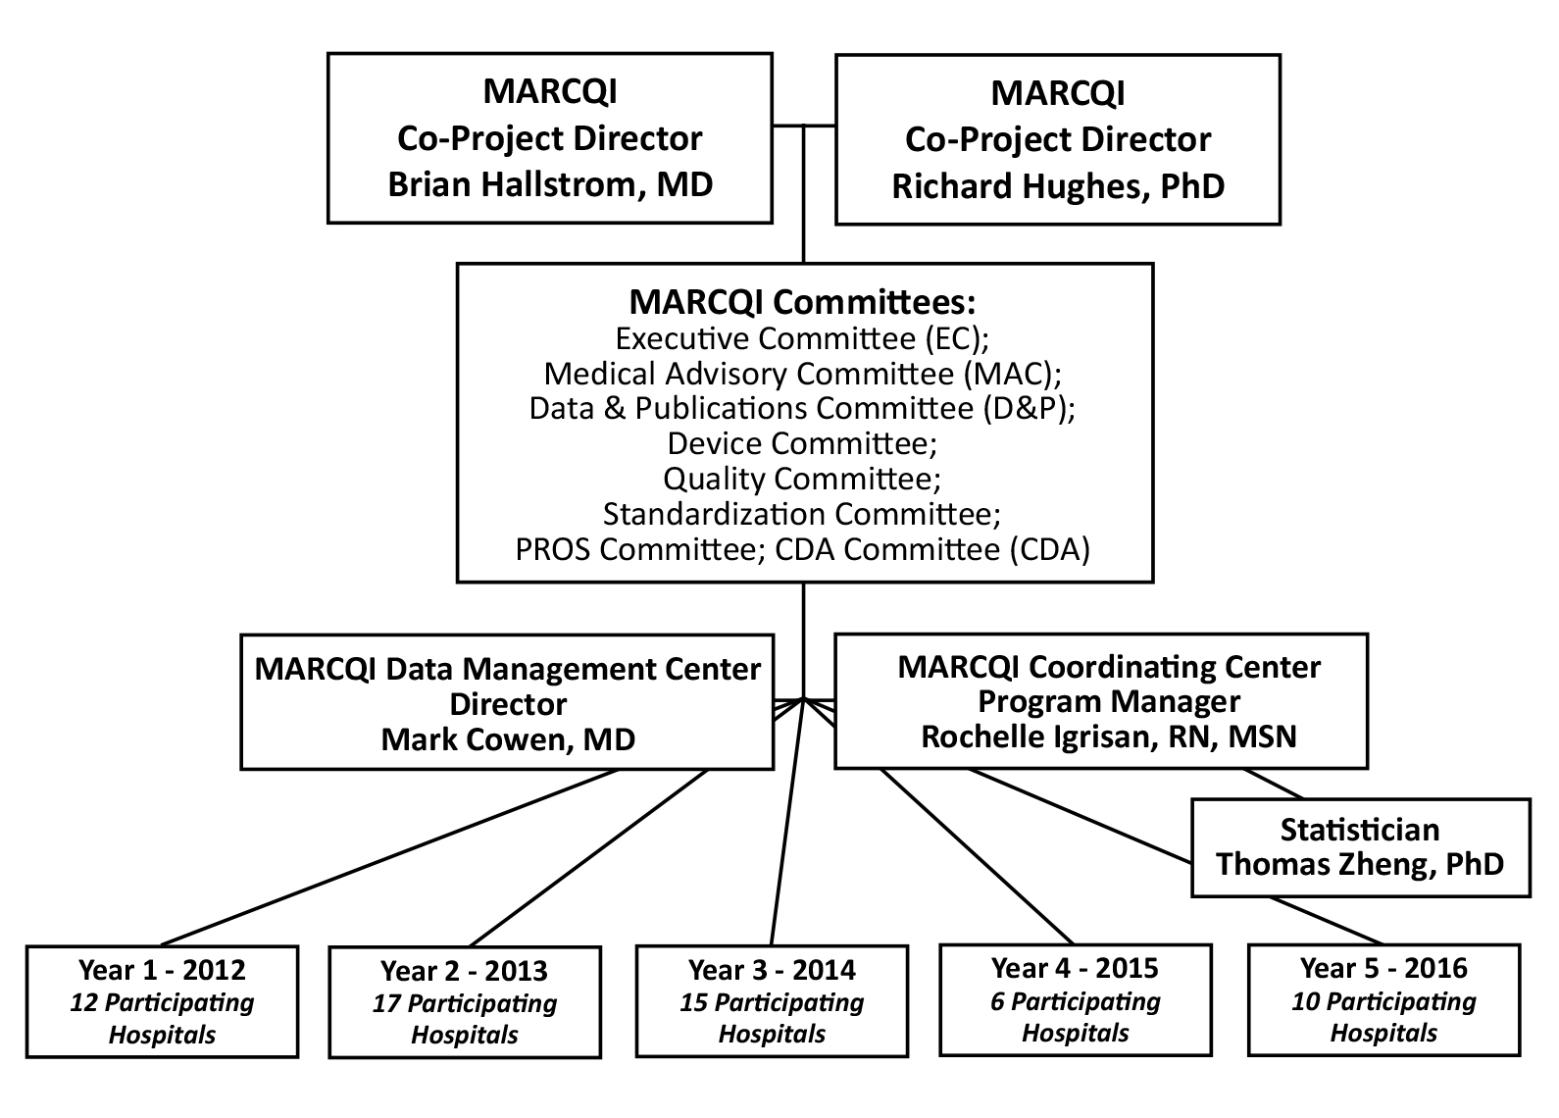
MARCQI organization

Slide 4
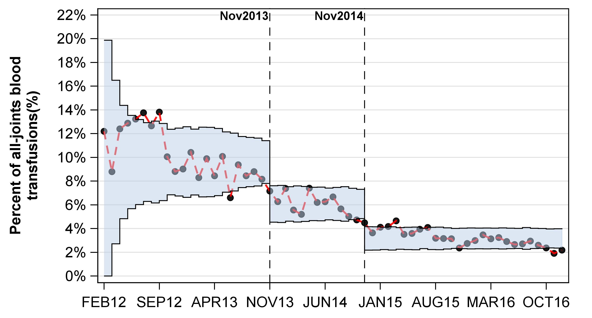
Blood transfusion over time for elective primary hip and knee replacement in Michigan

Slide 5
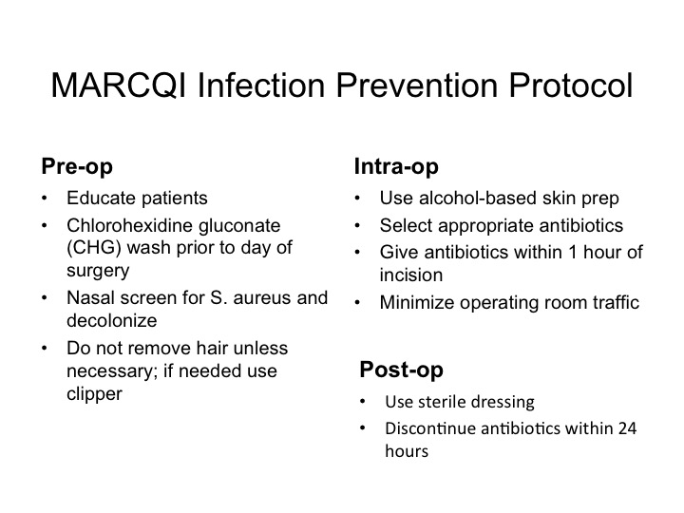

Slide 6
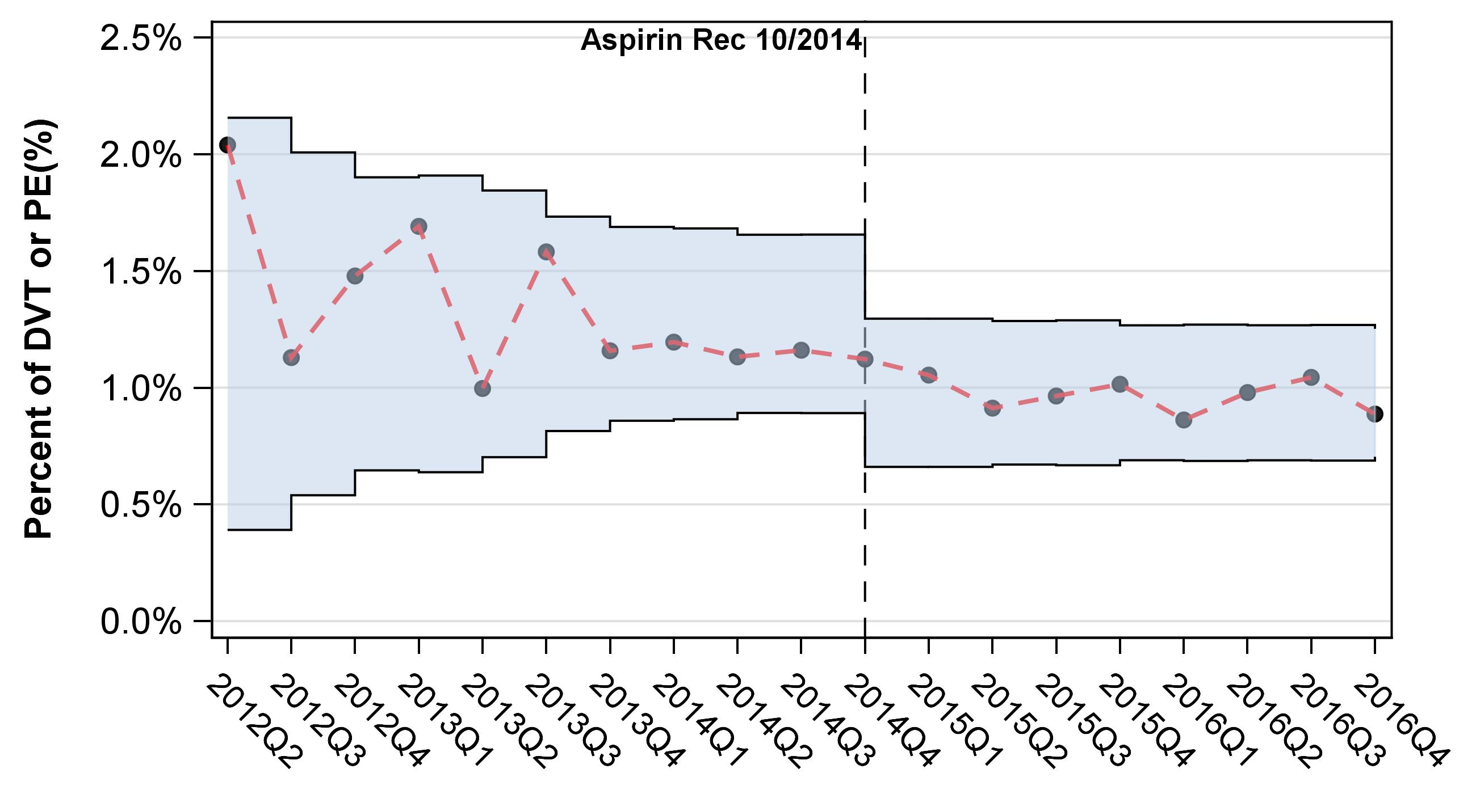
Percent of cases with DVT or PE within 90 days of surgery

Slide 7
THA

Slide 8
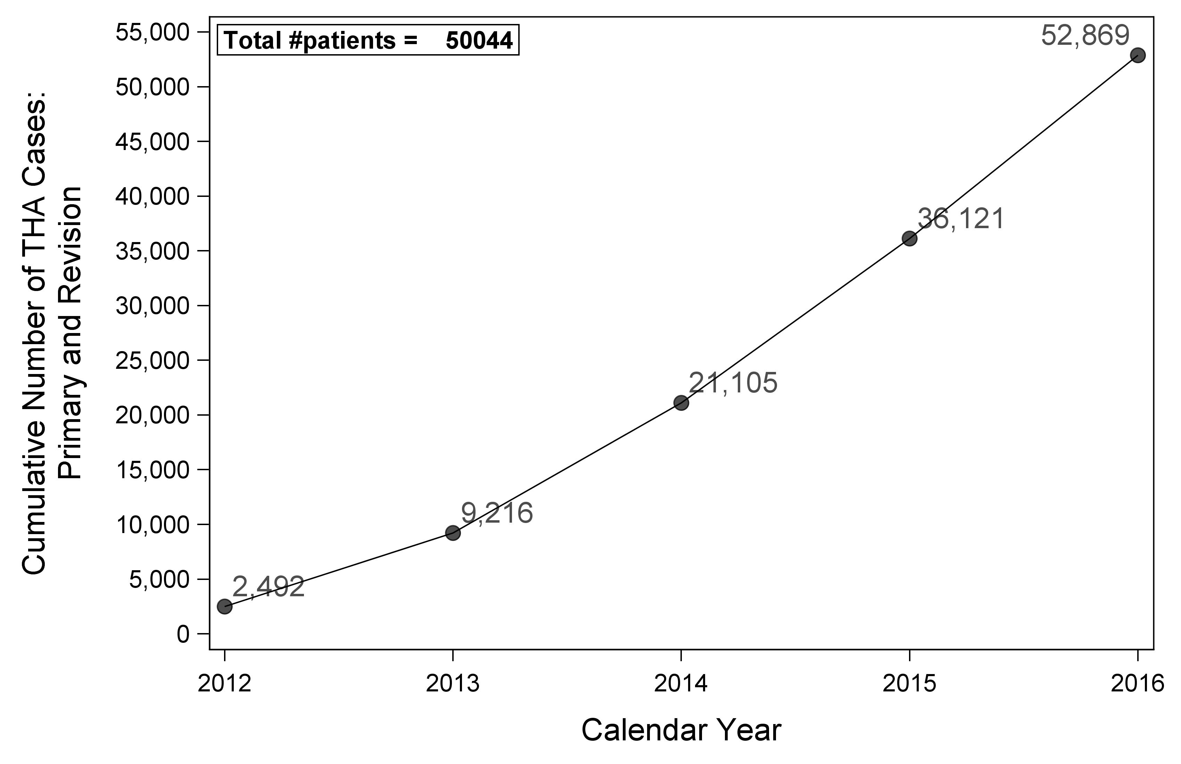
Figure 8: THA cases over time

Slide 9
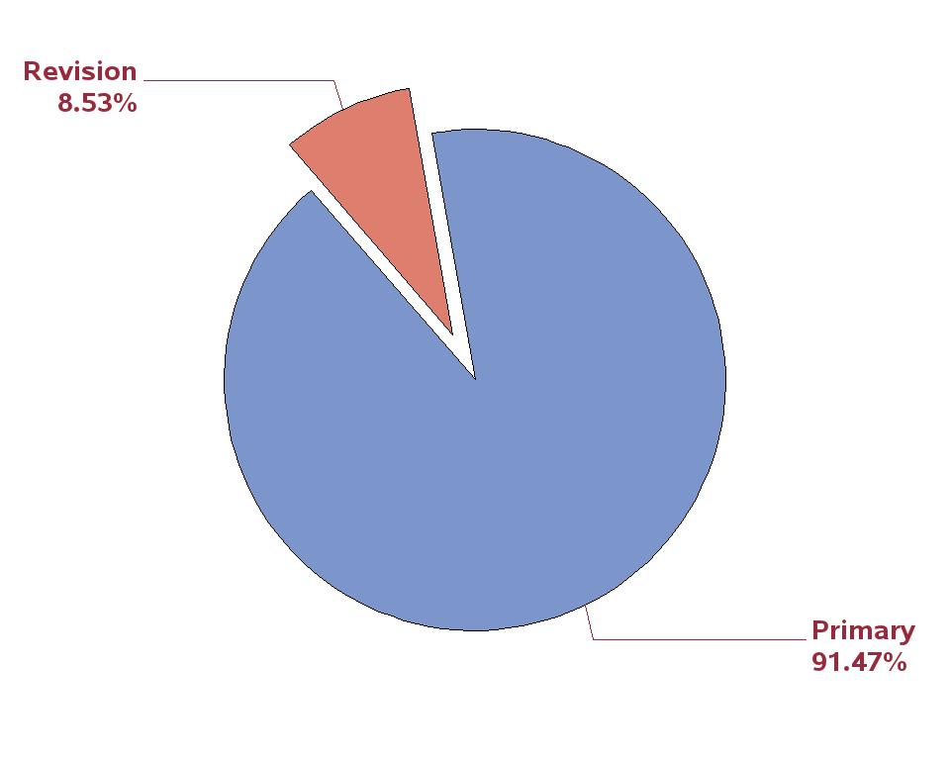
Figure 9: Percent of THA arthroplasty cases by primary or revision

Slide 10
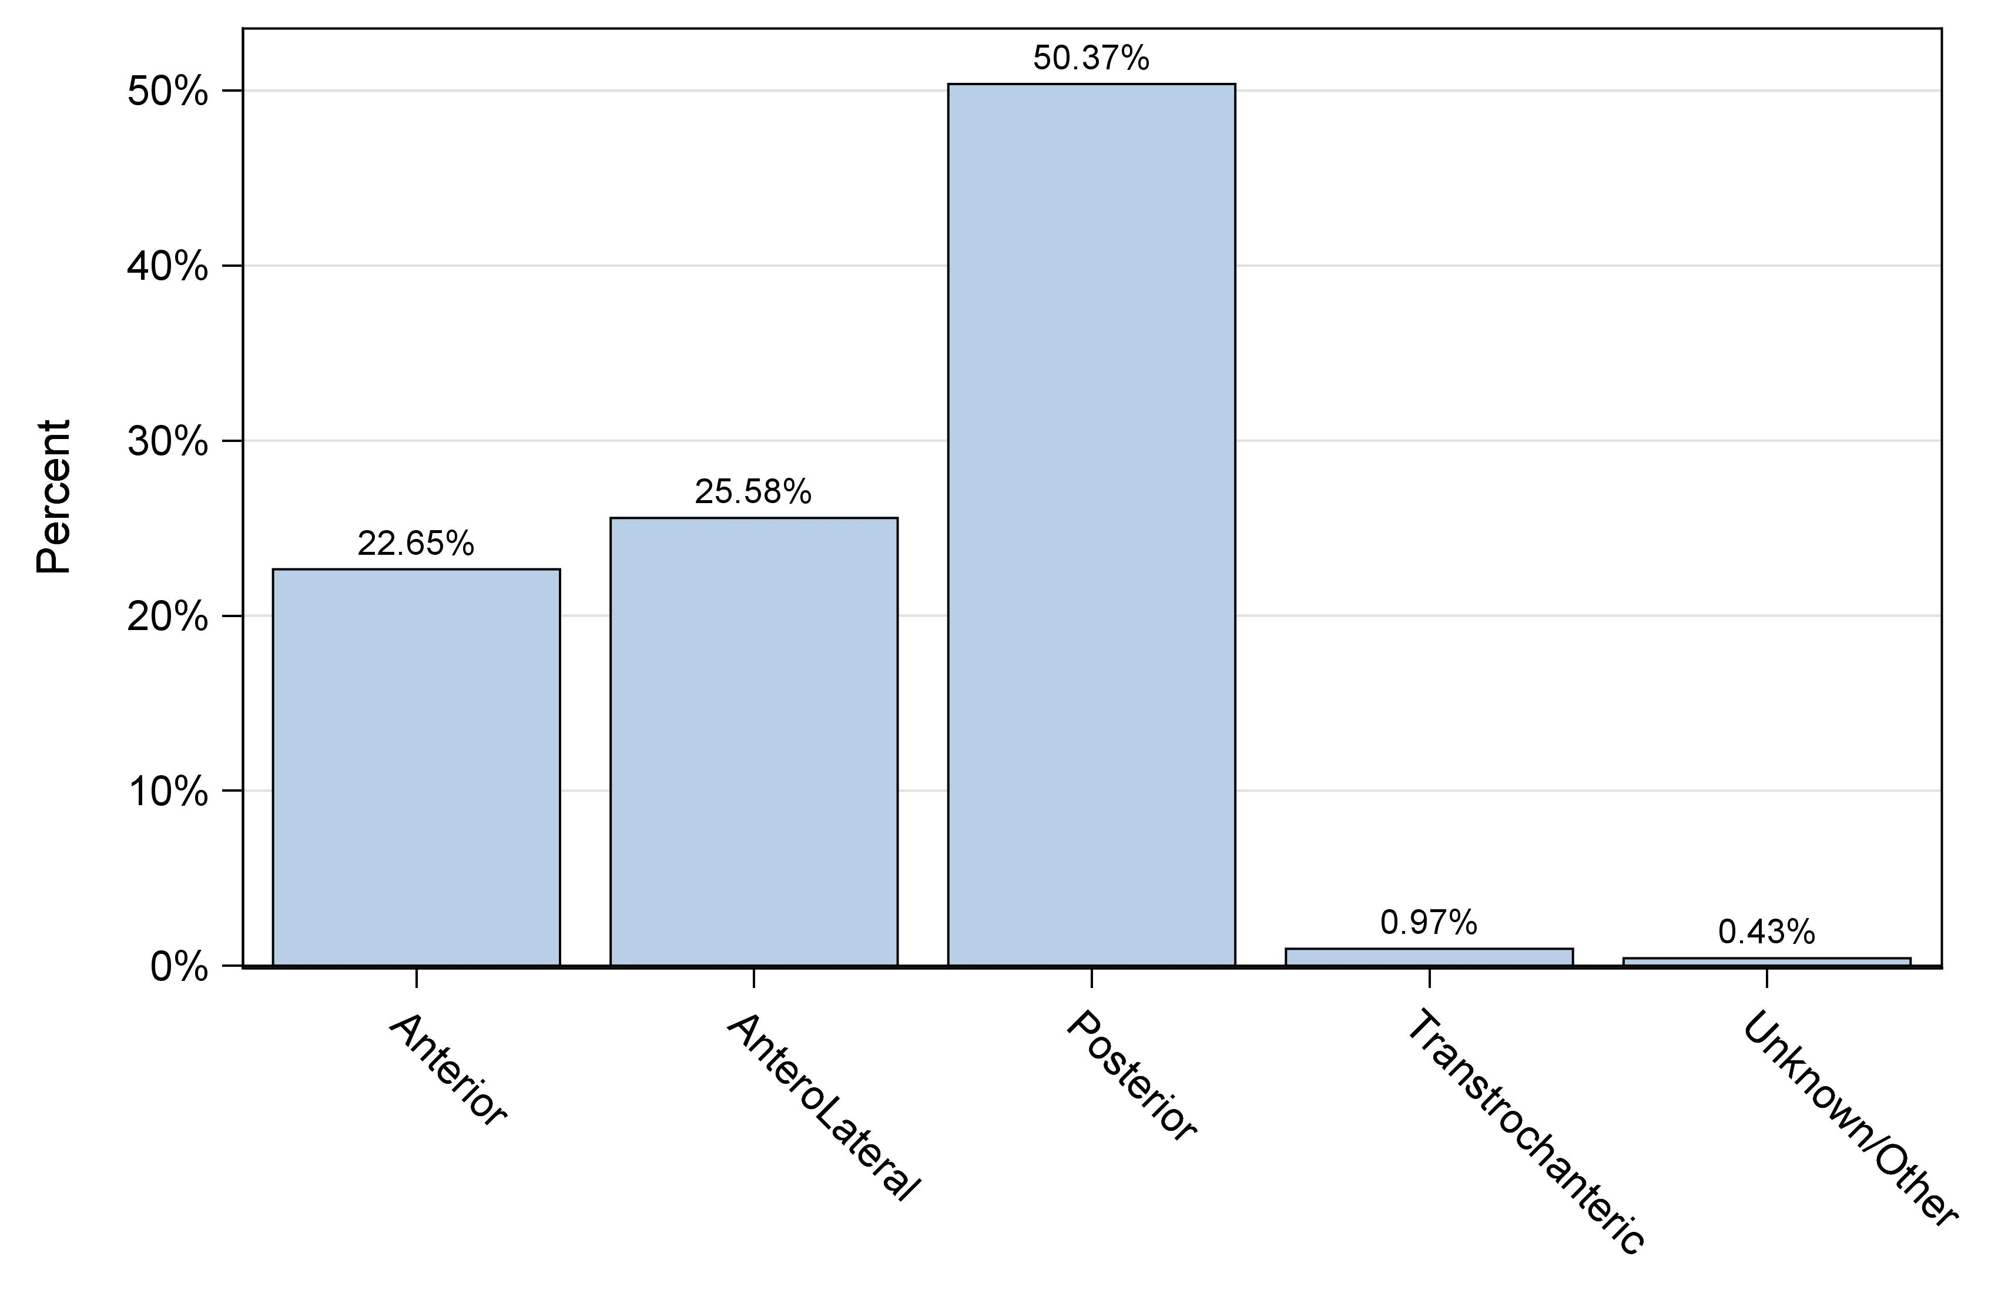
Figure 12: Percent of primary THA cases by approach

Slide 11
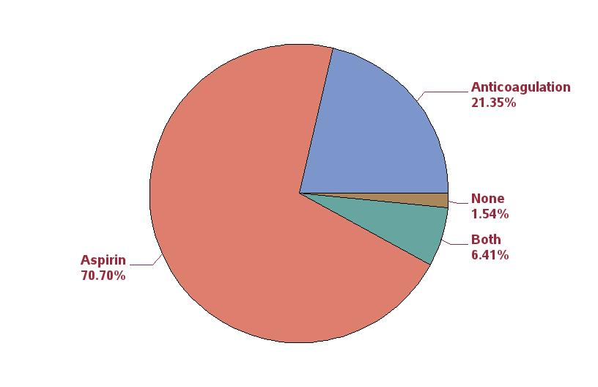
Figure 15: Percent of primary THA patients (first case) by thrombosis prophylaxis between 10/1/2016 and 12/31/2016
(this time window is shorter than rest of figures because of significant change over time)

Slide 12
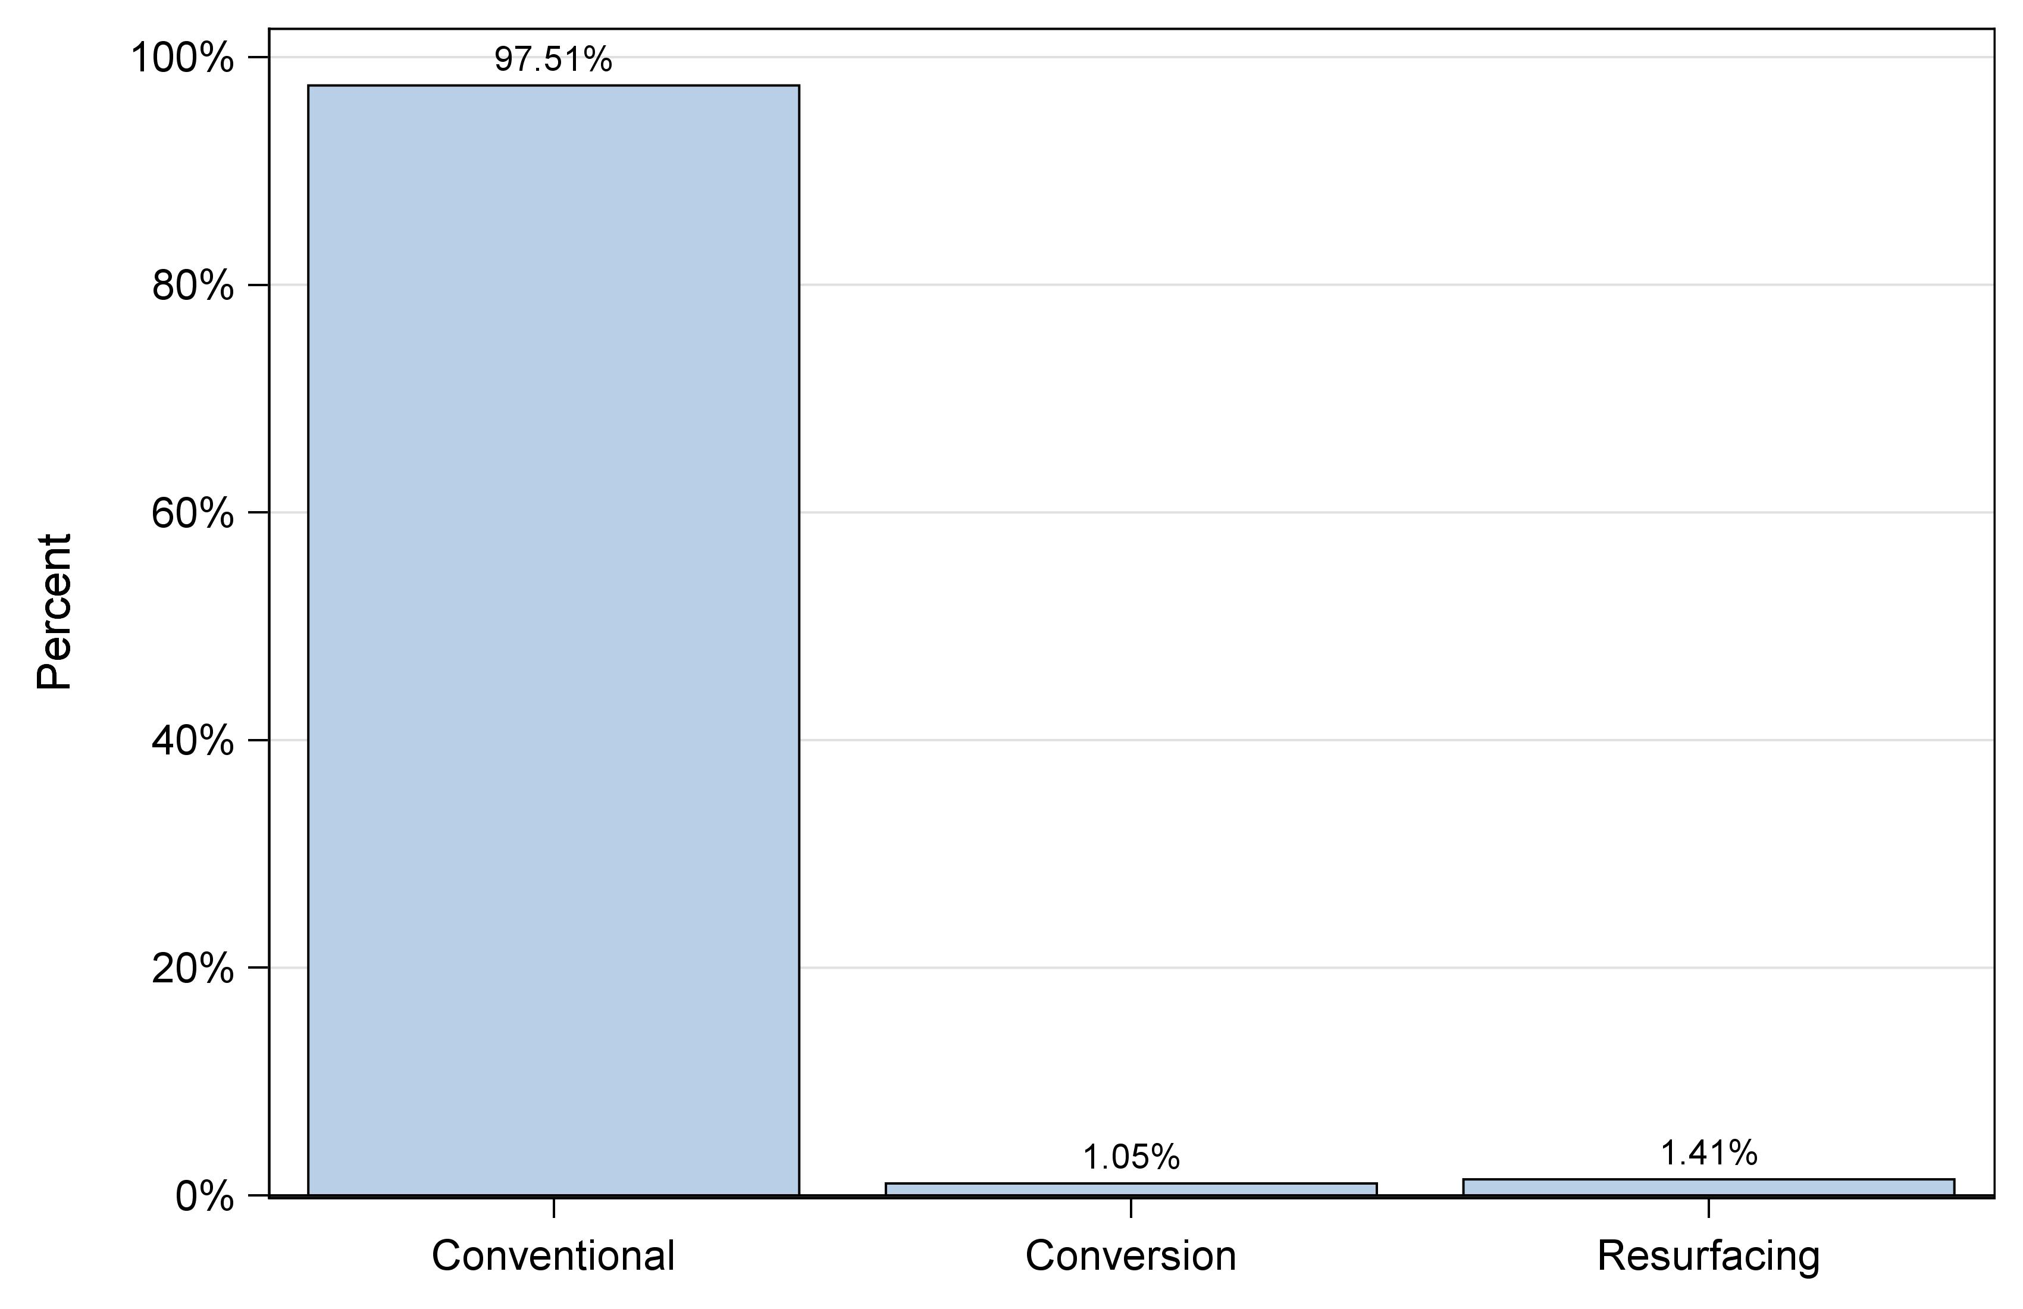
Figure 16: Percent of primary THA cases by procedure

Slide 13
Table 3: Ten most commonly used femoral/acetabular component combinations used in primary total conventional
THA
Rank | Stem/Cup | N | Percent
1 | Accolade II / Trident | 9941 | 20.9
2 | M/L Taper / Continuum | 4987 | 10.5
3 | Summit / Pinnacle | 3783 | 7.9
4 | Fitmore / Continuum | 1889 | 4.0
5 | Taperloc 133 / G7 | 1782 | 3.7
6 | Secur-Fit Plus Max / Trident | 1686 | 3.5
7 | Secur-Fit Max / Trident | 1500 | 3.1
8 | Anthology / Reflection 3 | 1458 | 3.1
9 | Taperloc 133 / RingLoc+ | 1267 | 2.7
10 | Tri-Lock BPS / Pinnacle | 1203 | 2.5
11 | Others | 18168 | 37.8

Slide 14
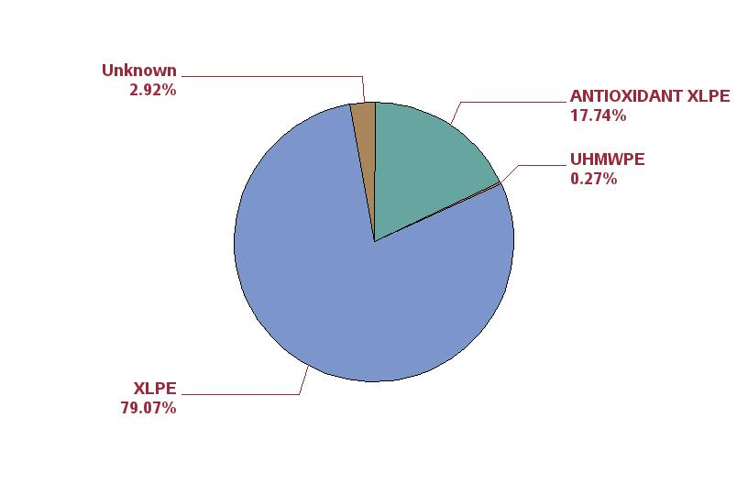
Figure 17: Percentage of polyethylene liners by type of polyethylene for primary conventional THA

Slide 15
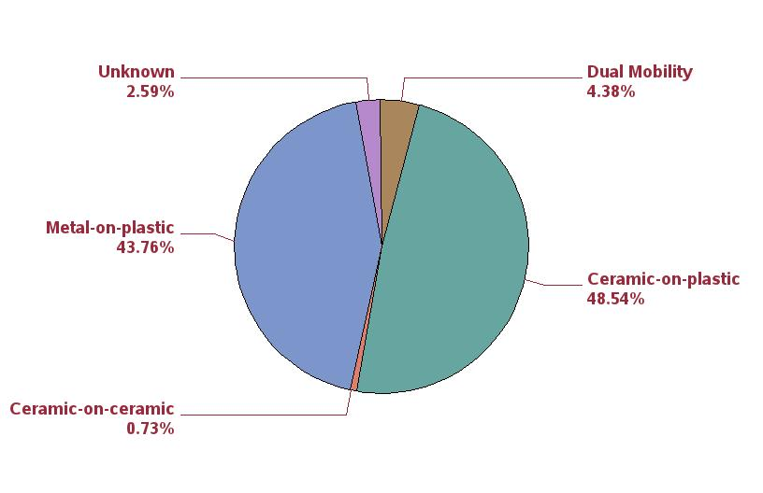
Figure 18: Percentage by bearing surface couple for primary conventional THA

Slide 16
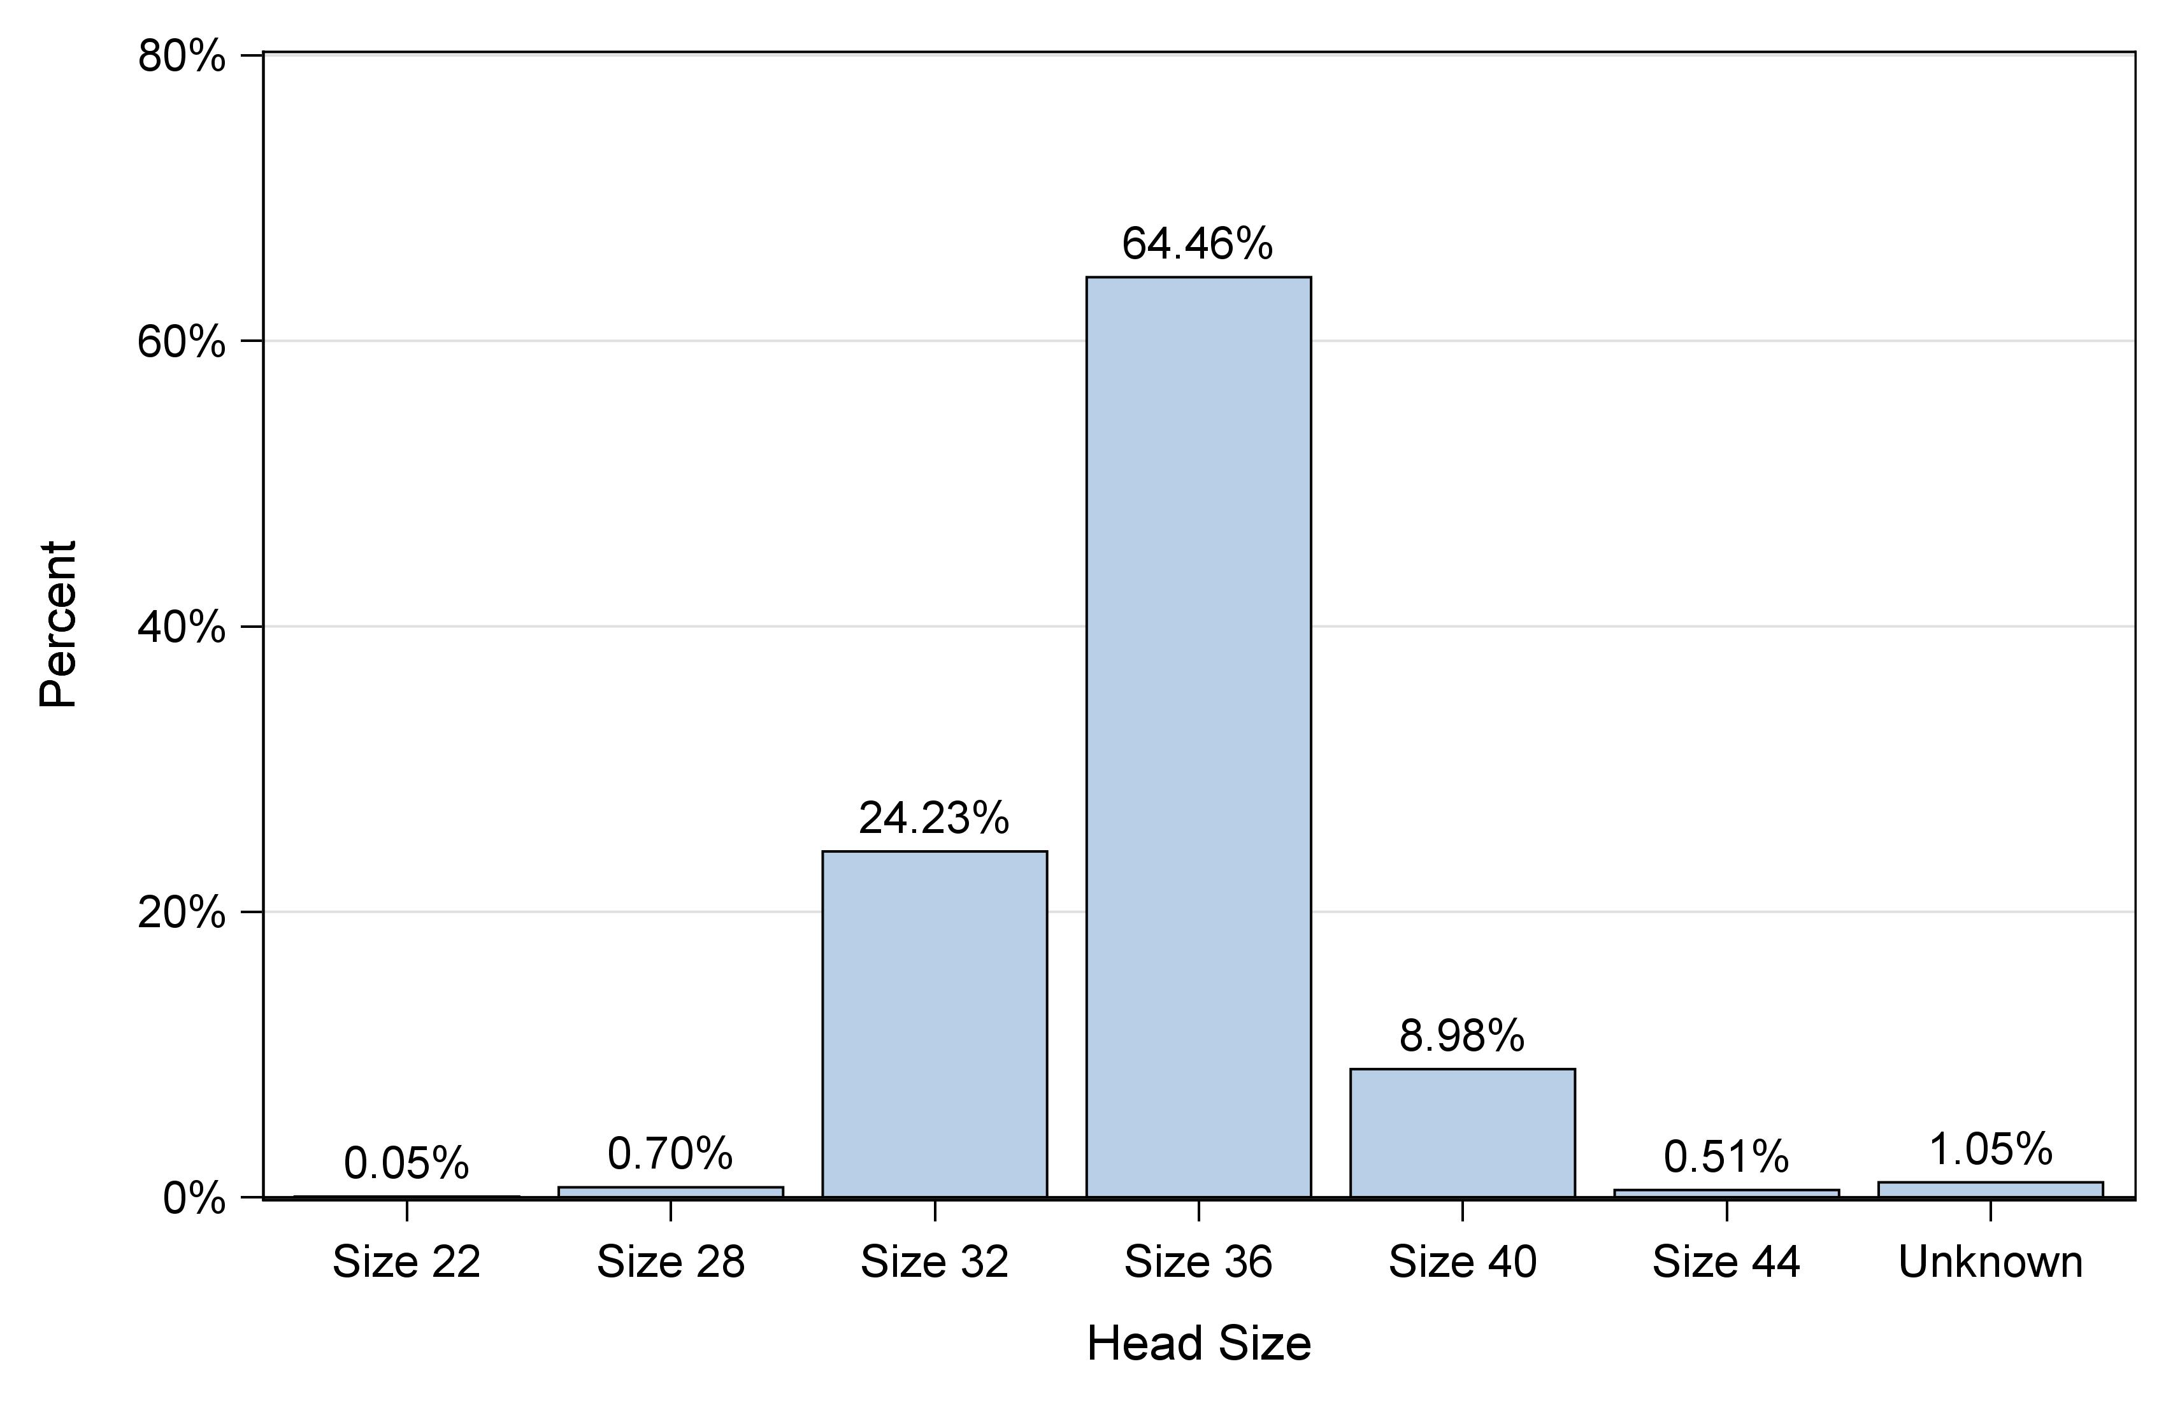
Figure 19: Distribution of head sizes for primary conventional THA, excluding dual mobility cases

Slide 17
Table 4: Most common reasons for revision following primary conventional THA
Rank | Reason for revision | N | Percent
1 | Instability/Dislocation | 143 | 24.4
2 | Peri-prosthetic fracture (Femur) | 124 | 21.1
3 | Joint Infection | 106 | 18.1
4 | Aseptic loosening | 84 | 14.3
5 | Pain | 76 | 12.9
6 | Component fracture/failure | 25 | 4.3
7 | Peri-prosthetic fracture (Acetabulum) | 14 | 2.4
8 | Malalignment | 13 | 2.2
9 | Poly liner wear | 1 | 0.2
10 | Metal reaction/Metallosis | 1 | 0.2

Slide 18
Table 5: Most common reasons for revision following primary conventional THA in first year post-operatively
Rank | Reason for revision | N | Percent
1 | Peri-prosthetic fracture (Femur) | 118 | 27.1
2 | Instability/Dislocation | 115 | 26.4
3 | Joint Infection | 83 | 19.0
4 | Aseptic loosening | 40 | 9.2
5 | Pain | 39 | 8.9
6 | Component fracture/failure | 21 | 4.8
7 | Malalignment | 10 | 2.3
8 | Peri-prosthetic fracture (Acetabulum) | 9 | 2.1
9 | Poly liner wear | 1 | 0.2

Slide 19
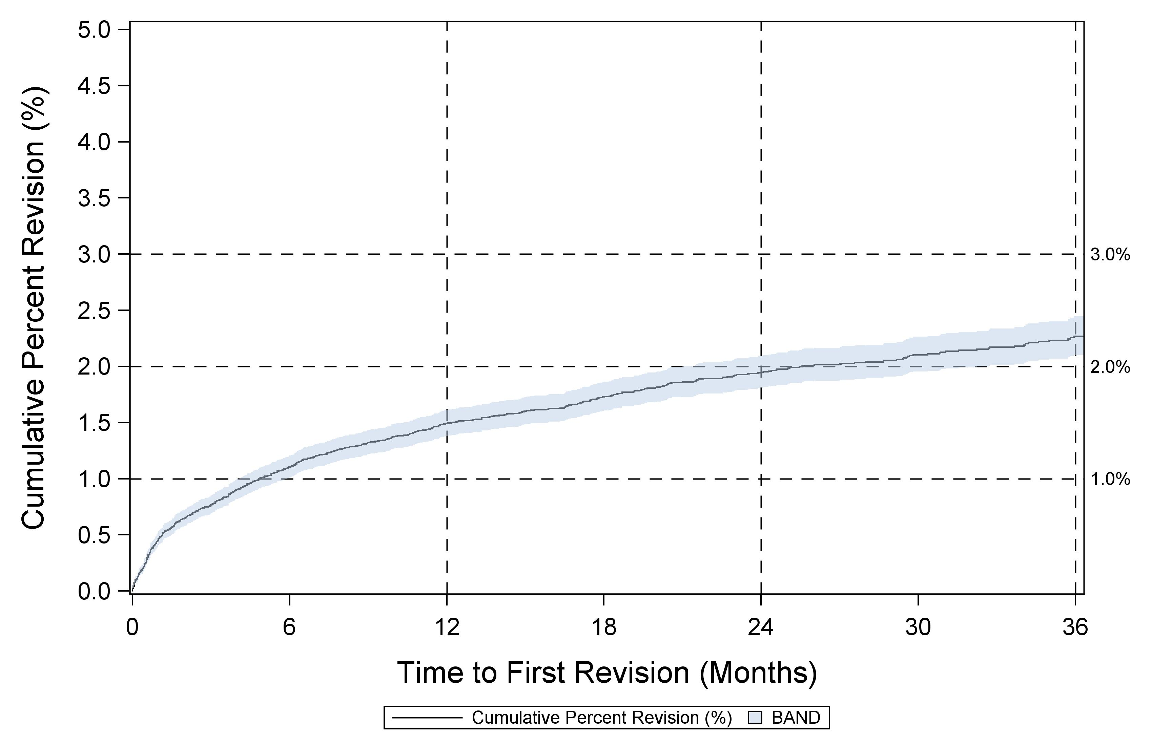
Figure 21: Cumulative percent revision for primary conventional THA

Slide 20
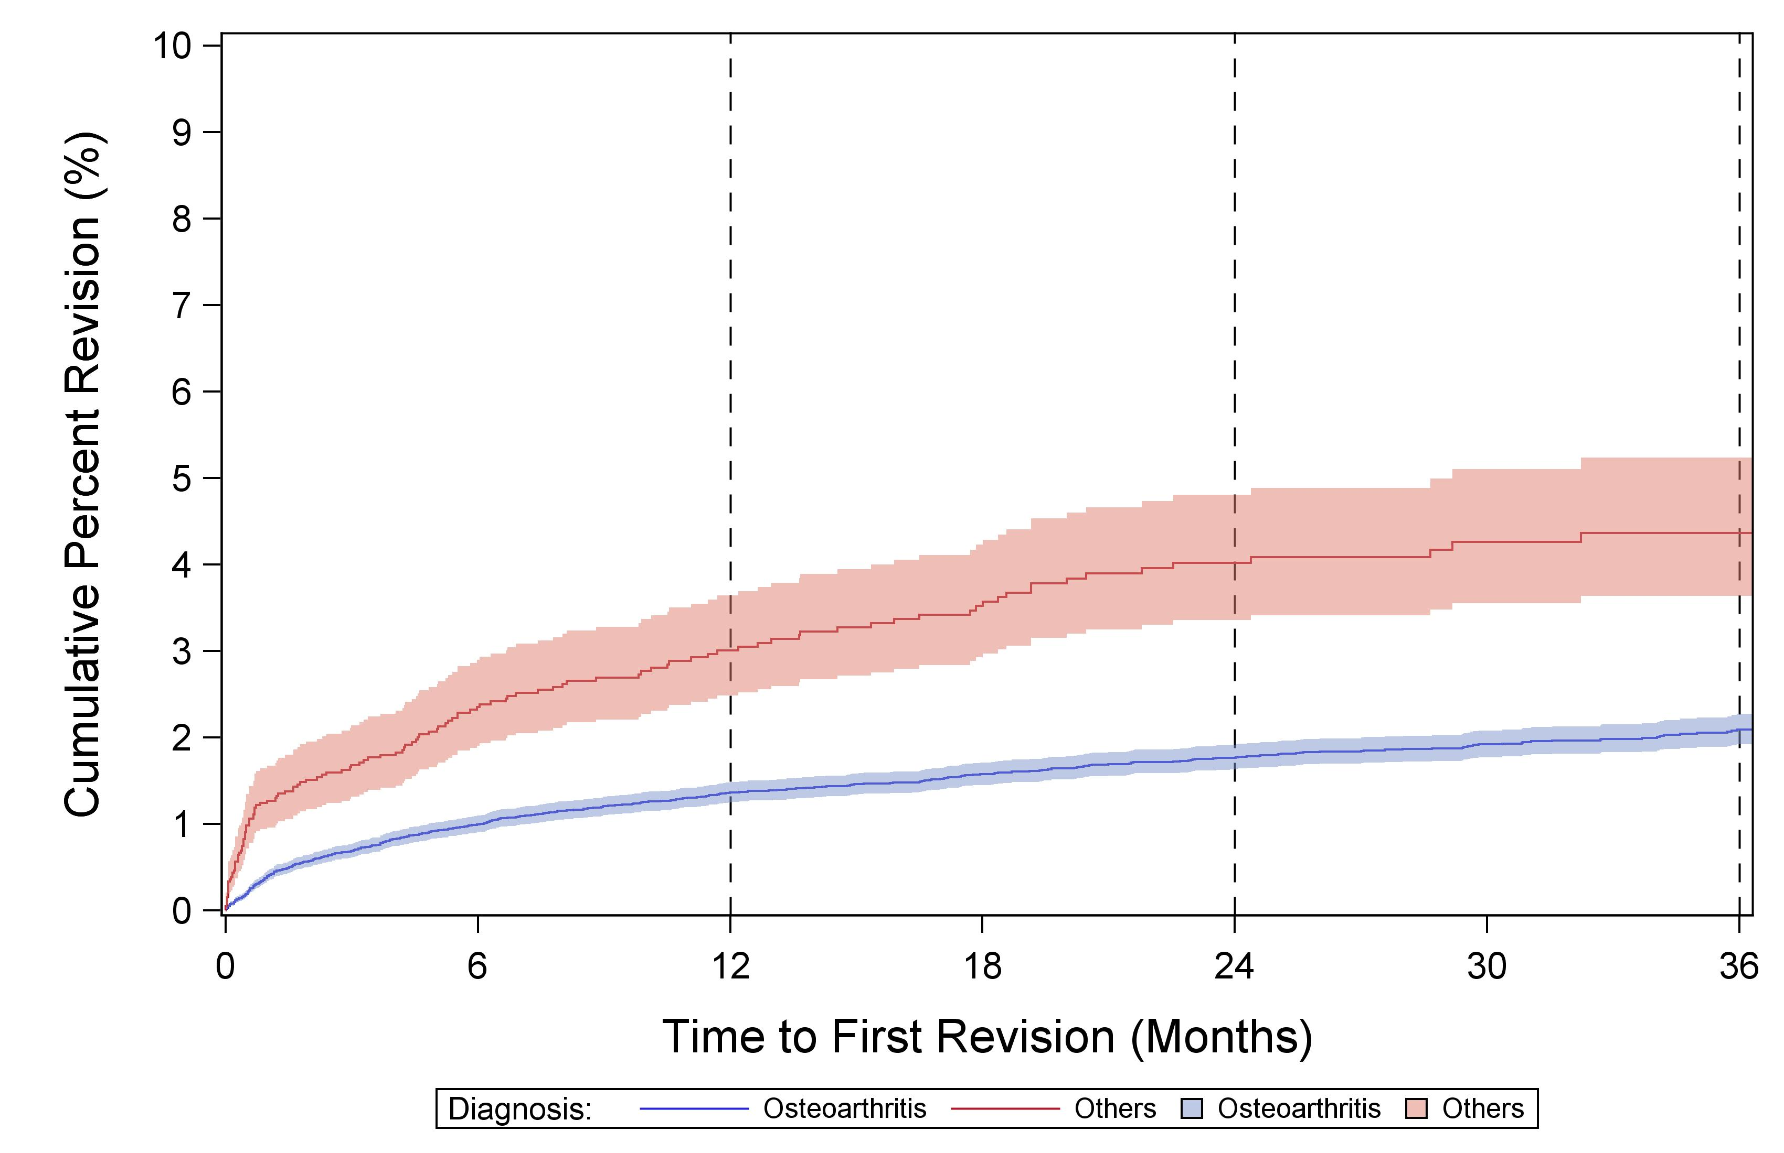
Figure 22: Cumulative percent revision for primary conventional THA by diagnosis

Slide 21
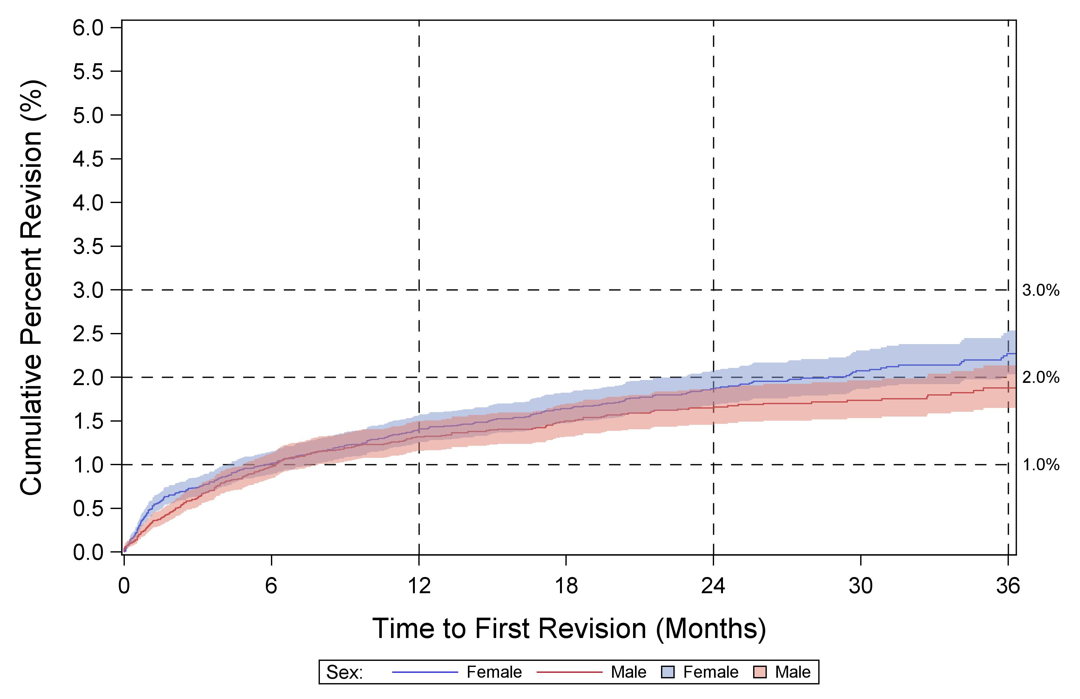
Figure 23: Cumulative percent revision for primary conventional THA by sex for osteoarthritis diagnosis

Slide 22
Cumulative percent revision risk at 3 years for femoral/acetabular combinations having at least 500 primary cases, sorted alphabetically

Slide 23
KNEE ARTHROPLASTY

Slide 24
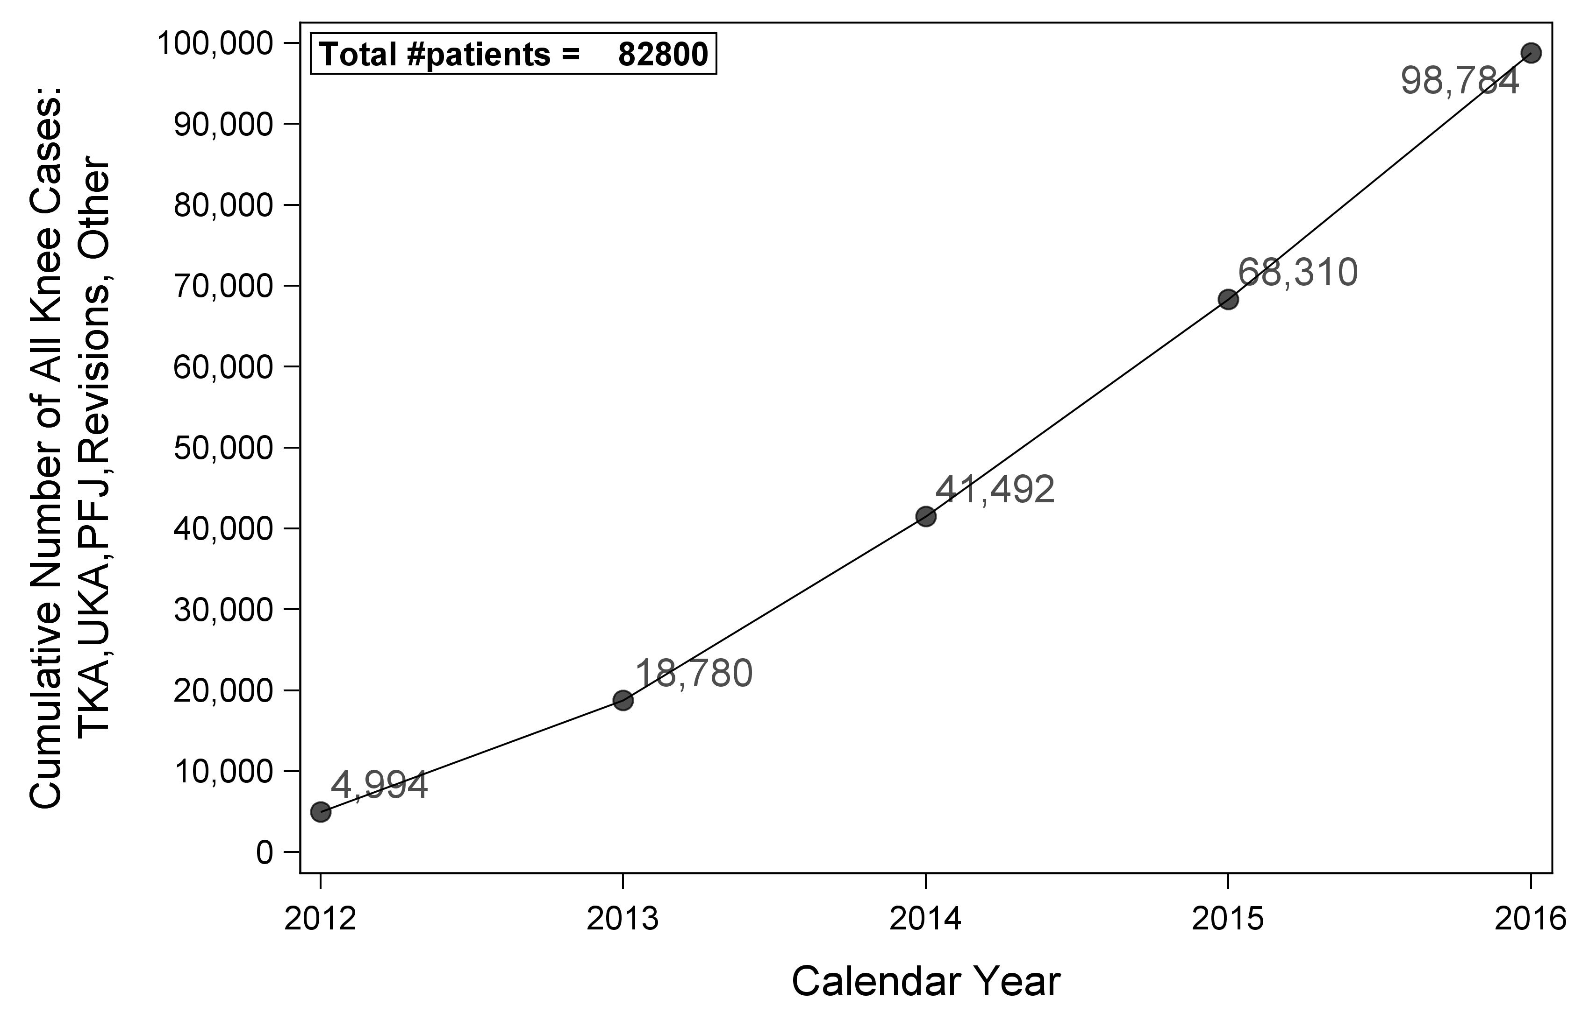
Figure 41: All knee cases over time

Slide 25

Figure 42: Percent of knee arthroplasty cases by primary or revision

Slide 26
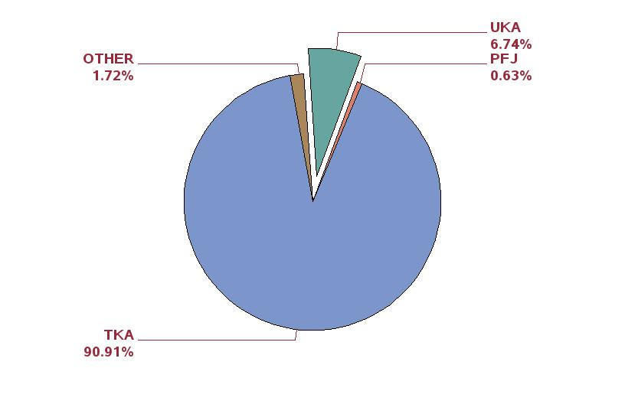
Figure 43: Percent of primary TKA cases performed as TKA, UKA, and PFJ

Slide 27
TKA

Slide 28
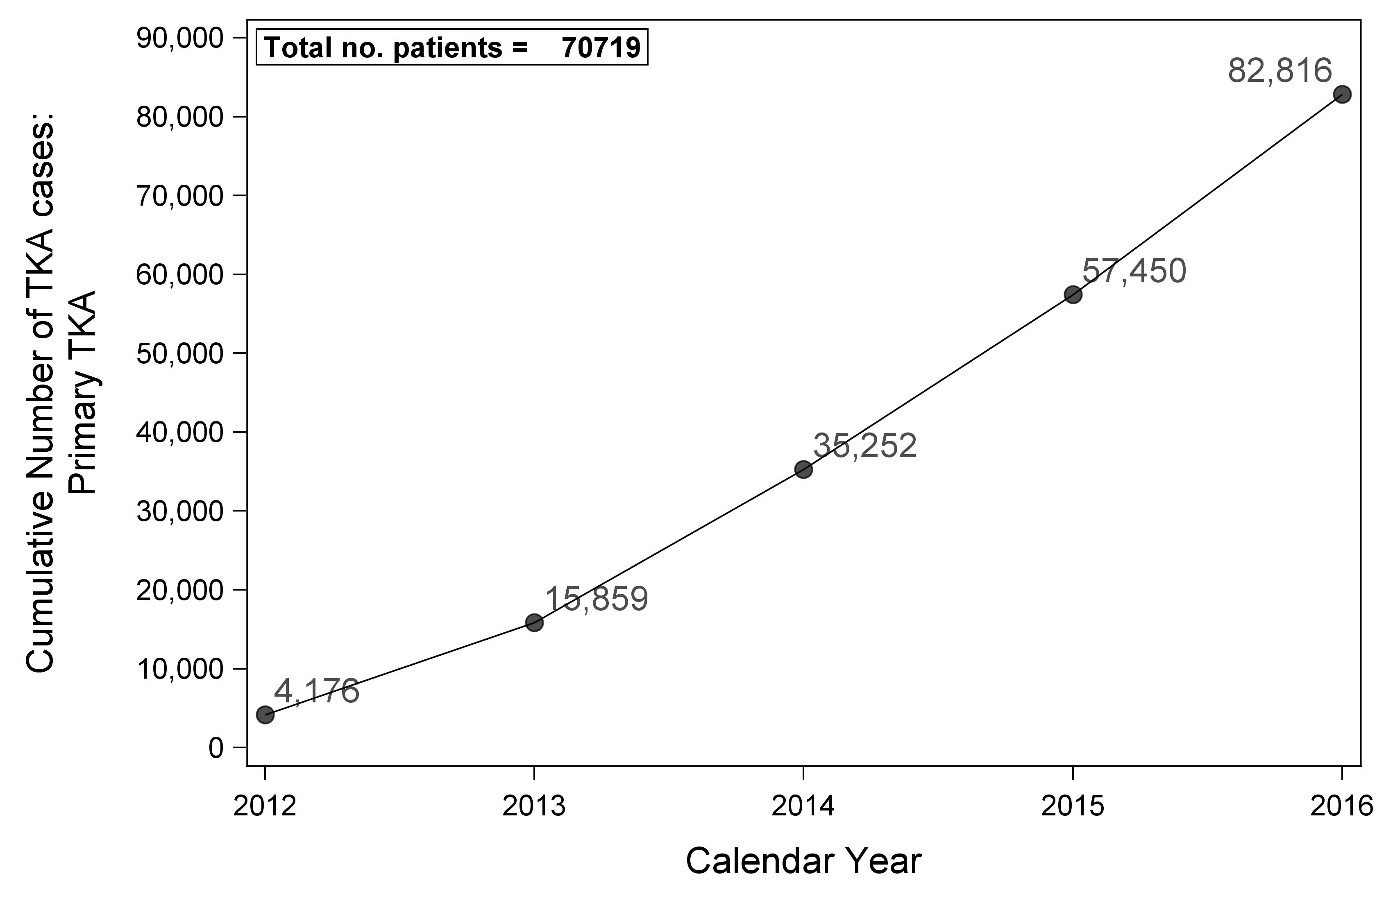
Figure 44: Primary TKA cases over time

Slide 29
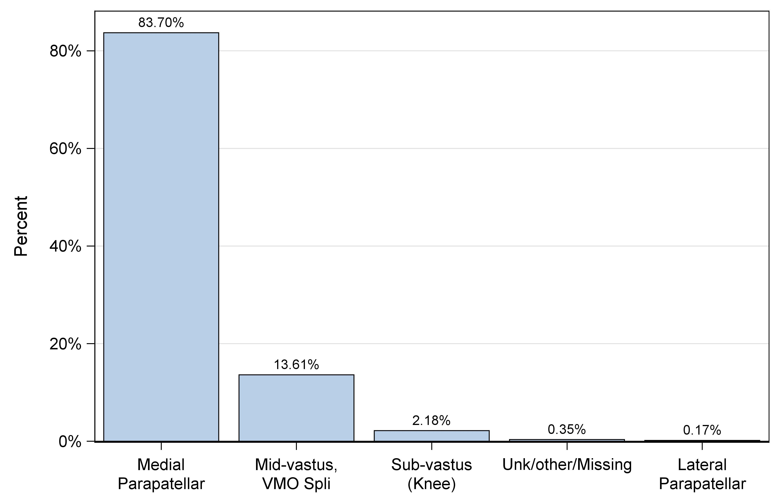
Figure 47: Percent of primary TKA cases by approach

Slide 30
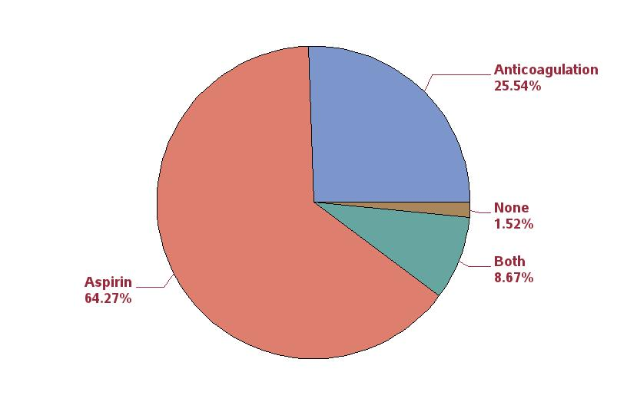
Figure 50: Percent of primary TKA patients (first case) by thrombosis pharmacoprophylaxis between 10/1/2016 and
12/31/2016 (this time window is shorter than rest of figures because of significant change over time)

Slide 31
Table 99: Ten most commonly used femoral/tibial component combinations in primary TKA
Rank | Femur/Tibia | N | Percent
1 | Persona / Persona | 18661 | 22.5
2 | Vanguard / Maxim | 12119 | 14.6
3 | Triathlon / Triathlon | 10558 | 12.8
4 | Triathlon / Triathlon TS | 10266 | 12.4
5 | Genesis II / Genesis II | 4959 | 6.0
6 | Attune / Attune | 4877 | 5.9
7 | Sigma PFC / Sigma | 2381 | 2.9
8 | Journey II / Journey | 1585 | 1.9
9 | NK II GS / NK II | 1577 | 1.9
10 | Sigma / Sigma | 1251 | 1.5
11 | Others | 14582 | 17.5

Slide 32
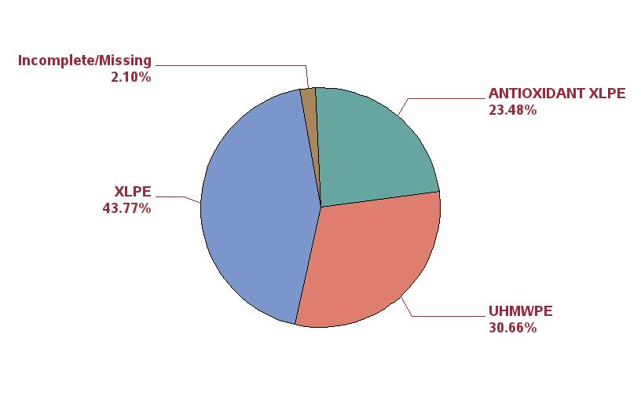
Figure 51: Percent of polyethylene inserts by type of polyethylene in primary TKA

Slide 33
Table 100: Most common reasons for first revision following TKA
Rank | Reason for revision | N | Percent
1 | Instability/Dislocation | 259 | 27.1
2 | Joint Infection | 221 | 23.1
3 | Pain | 205 | 21.4
4 | Aseptic loosening | 119 | 12.4
5 | Arthrofibrosis | 65 | 6.8
6 | Component fracture/failure | 33 | 3.4
7 | Malalignment | 13 | 1.4
8 | Peri-prosthetic fracture (Femur) | 12 | 1.3
9 | Extensor mechanism failure | 8 | 0.8
10 | Metal reaction/Metallosis | 7 | 0.7
11 | Peri-prosthetic fracture (Tibia) | 7 | 0.7
12 | Poly liner wear | 6 | 0.6
13 | Osteolysis | 1 | 0.1
14 | Patellofemoral joint | 1 | 0.1

Slide 34
Table 101: Most common reasons for first revision following primary TKA in first year post-operatively
Rank | Reason for revision | N | Percent
1 | Joint Infection | 122 | 28.7
2 | Instability/Dislocation | 112 | 26.4
3 | Pain | 74 | 17.4
4 | Arthrofibrosis | 42 | 9.9
5 | Aseptic loosening | 29 | 6.8
6 | Component fracture/failure | 12 | 2.8
7 | Malalignment | 9 | 2.1
8 | Peri-prosthetic fracture (Femur) | 8 | 1.9
9 | Peri-prosthetic fracture (Tibia) | 6 | 1.4
10 | Extensor mechanism failure | 5 | 1.2
11 | Poly liner wear | 3 | 0.7
12 | Metal reaction/Metallosis | 3 | 0.7

Slide 35
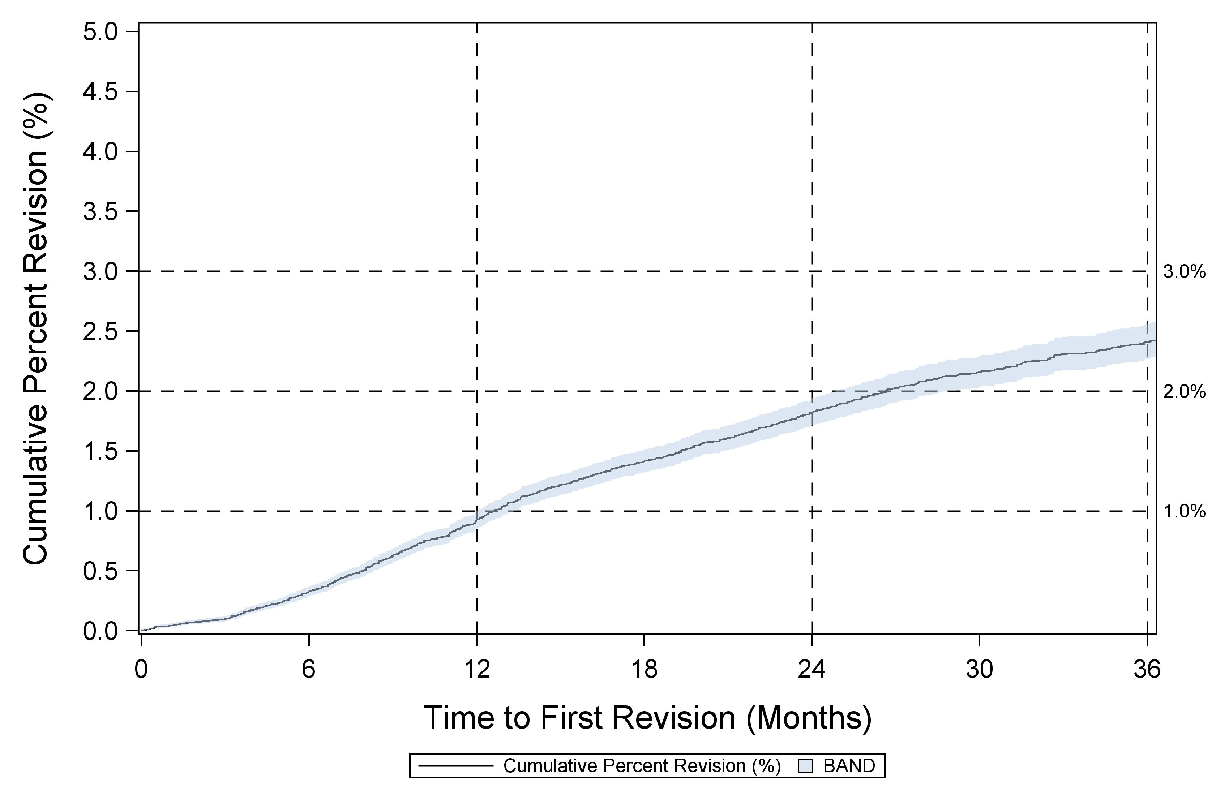
Figure 53: Cumulative percent revision for primary TKA

Slide 36
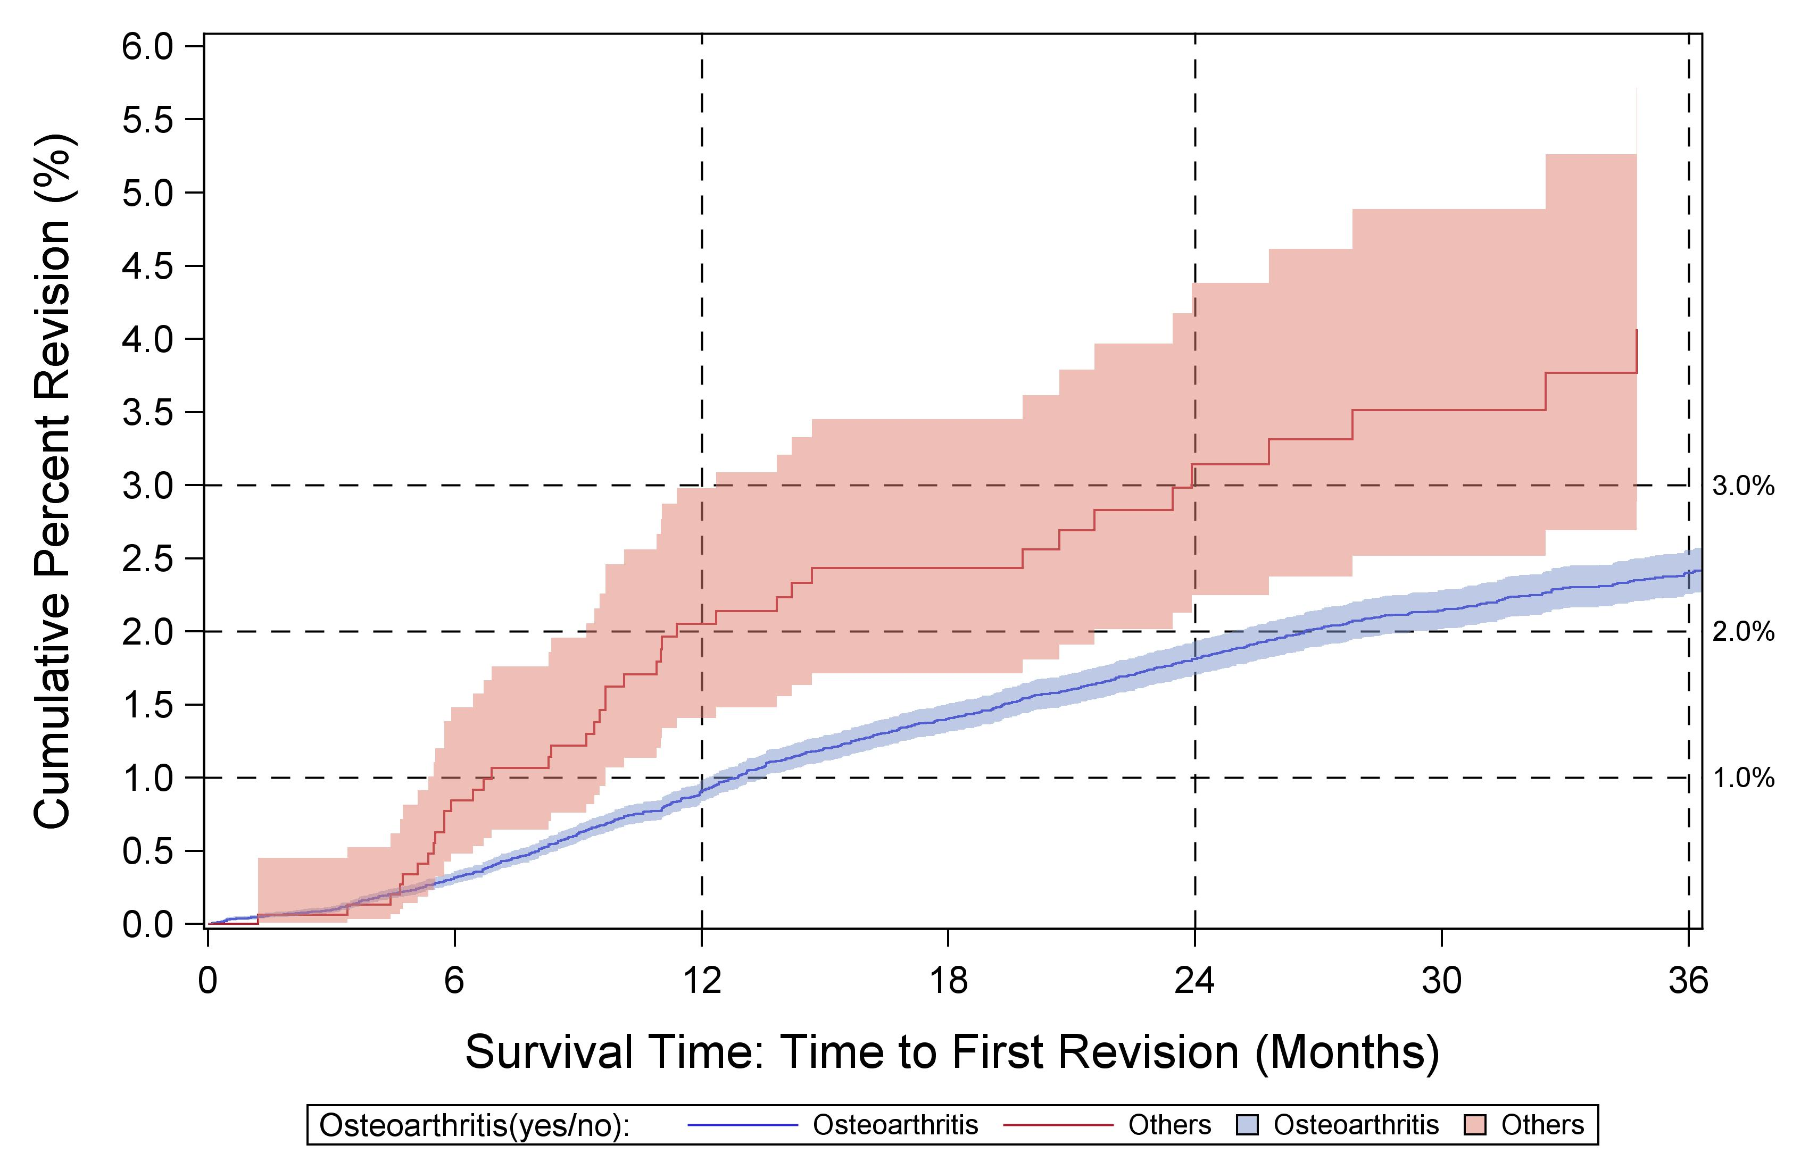
Figure 54: Cumulative percent revision for primary TKA by diagnosis

Slide 37
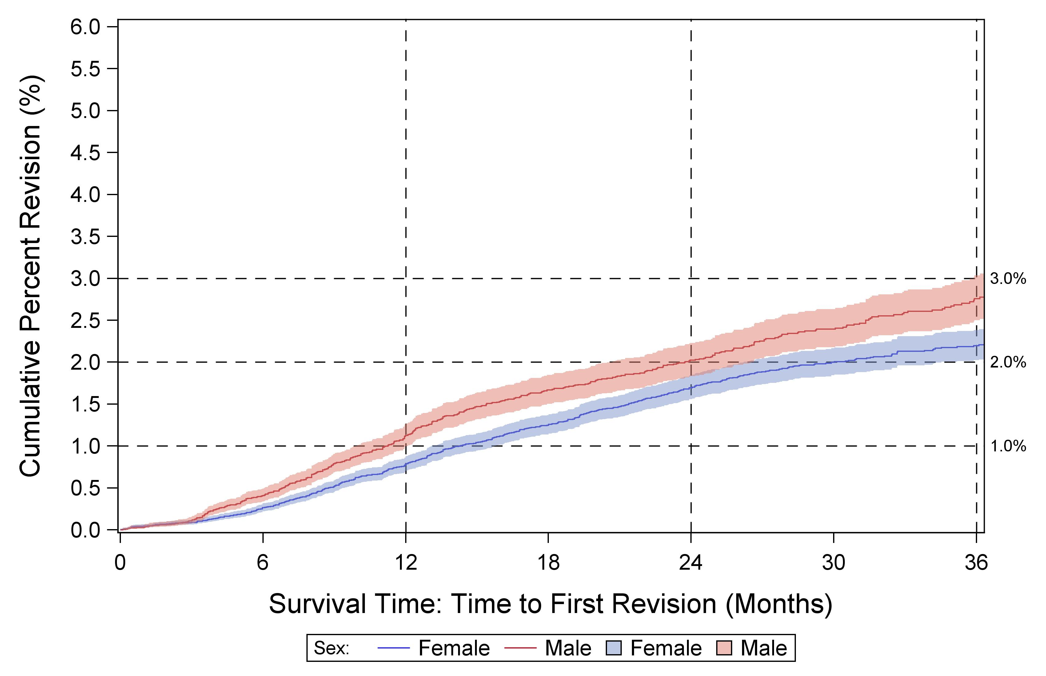
Figure 55: Cumulative percent revision for primary TKA by sex for osteoarthritis diagnosis

Slide 38
Cumulative percent revision risk at 3 years for femoral/tibial combinations having at least 500 primary cases, sorted alphabetically

Slide 39
UKA

Slide 40
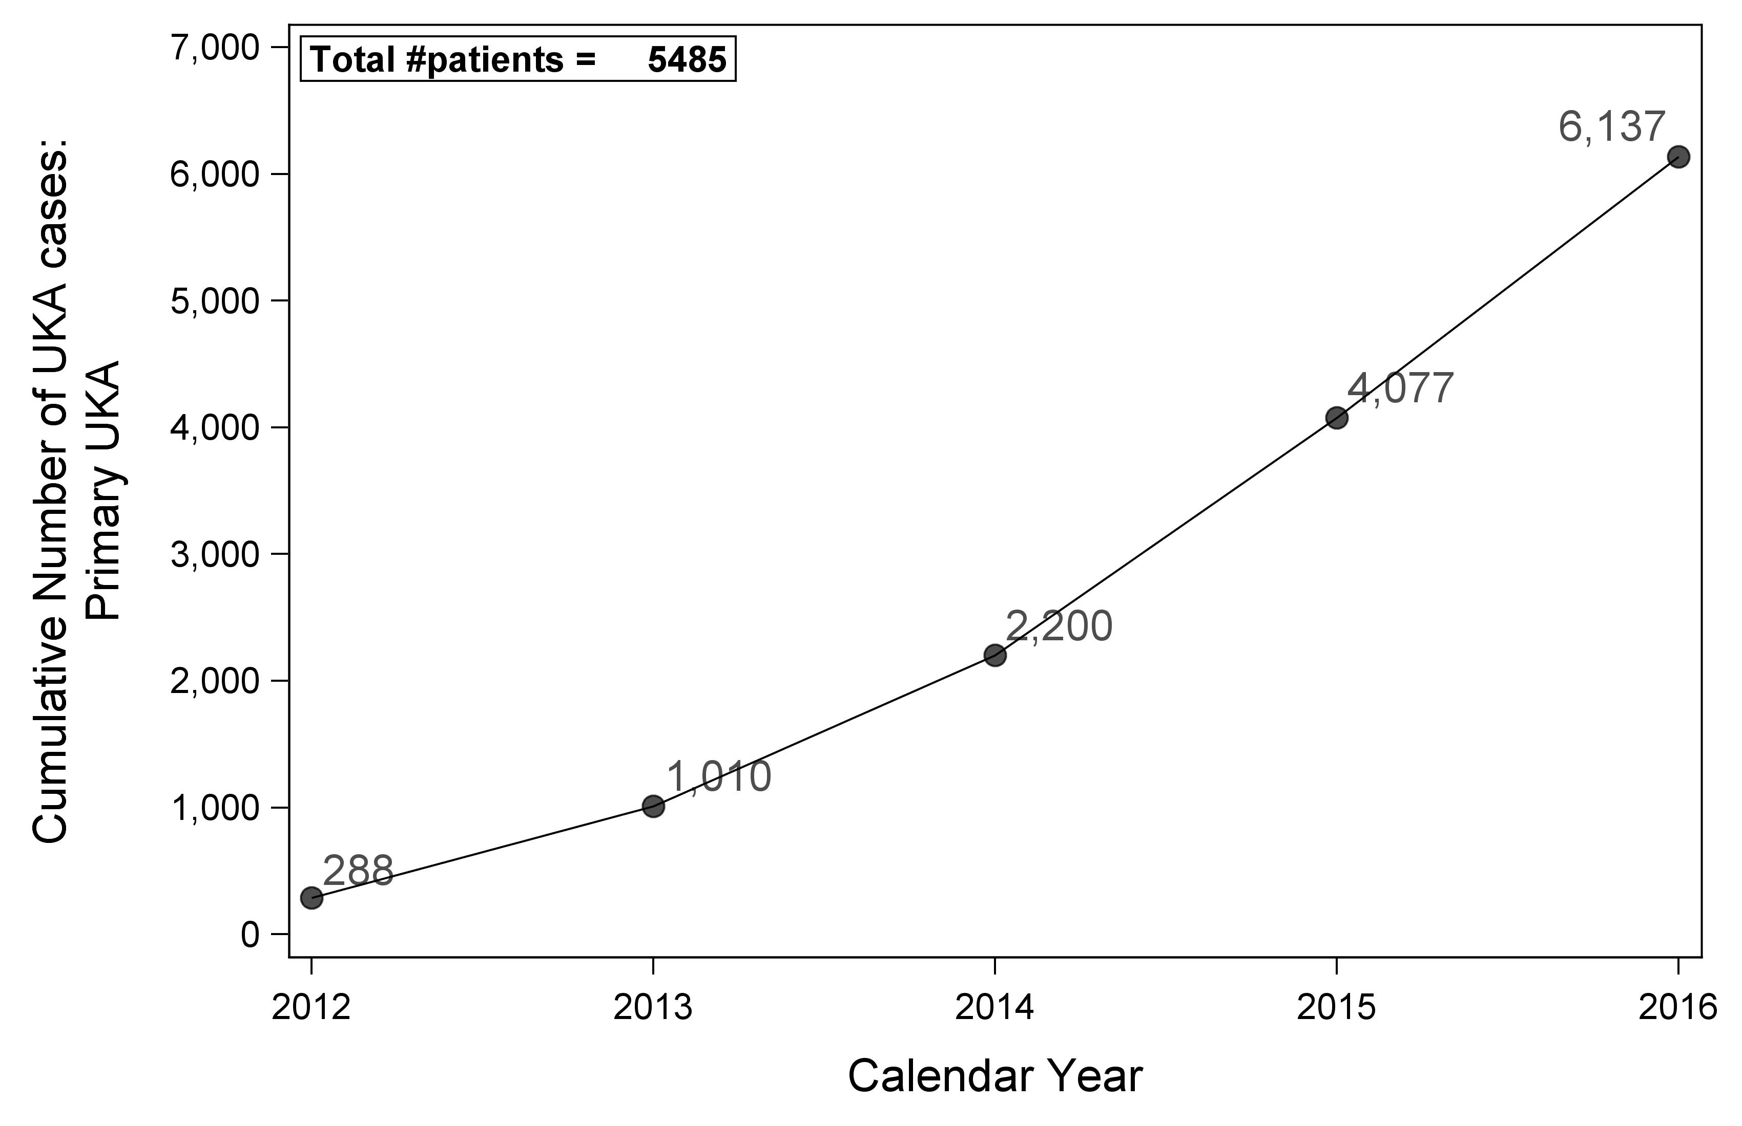
Figure 77: Primary UKA cases over time

Slide 41
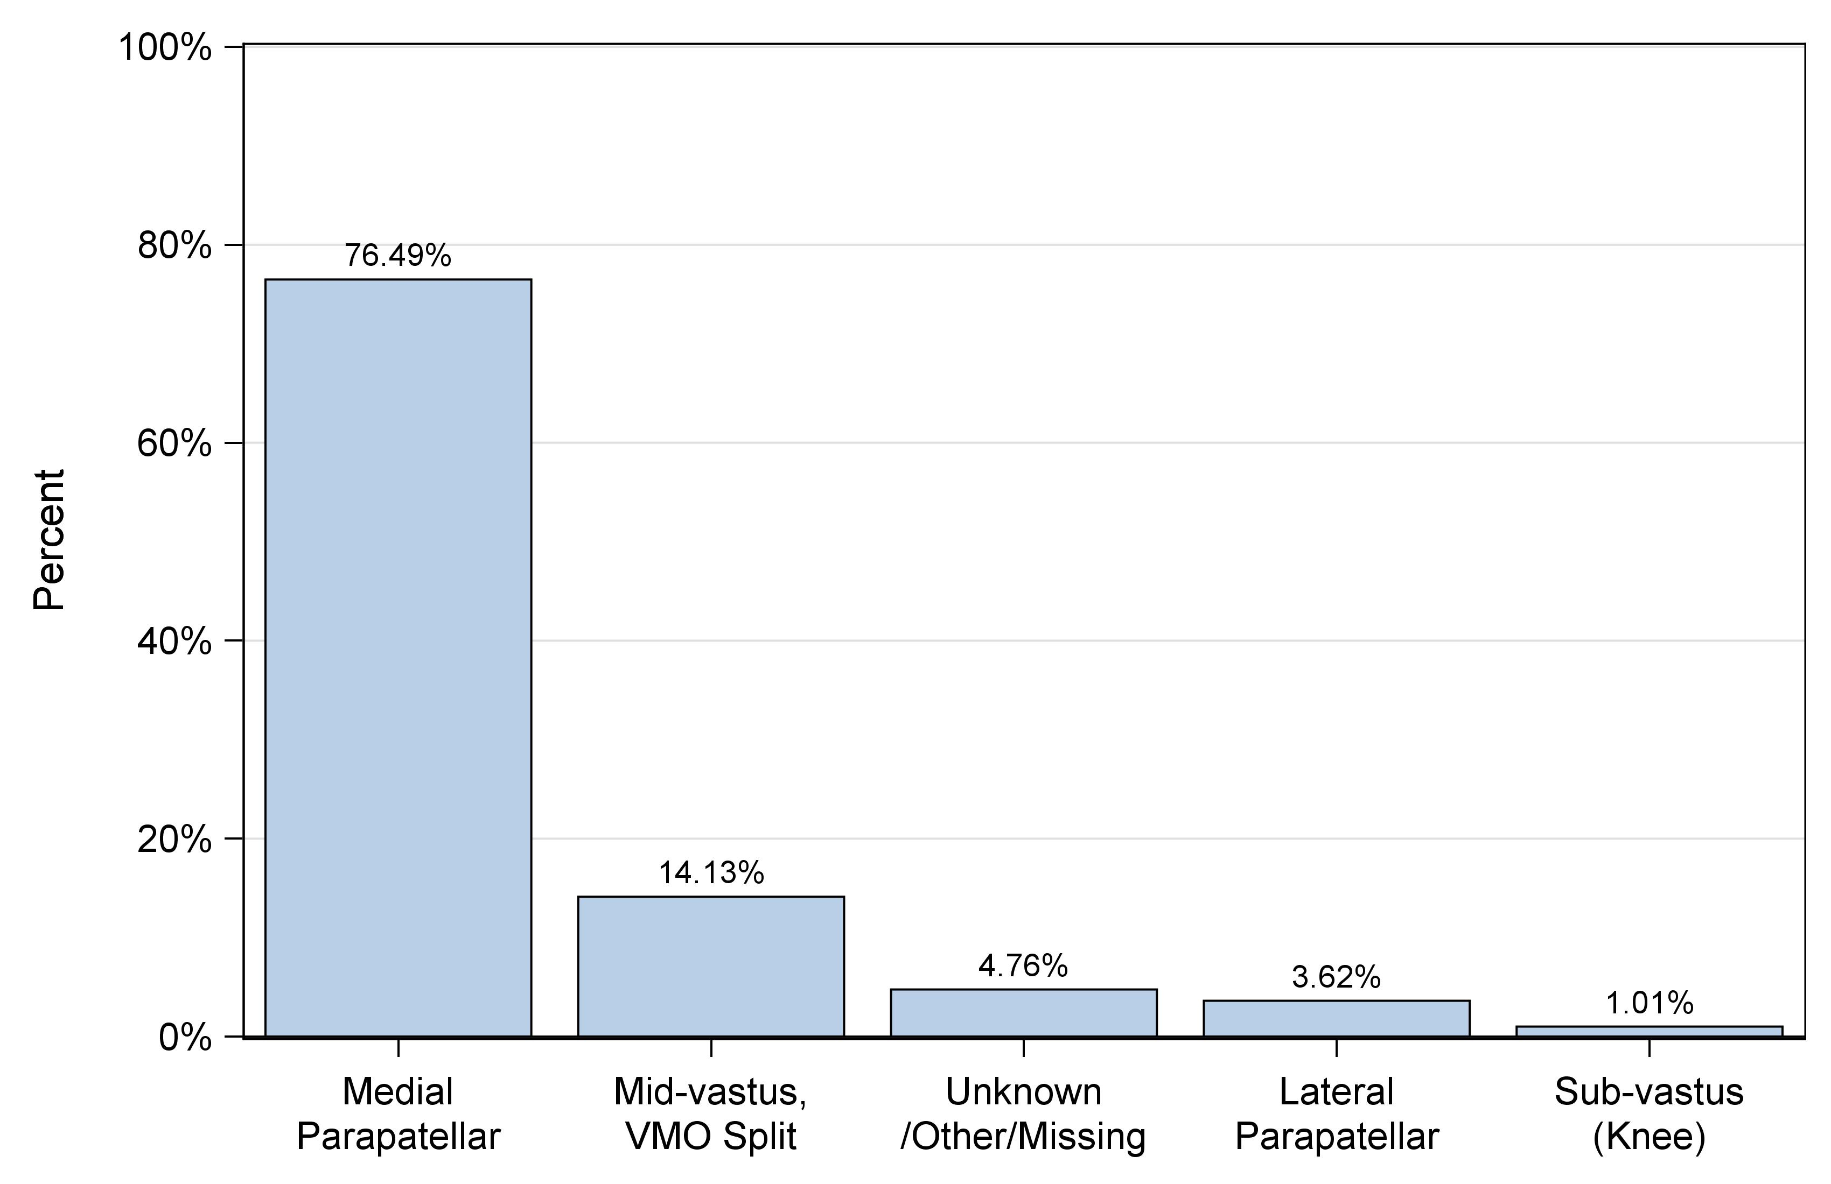
Figure 80: Percent of primary UKA cases by approach

Slide 42
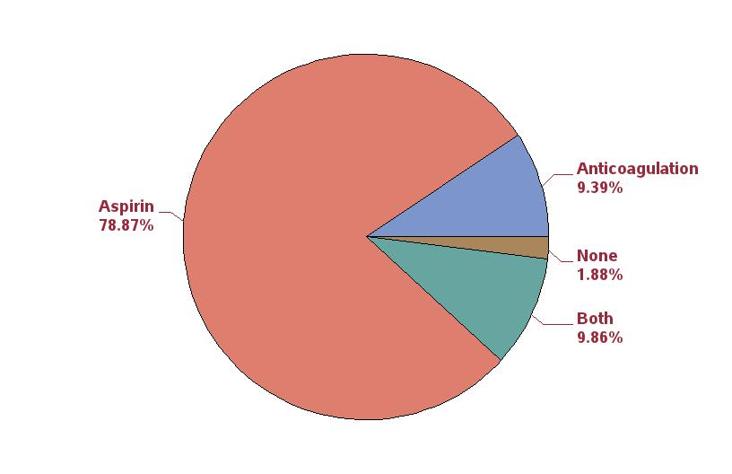
Figure 83: Percent of primary UKA patients (first case) by thombosis pharmacoprophylaxis between 10/1/2016 and
12/31/2016 (this time window is shorter than rest of figures because of significant change over time)

Slide 43
Table 173: Ten most commonly used femoral/tibial component combinations in primary UKA
Rank | Femur/Tibia | N | Percent
1 | Zimmer High Flex / Zimmer High Flex | 1971 | 32.1
2 | Restoris MCK / Restoris MCK | 1721 | 28.0
3 | Oxford / Oxford | 1665 | 27.1
4 | Triathlon PKR / Triathlon PKR | 212 | 3.5
5 | iBalance / iBalance | 143 | 2.3
6 | Journey / Journey | 95 | 1.6
7 | Sigma HP / Sigma HP | 82 | 1.3
8 | Stride / Stride | 75 | 1.2
9 | Oxford / Vanguard M | 57 | 0.9
10 | Mirror / Mirror | 24 | 0.4
11 | Others | 92 | 1.5

Slide 44
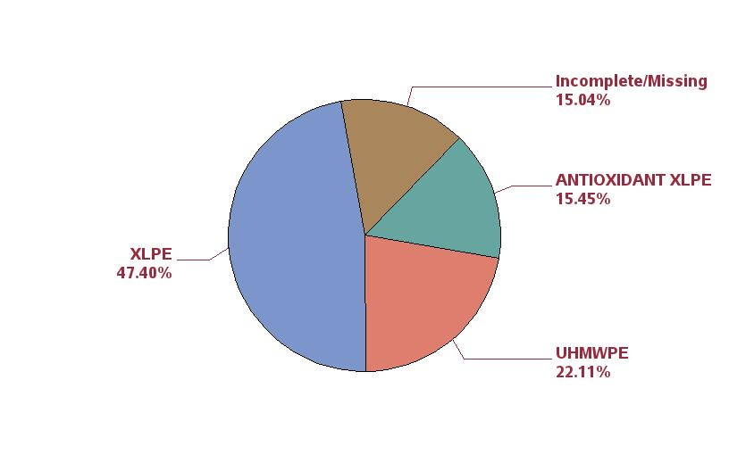
Figure 84: Percentage of polyethylene inserts by type of polyethylene in primary UKA

Slide 45
Table 174: Most common reasons for first revision following primary UKA
Rank | Reason for revision | N | Percent
1 | Pain | 31 | 26.5
2 | Conversion of UKA | 30 | 25.6
3 | Aseptic loosening | 19 | 16.2
4 | Instability/Dislocation | 10 | 8.5
5 | Joint Infection | 9 | 7.7
6 | Component fracture/failure | 6 | 5.1
7 | Peri-prosthetic fracture (Tibia) | 4 | 3.4
8 | Osteolysis | 3 | 2.6
9 | Patellofemoral joint | 2 | 1.7
10 | Peri-prosthetic fracture (Femur) | 1 | 0.9
11 | Arthrofibrosis | 1 | 0.9
12 | Extensor mechanism failure | 1 | 0.9

Slide 46
Table 175: Most common reasons for first revision following primary UKA in first year post-operatively
Rank | Reason for revision | N | Percent
1 | Pain | 11 | 22.9
2 | Joint Infection | 8 | 16.7
3 | Instability/Dislocation | 6 | 12.5
4 | Aseptic loosening | 5 | 10.4
5 | Conversion of UKA | 5 | 10.4
6 | Peri-prosthetic fracture (Tibia) | 4 | 8.3
7 | Osteolysis | 2 | 4.2
8 | Component fracture/failure | 2 | 4.2
9 | Patellofemoral joint | 2 | 4.2
10 | Peri-prosthetic fracture (Femur) | 1 | 2.1
11 | Arthrofibrosis | 1 | 2.1
12 | Extensor mechanism failure | 1 | 2.1

Slide 47
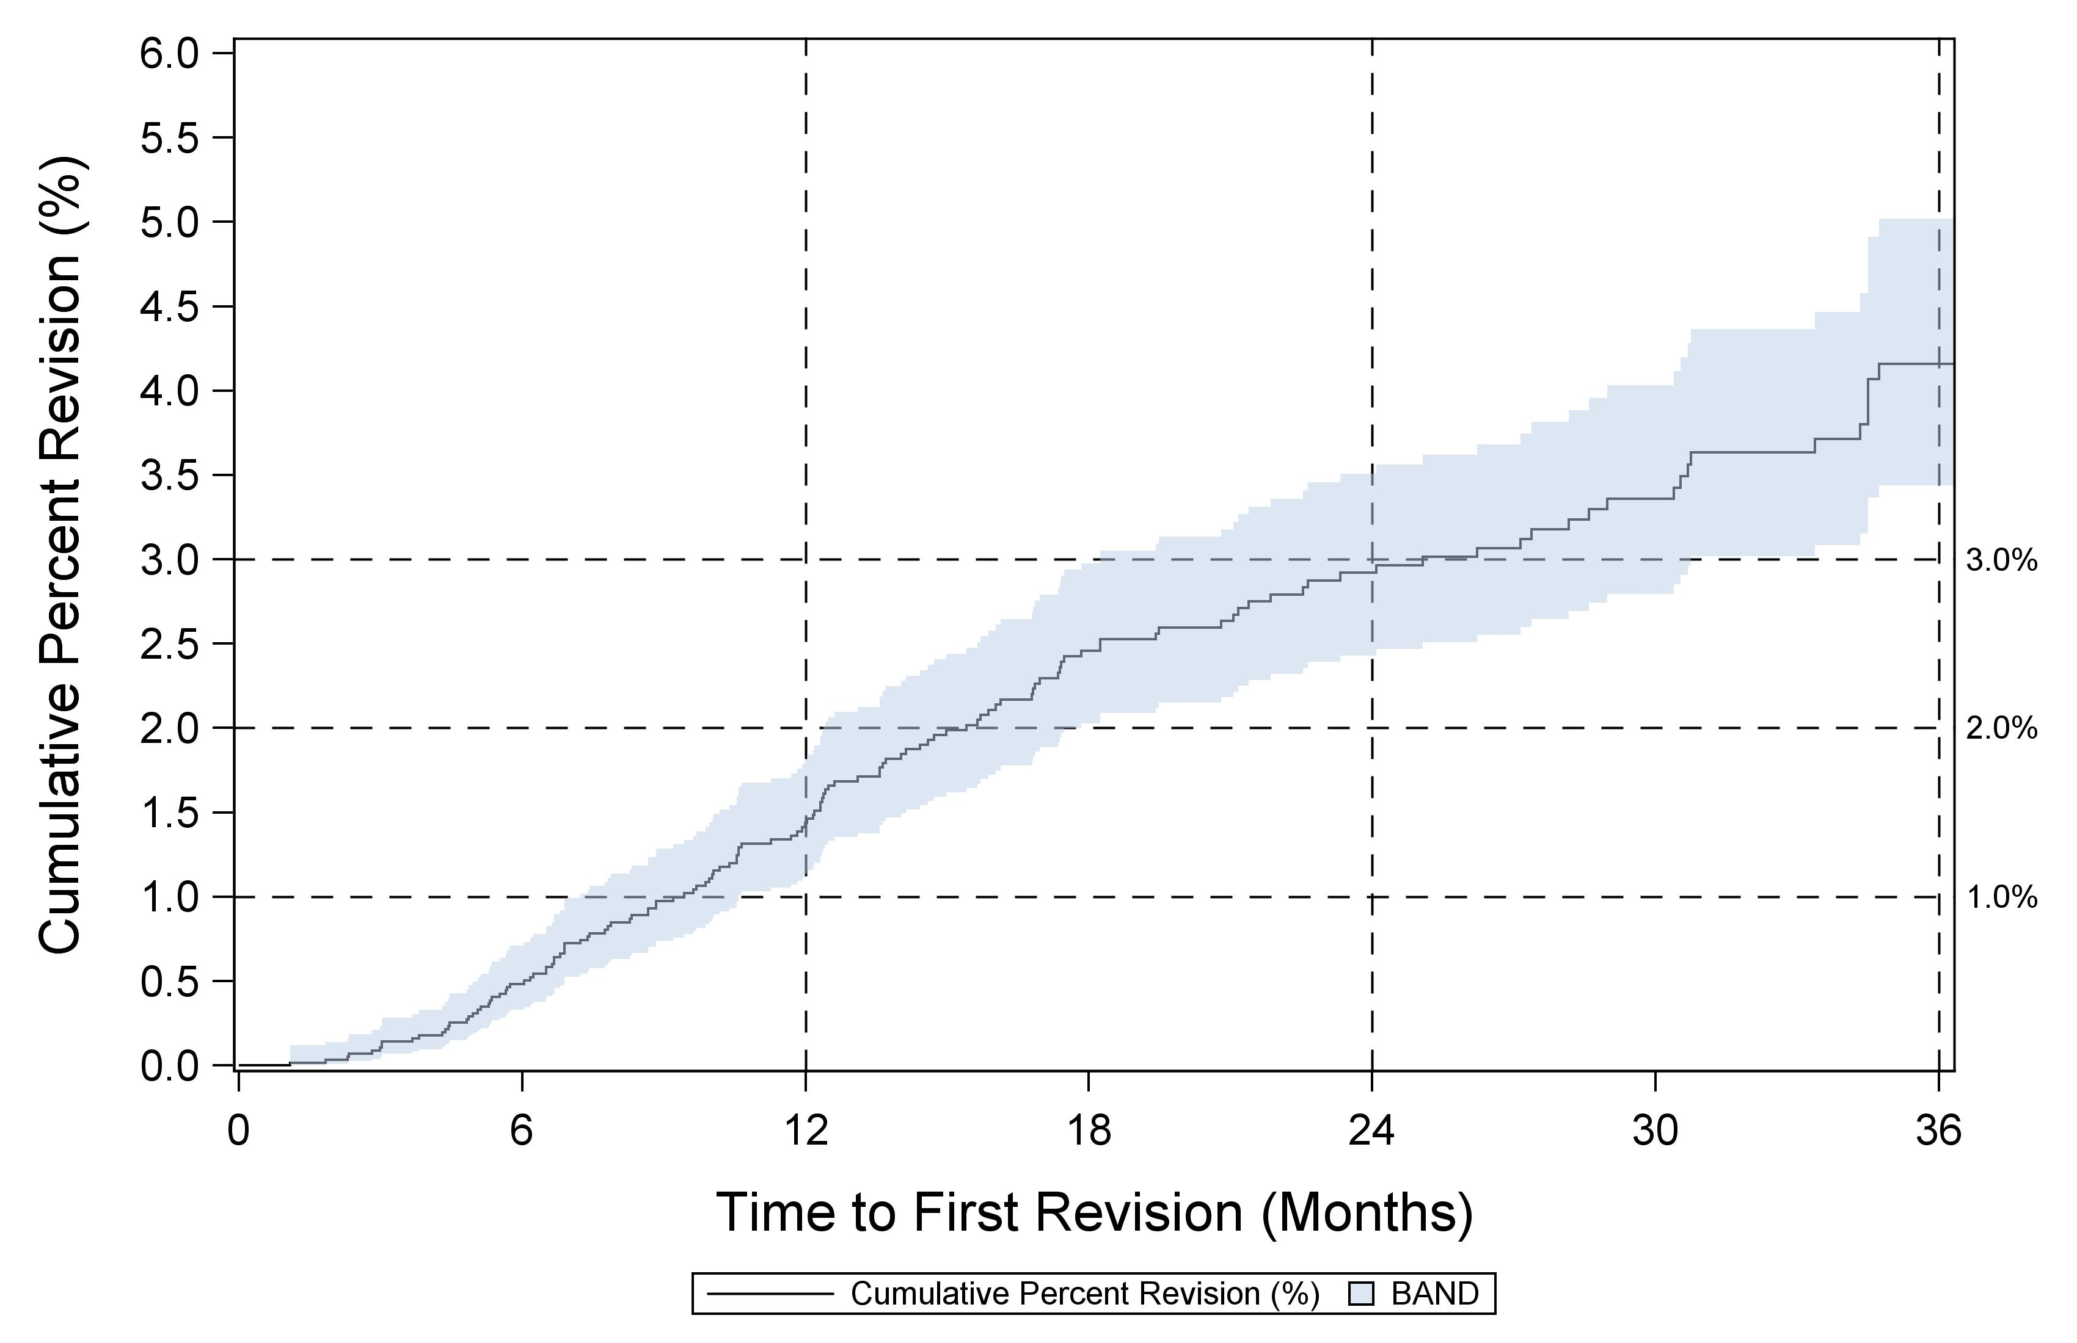
Figure 86: Cumulative percent revision for primary UKA

Slide 48
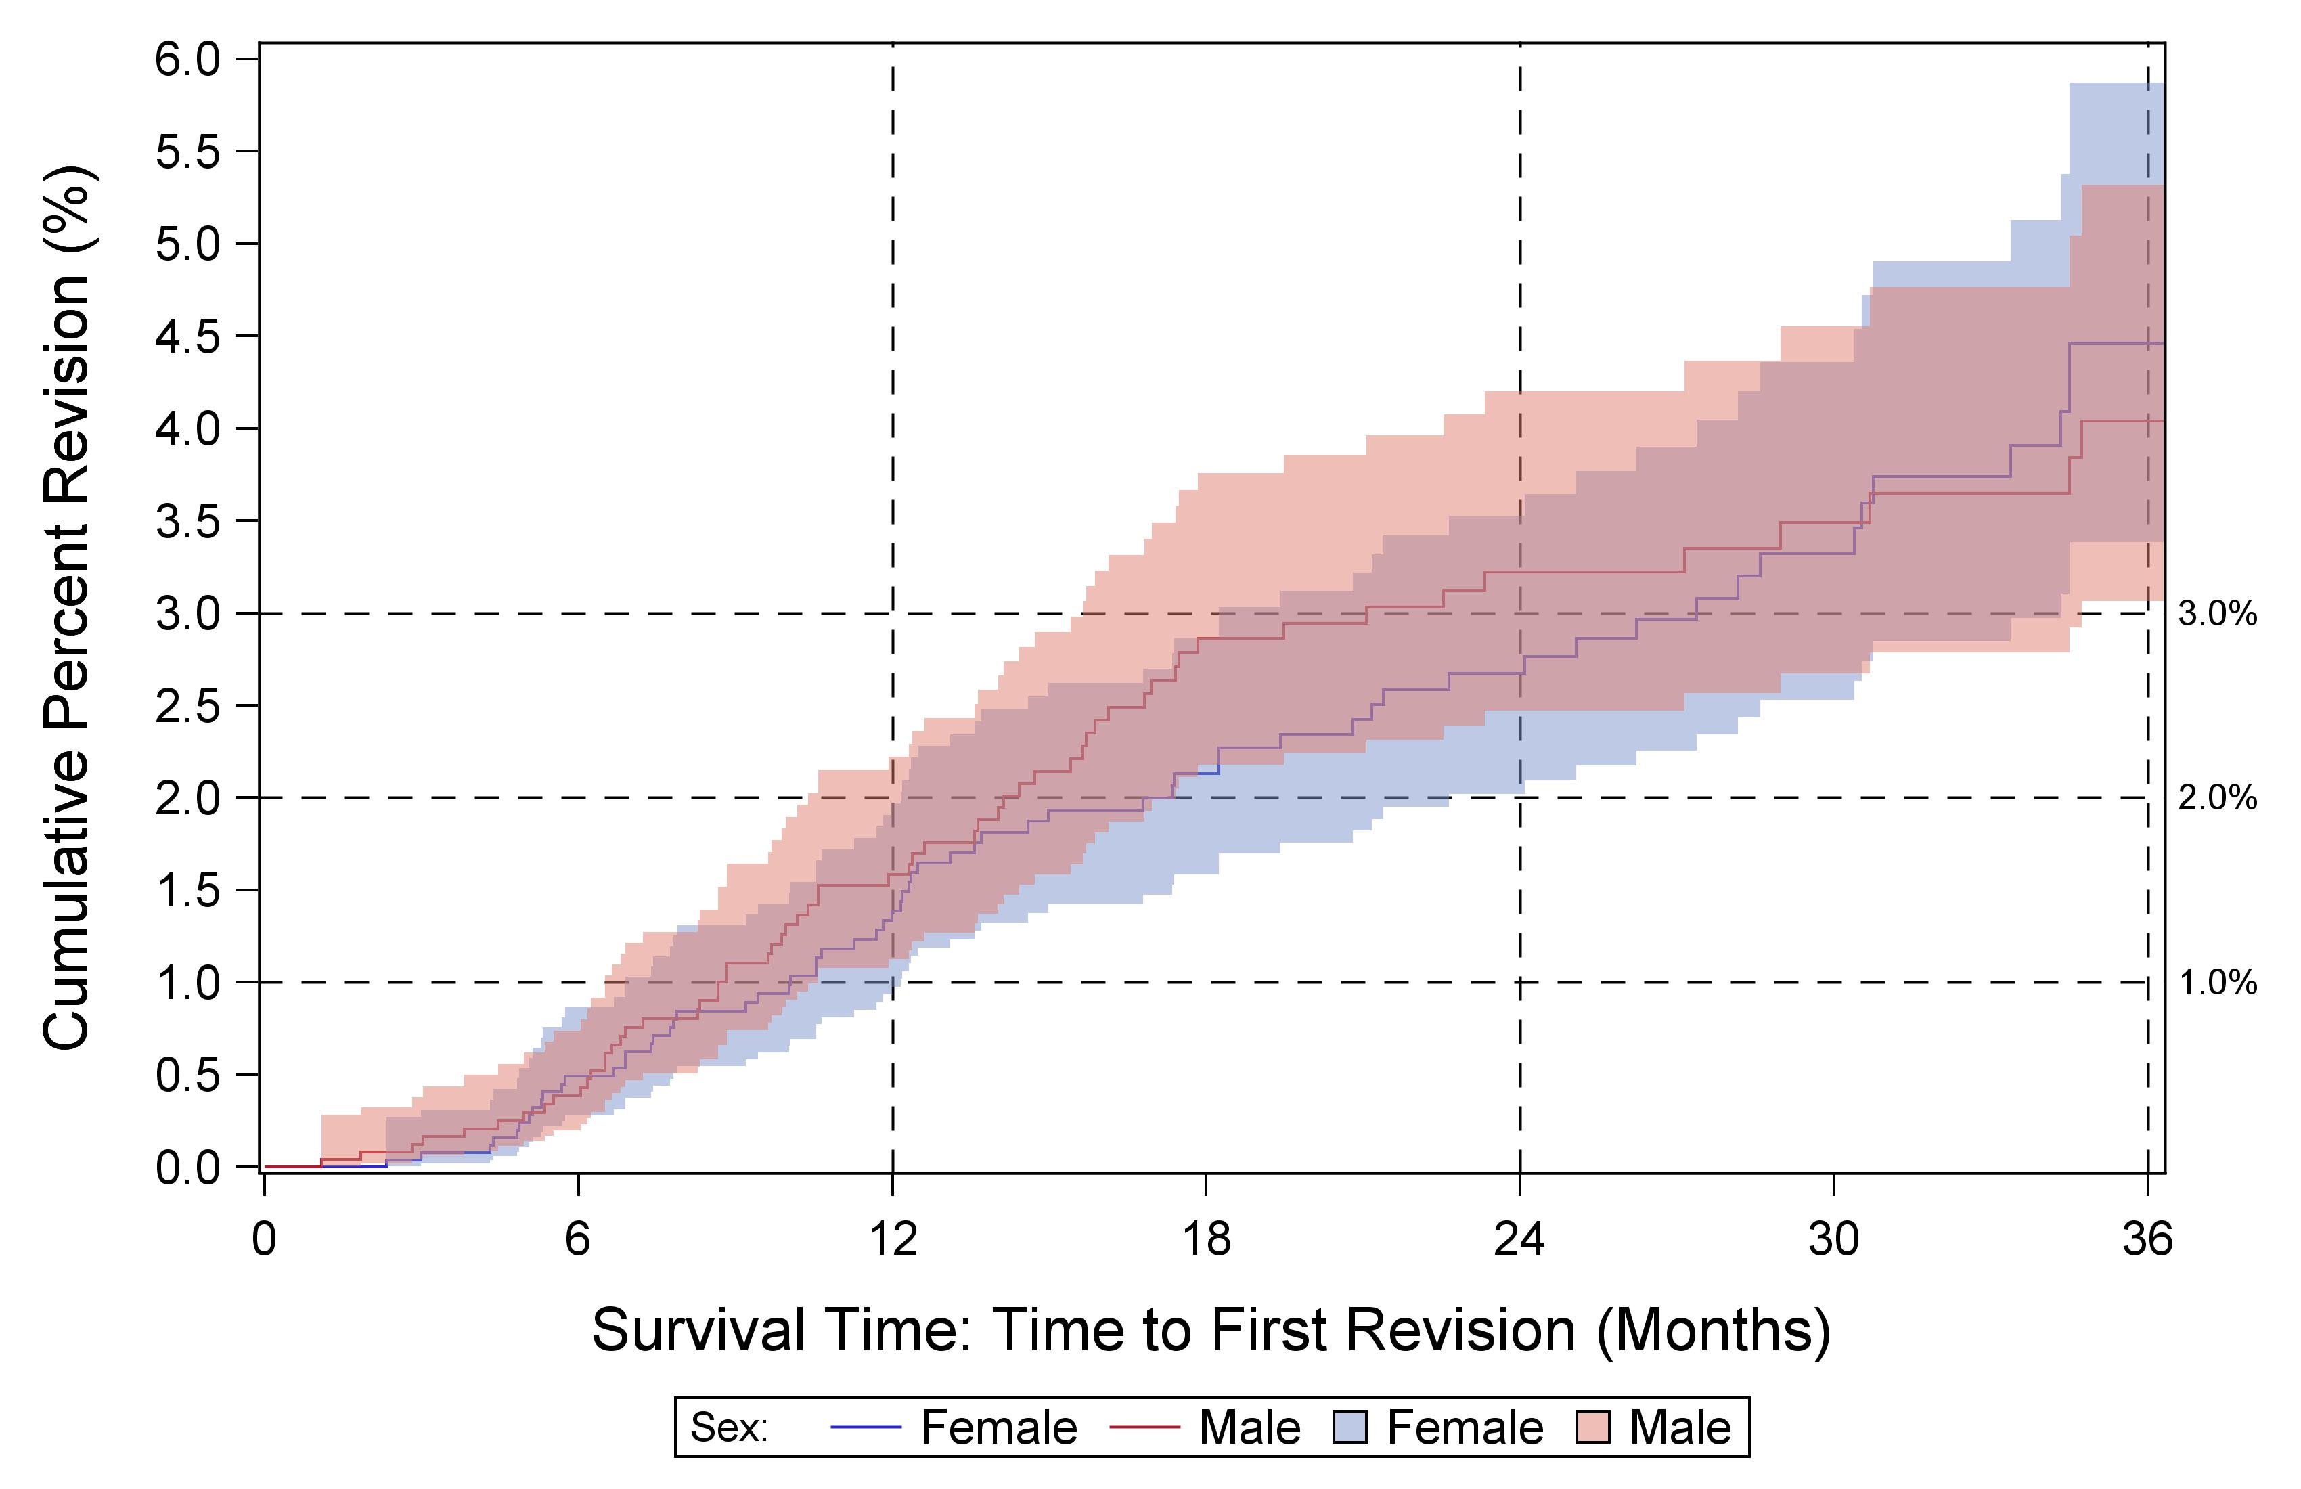
Figure 87: Cumulative percent revision for primary conventional UKA by sex for osteoarthritis diagnosis

Slide 49
Cumulative percent revision risk for UKA femoral/tibial combinations having at least 500 primary cases, sorted alphabetically

